Slide 1
The Firm’s Overall
Cost of Capital (WACC),
Capital Structure Considerations
FIN 300

Slide 2
Discussion Topics
Discuss the inputs for the firm’s cost of capital. In practice how do you measure the inputs to the cost of capital?
How to calculate the WACC?
Revisit different discount rates used in the dividend discount model vs the FCF discount model
How does the use of debt affect a firm’s returns?
Discuss within firm and within industry variation in use of debt.
Introduce M&M Theorem to focus on financing issues.
  Add taxes
  Add financial distress
Calculate the change in firm value associated with increases in debt.

Slide 3
WACC – the weighted average cost of capital from the various sources of financing
The firm can access different sources of financing (capital) via debt and equity channels.
Each source of capital is associated with a different “cost” (a different rate of return).
The overall “cost of capital” for the firm is a weighted average of these individual rates.

Slide 4
Sources of capital
The main sources of capital…
  Common Stock
  Preferred Stock (we will ignore this source in FIN 300)
  Debt
Each of these sources has a different rate of return. These are known as the “cost of equity”, “cost of preferred stock”, and the “cost of debt”. (r_{E}, r_{PS}, and r_{D})

Slide 5
Market-value balance sheet
Assets | Debt
 | Common Equity
Q: In what sense does it “balance”?

Slide 6
Market-value balance sheet
Assets | Debt
 | Common Equity
r_{D}
r_{E}
r_{A}
Q: In what sense does it “balance”?
A: In dollars and in returns.

Slide 7
Cost of capital: common stock
One way to solve for the cost of equity is to use the CAPM.
Using IBM as the example:
CAPM: E[r_{IBM,E}] = r_{f} + B_{IBM,E}(r_{m}-r_{f})

Slide 8
What are these inputs to the CAPM in practice? E[r_{IBM,E}] = r_{f} + B_{IBM,E}(r_{m}-r_{f})
r_{f} : risk free rate
  3-month rate vs 10- or 20-year rate? (matching principle would suggest using a long-term rate to discount long-term cash flows)
B_{IBM,E} : equity beta calculated using equity returns
(r_{m}-r_{f}) : market risk premium (typically between 4-8%)

Slide 9
How do you measure the cost of debt in practice?
If… | Then …
If the firm has a sizeable amount of bonds outstanding and the bonds are traded… | ..the yield to maturity on a long-term, recently traded, no special feature bond can be used to estimate the cost of debt.
Notes:
Arguably, the ideal cost of debt number to use would be the forecasted rate on new debt issuance. But in practice this is hard to know.
While the cost of debt can be estimated easily for some firms, by looking up traded bonds, it can be more difficult for non-rated firms. The default spreads can be obtained from http://pages.stern.nyu.edu/~adamodar/New_Home_Page/datafile/ratings.htm

Slide 10
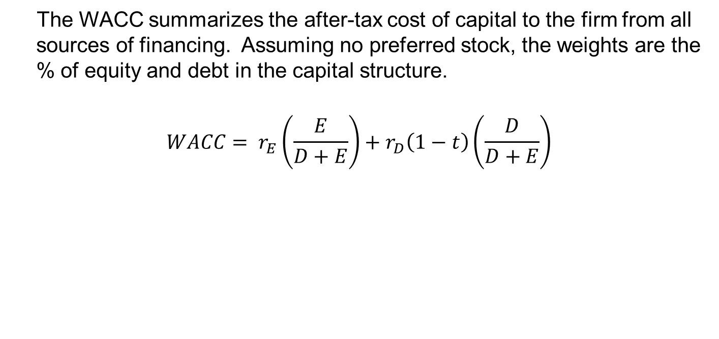
The weighted average cost of capital
The WACC summarizes the after-tax cost of capital to the firm from all sources of financing. Assuming no preferred stock, the weights are the % of equity and debt in the capital structure.
$$WACC= r_{E}\left(\frac{E}{D+E}\right)+r_{D}\left(1−t\right)\left(\frac{D}{D+E}\right)$$

Slide 11
WACC Example
In 2007 the market values of Alcoa’s stock and debt were $31,460 million and $7,397 million, respectively. The marginal tax rate was 35%.
Hence its total value was $31,460 million + $7,397 million = $38,857 million.
What was Alcoa’s 2007 WACC?

Slide 12
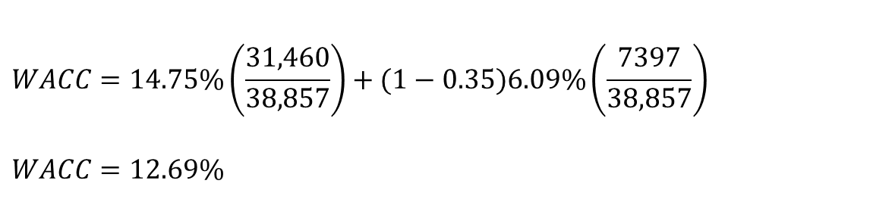

WACC Example, cont.
Assume $r_{E}=14.75\% , r_{D}=6.09\%$
Given the costs of common stock, preferred stock, and debt and the numbers on the previous slide, Alcoa’s WACC in late 2007 was
$$WACC=14.75\%\left(\frac{31,460}{38,857}\right)+(1−0.35)6.09\%\left(\frac{7397}{38,857}\right)$$
$$WACC=12.69\%$$

Slide 13
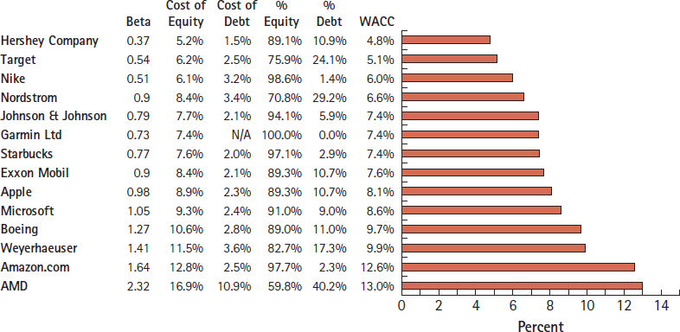
Example WACCs
Notes:
If you are interested in recent articles talking about companies WACCs see
https://www.forbes.com/sites/greatspeculations/2016/05/12/ranking-u-s-stocks-on-weighted-average-cost-of-capital/#30a7f07f41a6
http://people.stern.nyu.edu/adamodar/New_Home_Page/datafile/wacc.htm
This figure comes from Berk, Demarzo, and Harford’s Fundamentals of Corporate Finance and is based on publicly available information from 2016.

Slide 14
Miscellaneous points on cost of capital
The cost of debt should be estimated in the same currency as the cost of equity and the cash flows in the valuation.
The D and E references in the equations are all based on market values and not accounting book values.
In practice E is normally estimated by multiplying the number of outstanding common shares by the current share price.
In practice, if the firm is financially healthy with a good credit rating the market value of D is often estimated using the book value.

Slide 15
So when will you use the WACC as the discount rate?
When discounting FCFs to estimate the firm value.
When discounting new project cash flows if the project has risk like those previously undertaken by the firm

Slide 16
Cost of debt < WACC < cost of equity
Intuition:
When discounting cash flows always choose a discount rate that properly reflects the level of risk in those cash flows. (matching principle)
In general…
Use the cost of equity as discount rate for equity-related cash flows.
Use the cost of debt as the discount rate for debt-related cash flows.
Use the overall cost of capital (WACC) for overall firm cash flows (i.e. cash flows to both the debt and equity holders).

Slide 17
WACC summary
Know the formula:
WACC = D/(D+E) x r_{D} (1-t)+ E/(D+E) x r_{E}
Know what each of the WACC inputs are
Where possible, always use market information for the rates and proportions.
The WACC is the appropriate discount rate for FCFs at the firm-level. WACC is not the correct discount rate for project cash flows that are either more or less risky than the overall firm.

Slide 18
Concept check - Firm value
The firm value is the present value of what types of cash flows?
What is the appropriate discount rate for these cash flows?
If a firm has no debt, is the firm value the same as the equity value?
Why does the WACC formula include a (1-t) term?
How do you convert an EBIT number to a free cash flow number?
Free cash flows extend indefinitely into the future. How do terminal values make the analysis more tractable?
What would you need to do to the firm value in order to use it to then calculate the value of a single share of stock?

Slide 19
Review terminology for your personal study
(some of these terms are in the assigned reading)
You should be able to give a 1-2 sentence description, or formula, of each of these terms.
WACC WACC inputs | Cost of equity Cost of debt FCFs

Slide 20
Discussion Topics
Discuss the inputs for the firm’s cost of capital. In practice how do you measure the inputs to the cost of capital?
How to calculate the WACC?
Revisit different discount rates used in the dividend discount model vs the FCF discount model
How does the use of debt affect a firm’s returns?
Discuss within firm and within industry variation in use of debt.
Introduce M&M Theorem to focus on financing issues.
  Add taxes
  Add financial distress
Calculate the change in firm value associated with increases in debt.

Slide 21

Uber Boosts Bond Sale to $2 Billion With Orders Swelling
-- Bloomberg October 16, 2018
Uber Technologies Inc. increased the size of its debut bond offering as orders for the private placement swelled in a market hungry for deals, according to people with knowledge of the sale.
The ride-hailing firm set final terms for the debt including a $1.5 billion portion of eight-year bonds and $500 million of five-year securities, the people said.

Slide 22

Why debt and not equity?
… Or why equity and not debt?

Slide 23
Debt vs Equity
Debt vs. Equity A general comparison
Debt | Equity
Must be repaid or refinanced. | Can usually be kept permanently.
Requires regular interest payments. Failure to pay can trigger bankruptcy. | No payment requirements. May receive dividends, but only out of retained earnings.
Collateral may be required. | No collateral required.
Interest payments are tax deductible. | Dividend payments are not tax deductible.
Debt does not dilute voting control (except in bankruptcy). | New shareholders share control of the company.
Debt leverages company profits. | Shareholders share the company profits.

Slide 24
Example of how EPS is affected with and without leverage: All Equity Scenario
Consider 4 possible
outcomes (A-D)
Expected outcome
Notes:
5

Slide 25
Example of how EPS is affected with and without leverage: 50% Debt 50% Equity Scenario
Notes:
6
Under the 50% debt scenario the firm value is still $10000 (same as before) but now it divided into $5000 of debt and $5000 of equity.
This implies that there are only 500 shares outstanding rather than 1000.
EPS = equity earnings/number of shares
Return on shares = equity earnings/5000

Slide 26
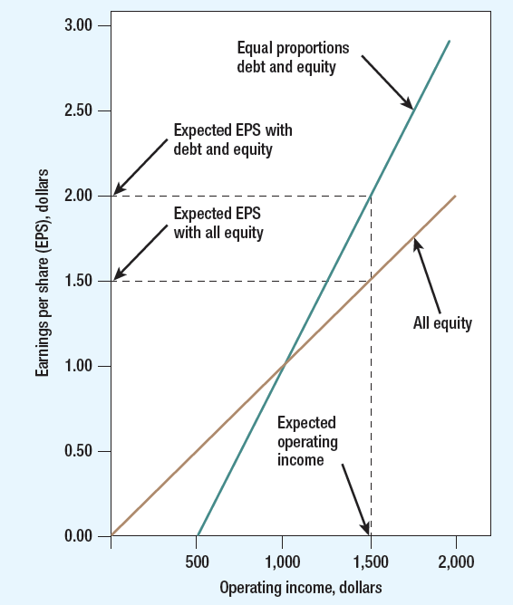
The effect of leverage on EPS from prior example

Slide 27
First capital structure observation: Even though firms within the same industry normally have similar capital structures, there variation within industries.
Hence firms in the same industry can sometimes have very different capital structures. For example, in 2008 …

Slide 28
Questions related to within industry variation…
Question: Why do some firms within an industry choose higher amounts of debt?
Possible firm-level related reasons: differences in management, exposure to bankruptcy, tax shields…
Related questions…
Do lower levels of debt imply better financial management?
What are the trade-offs between higher levels of equity versus higher levels of debt?

Slide 29
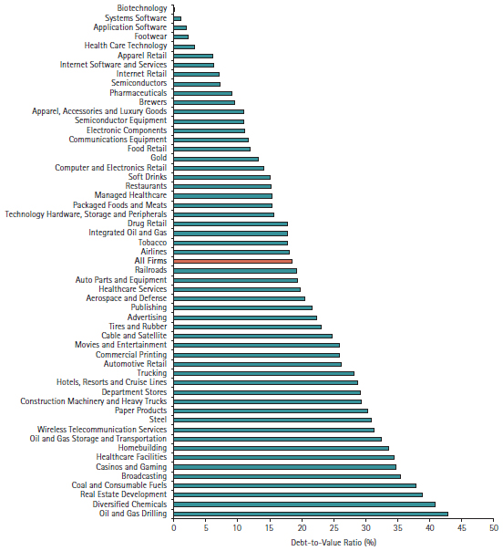
Second capital structure observation: Capital structures vary widely across industries
Notes:
This figure comes from Berk Demarzo and Harford’ Corporate Finance text

Slide 30
Questions related to variation across industries…
Why do capital structures vary across industries? What industry-level characteristics affect the decision of how much debt to use?

Slide 31
Discussion topics
Discuss the inputs for the firm’s cost of capital. In practice how do you measure the inputs to the cost of capital?
How to calculate the WACC?
Revisit different discount rates used in the dividend discount model vs the FCF discount model
How does the use of debt affect a firm’s returns?
Discuss within firm and within industry variation in use of debt.
Introduce M&M Theorem to focus on financing issues.
  Add taxes
  Add financial distress
Calculate the change in firm value associated with increases in debt.

Slide 32
M&M Proposition 1:
(“perfect capital market” assumptions)
If we assume:
a) No Taxes
b) No Transactions/Information Costs
(this includes no costs associated with bankruptcy)
c) Fixed Real Investment Policy
(investment choices are not affected by financing)
Then it follows that…

Slide 33
M&M Proposition 1 (continued):
Then it follows that…
The market value of the firm is independent of the choice of financing policy (i.e., there is no unique capital structure which maximizes firm value.)
Another way to say this:
The total value of a firm is equal to the market value of the free cash flows generated by its assets.

Slide 34
M&M Restated
(This shows the importance of M&M)
If and only if there are no taxes, no transaction costs and fixed real investment policy is used, does capital structure not matter.
→ Hence, if financing policy does affect the value of the firm, it will do so through at least one of these channels:
a) Taxes
b) Transactions/Information/ Costs
c) Investment Policy

Slide 35
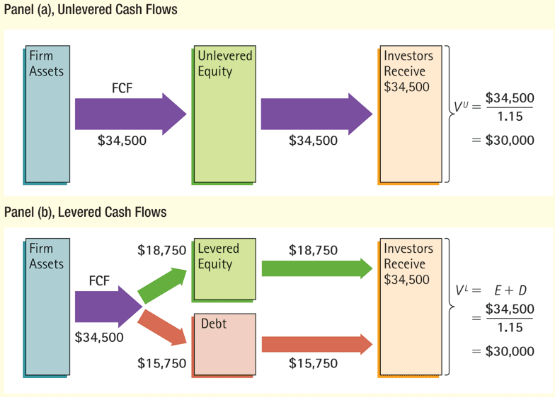
Figure 16.3 Unlevered Versus Levered Cash Flows with Perfect Capital Markets

Slide 36
M&M’s Proposition I
No matter how you divide up the cash flow between debt and equity, the total value (V_{L}=V_{U} = D + E) remains the same! (under certain assumptions)
It’s like pizza: The value depends on the real stuff, not how you slice it.
Which pizza is worth more?

Slide 37
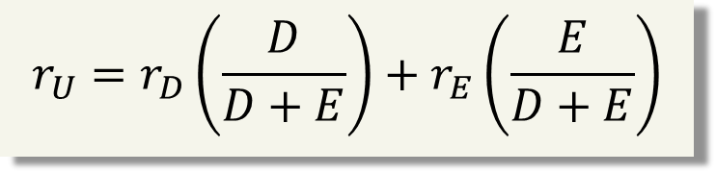
Without tax benefits to debt the firm’s cost of capital would be a simple weighted average
$$r_{U}=r_{D}\left(\frac{D}{D+E}\right)+r_{E}\left(\frac{E}{D+E}\right)$$

Slide 38
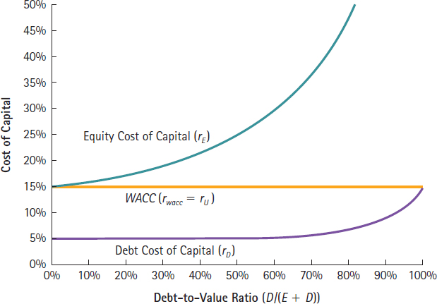
Figure 16.5: WACC and leverage with perfect capital market assumptions

Slide 39
Concept check
What does the M&M proposition I say? What are the assumptions involved?
Your friend says “M&M’s assumptions are not realistic. Hence their proposition doesn’t have much real-world importance.” Evaluate this statement.

Slide 40
Debt provides tax benefits
When you borrow money, you are allowed to deduct interest expenses from your income to arrive at taxable income. This reduces your taxes.
The dollar tax benefit from the interest payment in any year is a function of your tax rate and the interest payment:
  Tax benefit each year = Tax Rate * Interest Payment
This implies that firm value will be affected by how much debt is used because the “tax benefits” are valuable.

Slide 41
Interest deduction and firm value
Consider the impact of interest expenses on taxes paid by Kroger, Inc.
  In 2015, Kroger had EBIT of $3.58 billion
  Interest expenses of $480 million
  Corporate tax rate is 35%
  Compare Kroger’s actual net income with what it would have been without debt

Slide 42
Kroger’s Income with and without Leverage, 2015 ($ millions)
Blank | With Leverage | Without Leverage
EBIT | $3580 | $3580
Interest expense | −480 | 0
Income before tax | 3100 | 3580
Taxes (35%) | −1085 | −1253
Net income | $2015 | $2327
Total amount available to all investors is:
Blank | With Leverage | Without Leverage
Interest paid to debt holders | 480 | 0
Income available to equity holders | 2015 | 2327
Total available to all investors | $2495 | $2327

Slide 43
Example:
Computing the interest tax shield
Shown on the next slide is the income statement for E. C. Builders (ECB). Given its marginal corporate tax rate of 35%, what is the amount of the interest tax shield for ECB in years 2010 through 2013?

Slide 44
Example, continued
ECB Income Statement ($ million) | 2010 | 2011 | 2012 | 2013
Total Sales | $3369 | $3706 | $4077 | $4432
Cost of Sales | −2359 | −2584 | −2867 | −3116
SG&A | −226 | −248 | −276 | −299
Depreciation | −22 | −25 | −27 | −29
Operating income | 762 | 849 | 907 | 988
Other income | 7 | 8 | 10 | 12
EBIT | 769 | 857 | 917 | 1000
Interest expense | −50 | −80 | −100 | −100
Income before tax | 719 | 777 | 817 | 900
Taxes (35%) | −252 | −272 | −286 | −315
Net Income | $467 | $505 | $531 | $585

Slide 45
Example, continued
($ million) | 2010 | 2011 | 2012 | 2013
Interest expense | 50 | 80 | 100 | 100
Interest tax shield (35% × interest expense) | 17.5 | 28 | 35 | 35
By using debt, ECB is able to reduce its taxable income and therefore decrease its total tax payments by $115.5 million over the four-year period.
Thus, the total amount of cash flows available to all investors (debt holders and equity holders) is $115.5 million higher over the four-year period.

Slide 46
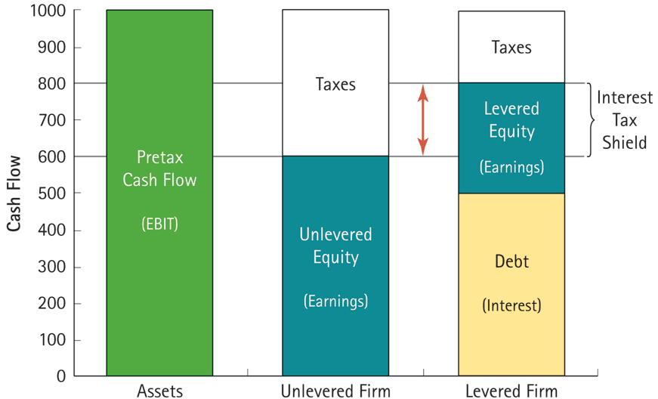
46

Slide 47
Example 2:
Computing the interest tax shield
Shown on the next slide is the income statement for Dalton Asphalt Painters (DAP). Given its marginal corporate tax rate of 35%, what is the amount of the interest tax shield for DAP in years 2014 through 2017?

Slide 48
Example 2, continued
DAP Income Statement ($ million) | 2014 | 2015 | 2016 | 2017
Total Sales | 2752 | 2890 | 3236 | 3625
Cost of Sales | −2215 | −2326 | −2605 | −2917
SG&A | −125 | −131 | −147 | −165
Depreciation | −10 | −11 | −12 | −13
Operating income | 402 | 422 | 473 | 529
Other income | 5 | 2 | 1 | 7
EBIT | 407 | 424 | 474 | 536
Interest expense | −20 | −25 | −25 | −30
Income before tax | 387 | 399 | 449 | 506
Taxes (35%) | −135 | −140 | −157 | −177
Net Income | 252 | 259 | 292 | 329

Slide 49
Example 2, continued
The interest tax shield each year is calculated at the tax rate times interest expense
($ million) | 2014 | 2015 | 2016 | 2017
Interest expense | 20 | 25 | 25 | 30
Interest tax shield (35% × interest expense) | 7 | 8.75 | 8.75 | 10.5

Slide 50
How is the market value of the firm affected by the tax savings?
Important Intuition: The market value of the firm is different with and without debt. The “levered” value tends to be larger than the “unlevered” value because of the value of the taxes saved.
Note that the above formula is incomplete because it doesn’t include the negative effects of having too much debt. Later in the slide set, the negative costs are considered too.
Notes:
Firm value with leverage = (firm value without leverage) + (present value of all tax savings over time)
This formula assumes there are no costs to having debt in the capital structure.

Slide 51
How is the market value of the firm affected by the tax savings?
If the firm’s marginal tax rate (T_{C}) is constant, we have the following general formula:
  PV(Interest Tax Shield) = PV(T_{C} × Future Interest Payments)
  =T_{C} × PV(Future Interest Payments)
  =T_{C} × D
  (Eq. 16.7)

Slide 52
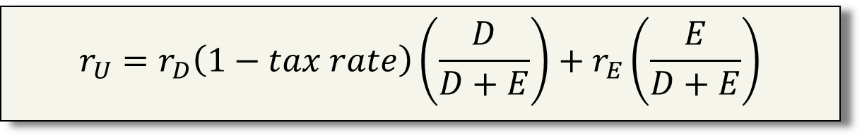
Weighted Average Cost of Capital with Taxes
$$r_{U}=r_{D}\left(1−tax rate\right)\left(\frac{D}{D+E}\right)+r_{E}\left(\frac{E}{D+E}\right)$$

Slide 53
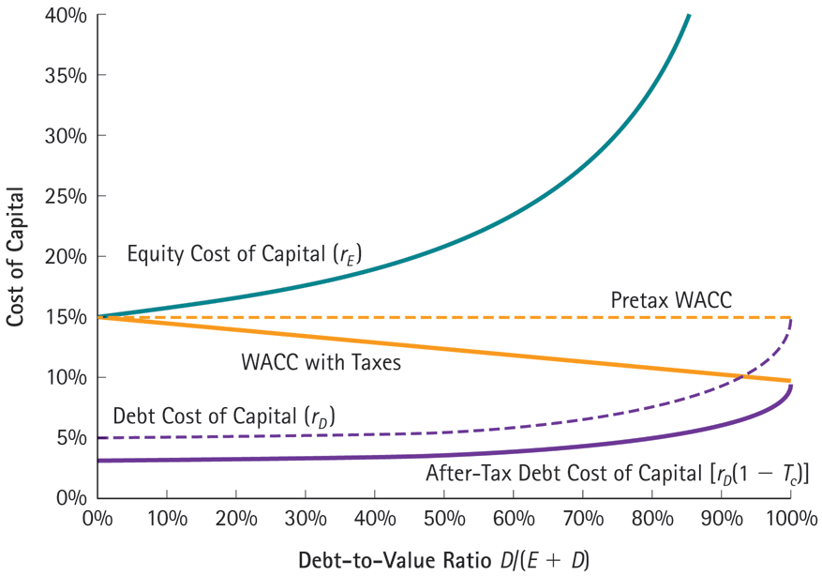
Figure 16.7:
The WACC with and without Corporate Taxes

Slide 54
Discussion topics
Discuss the inputs for the firm’s cost of capital. In practice how do you measure the inputs to the cost of capital?
How to calculate the WACC?
Revisit different discount rates used in the dividend discount model vs the FCF discount model
How does the use of debt affect a firm’s returns?
Discuss within firm and within industry variation in use of debt.
Introduce M&M Theorem to focus on financing issues.
  Add taxes
  Add financial distress
Calculate the change in firm value associated with increases in debt.

Slide 55
Financial distress:
“You can lose the pizza, too”
Examples of financial distress costs:
  Legal costs
  Managers’ time
  Employee disruption
  Lost trade credit
  Lost sales
Main idea: Getting into distress burns up real resources

Slide 56
Financial distress ≠ Bankruptcy ≠ Liquidation
Bankruptcy: “A legally declared inability or impairment of ability of an individual or organizations to pay their creditors…”
Liquidation: “The process by which a company (or part of a company) is brought to an end, and the assets and property of the company redistributed.”
Financial distress: “A condition when promises to creditors of a company are broken or honored with difficulty. Sometimes financial distress can lead to bankruptcy…”
Notes:
Average direct costs are 3% to 4% of the pre−bankruptcy market value of total assets

Slide 57
Concept check
V_{L} = V_{U} + t * D - PV(Financial distress)
What is V_{L}?
How is V_{L} related to V_{U}?
What does t*D represent?
How might you get a sense of how much the PV of financial distress costs equals?

Slide 58
Summary of main ideas:
Using debt has benefits …
  Lower corporate taxes
  Aggressive financing can signal managers’ favorable information
  Financial leverage can increase shareholders’ returns
And costs …
  Risk and costs of default
  Constraints from bond covenants
  Less financing flexibility
  Possible perverse investment incentives (agency costs of debt)
So managers need to try to balance the benefits
with the costs for their firm

Slide 59
Why (when?) is the debt tax shield = t*D?
Assumptions:
Interest expense this year = r_{D}* D
Tax savings this year = t * r_{D}* D
These savings occur every year (in perpetuity)
r_{D} measures the riskiness of the annual tax shield
If all of these assumptions hold then the PV of the annual tax shield = (t * r_{D}* D) ÷ r_{D} = t * D

Slide 60
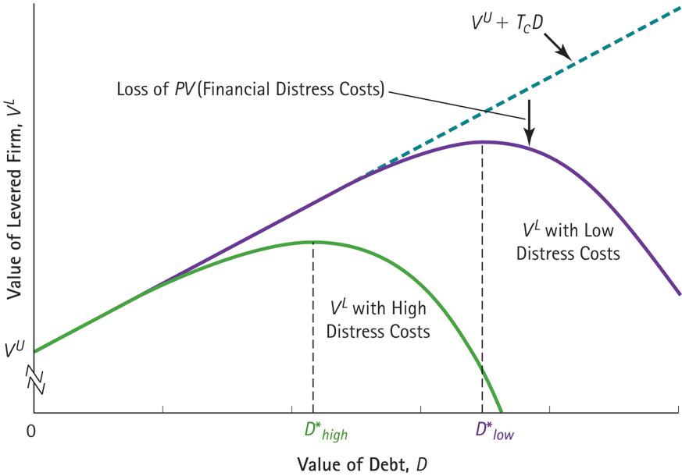
Figure 16.8: Optimal Leverage with Taxes and Financial Distress Costs

