Slide 1
Review of FIN 300 topics (part 1)
FIN 300 – Principles of Finance
Professor Schonlau

Slide 2
Discussion Topics
We will spend the time in class today going through key takeaways from the lectures that covered the topics in PowerPoint files 1 - 10.
We won’t have time to go into detail about everything, but our class discussion is intended to help you remember some of the key points from the first half of the semester.
As part of our discussion, I will highlight the topics from these lectures that might appear on the final exam.

Slide 3
Example review questions related to PowerPoint file 1
What are the 4 types of firms we talked about in class?
What are some distinguishing characteristics of these types of firms?
What should be the overarching goal of a manager’s decision making?
What is a “fiduciary duty”? Managers have a fiduciary duty to whom?
What is the relationship between real and nominal rates?
What is the CPI? How is it used to solve for inflation?
What types of conditions would lead the Fed to lower or increase interest rates?
What is the yield curve? Why do short-term rates change? What information does the shape provide?

Slide 4
Four types of firms
Sole Proprietorships
Partnerships
Limited Liability Companies
Corporations

Slide 5
Table 1.1: Characteristics of the Different Types of Firms
 | Number of Owners | Liability for Firm’s Debts | Owners Manage the Firm | Ownership Change Dissolves Firm | Taxation
Sole Proprietorship | One | Yes | Yes | Yes | Personal
Partnership | Unlimited | Yes; each partner is liable for the entire amount | Yes | Yes (firm ends with death or withdrawal of any partner*) | Personal
Limited Partnership | At least one general partner (GP), no limit on limited partners (LP) | GP-Yes LP-No | GP-Yes LP-No | GP-Yes LP-No | Personal
Notes:
* Partners can avoid liquidation if the partnership agreement provides for alternatives such as a buyout of a deceased or withdrawn partner

Slide 6
Table 1.1 (cont.): Characteristics of Different Types of Firms
 | Number of Owners | Liability for Firm’s Debts | Owners Manage the Firm | Ownership Change Dissolves Firm | Taxation
Limited Liability Company | Unlimited | No | Yes | No* | Personal
S Corporation | At most 100 | No | No (but they legally may) | No | Personal
C Corporation | Unlimited | No | No (but they legally may) | No | Double
*However, most LLCs require the approval of the other members to transfer your ownership.

Slide 7
Information based on IRS data (Figure 1.1) Types of U.S. Firms
 | Percent of Businesses | Percent of Revenue
Sole Proprietorships | 72.0% | 3.6%
Corporations | 17.6% | 81.6%
LLC | 6.8% | 8.6%
Partnerships | 3.5% | 6.2%

Slide 8
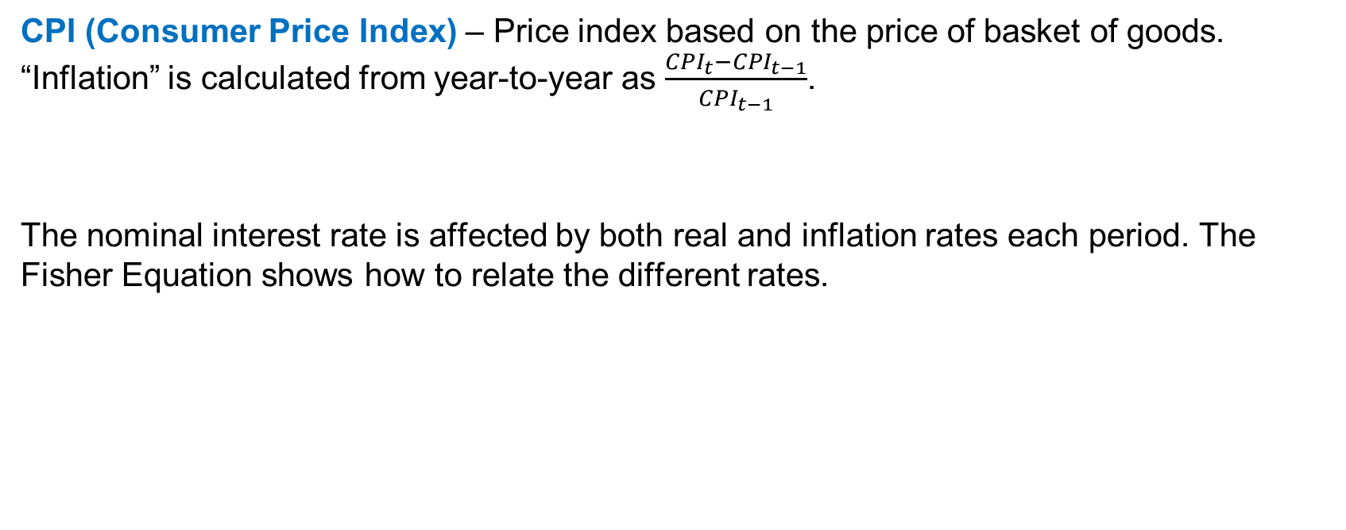
Inflation, nominal rates, real rates, CPI
CPI (Consumer Price Index) – Price index based on the price of basket of goods. “Inflation” is calculated from year-to-year as $\frac{{CPI}_{t}−{CPI}_{t−1}}{{CPI}_{t−1}}$.
The nominal interest rate is affected by both real and inflation rates each period. The Fisher Equation shows how to relate the different rates.
(1+ nominal rate) = (1+ real rate) *(1+ inflation rate)
Notes:
CPI measures price change from the perspective of the consumer.
PPI measures price change from the perspective of the seller.

Slide 9
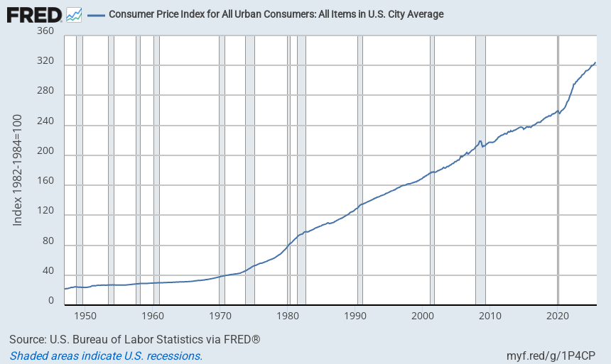
CPI level across time.
The 1982-1984 CPI level was set to 100.

Slide 10
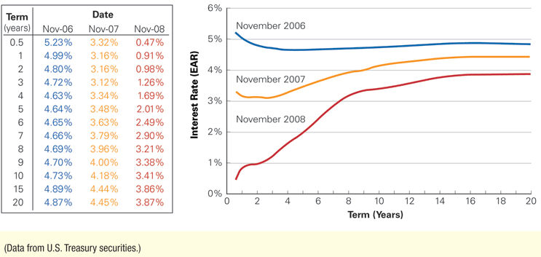
Figure 5.3 Term Structure of Risk-Free U.S. Interest Rates, November 2006, 2007, and 2008
Notes:
To see the yield curve across time: https://stockcharts.com/freecharts/yieldcurve.php

Slide 11
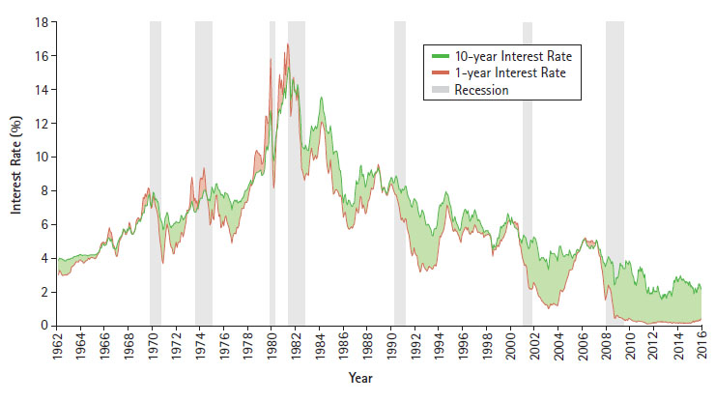
Figure 5.5 Short- versus Long-Term U.S. Interest Rates and Recessions
Notes:
One-year and 10-year U.S. Treasury rates are plotted, with the spread between them shaded in green if the shape of the yield curve is increasing (the one-year rate is below the 10-year rate) and in red if the yield curve is inverted (the one-year rate exceeds the 10-year rate). Gray bars show the dates of U.S. recessions as determined by the National Bureau of Economic Research. Note that inverted yield curves tend to precede recessions as determined by the National Bureau of Economic Research. In recessions, interest rates tend to fall, with short-term rates dropping further. As a result, the yield curve tends to be steep coming out of a recession.

Slide 12
Term structure of interest rates (or yield curve)
The term structure is the set of interest rates for various maturities for a particular risk class of bonds.
Example yield curve
r
.09
.08
.06
1 2 3 years

Slide 13
Example review questions related to PowerPoint file 2
What is the difference between simple and compound interest?
What TVM formulas move single cash flows through time?
How do the above formulas change to accommodate interest that is assessed monthly?
Can you calculate the present value and/or future value of a cash flow?

Slide 14
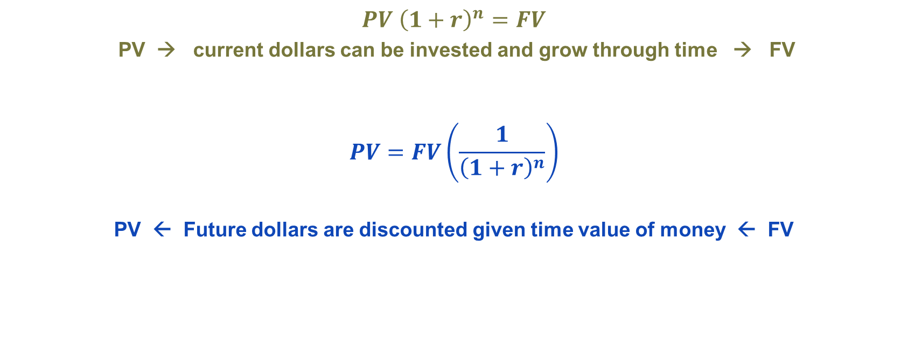
TVM terminology (single cash flows)
“interest factor”
$PV {\left(1+r\right)}^{n}=FV$
PV → current dollars can be invested and grow through time → FV
$$PV=FV\left(\frac{1}{{\left(1+r\right)}^{n}}\right)$$
PV ← Future dollars are discounted given time value of money ← FV
“discount factor”

Slide 15
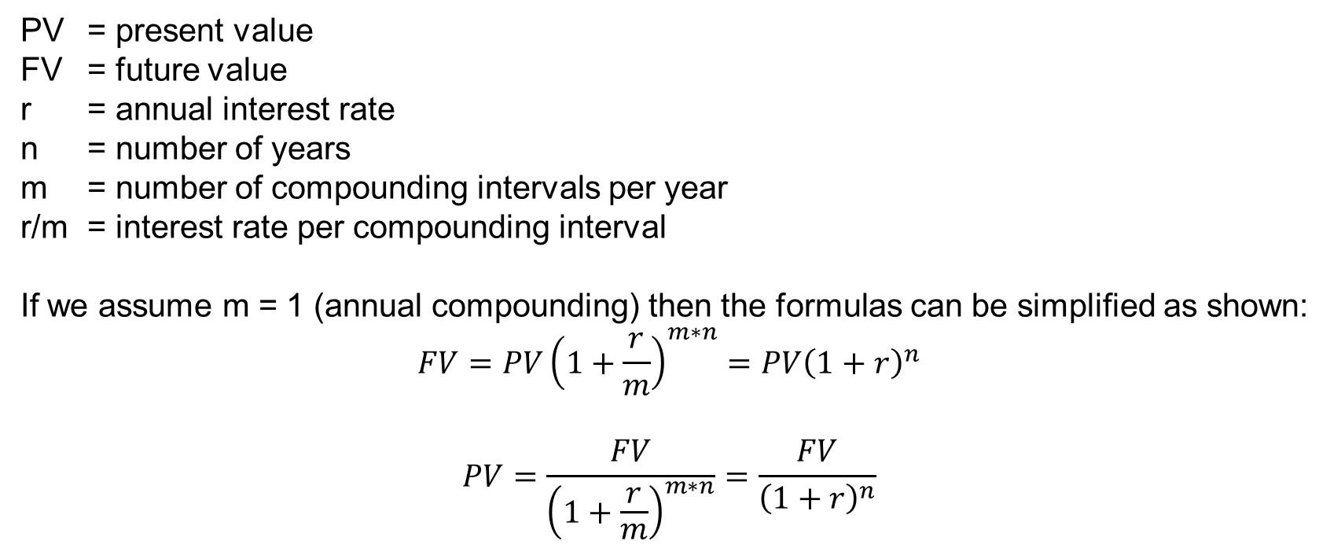
These formulas move a single cash flow through time.
PV = present value
FV = future value
r = annual interest rate
n = number of years
m = number of compounding intervals per year
r/m = interest rate per compounding interval
If we assume m = 1 (annual compounding) then the formulas can be simplified as shown:
$$FV=PV{\left(1+\frac{r}{m}\right)}^{m∗n}=PV{\left(1+r\right)}^{n}$$
$$PV=\frac{FV}{{\left(1+\frac{r}{m}\right)}^{m∗n}}=\frac{FV}{{\left(1+r\right)}^{n}}$$
Notes:
Note: These formulas are used when you have a single cash flow to move through time as opposed to a stream of cash flows.

Slide 16

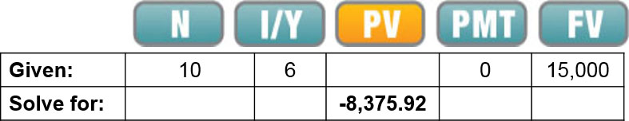
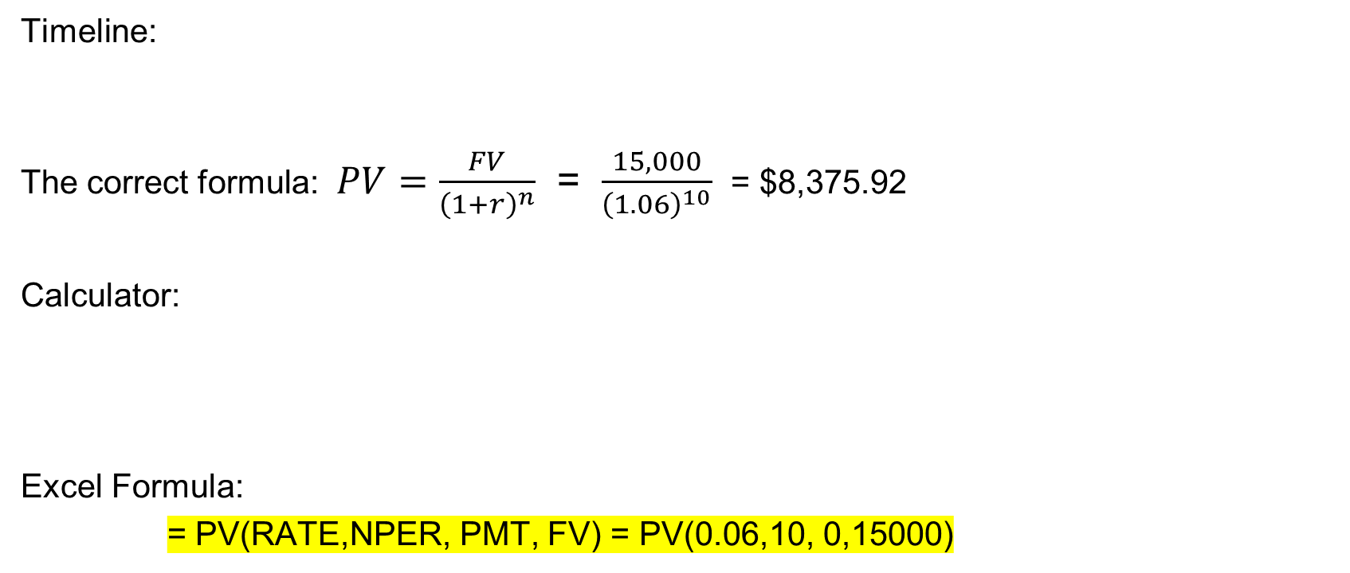
Example: You are considering investing in a savings bond that will pay $15,000 in 10 years. If the interest rate is 6% per year, what is the bond worth today?
Timeline:
The correct formula: $PV=\frac{FV}{{\left(1+r\right)}^{n}}$ = $\frac{15,000}{{\left(1.06\right)}^{10}}$ = $8,375.92
Calculator:
Excel Formula:
= PV(RATE,NPER, PMT, FV) = PV(0.06,10, 0,15000)
Notes:
In the textbook the Chapter 4 appendix talks about using the TVM functions on different types of calculators.

Slide 17
Example review questions related to PowerPoint file 3
What is the difference between an annuity, annuity due, and a perpetuity?
Which TVM formulas move streams of cash flows through time?
Can you calculate the present value and/or the future value of a stream of cash flows?

Slide 18
Terminology for streams of payments
Annuity – a series of identical fixed payments to be made for a specified number of years.
Perpetuity – a series of identical fixed payments to be made forever.
“Growing annuities” and “growing perpetuities” reflect streams of payments where each successive payment is a certain percentage higher than the prior payment.

Slide 19
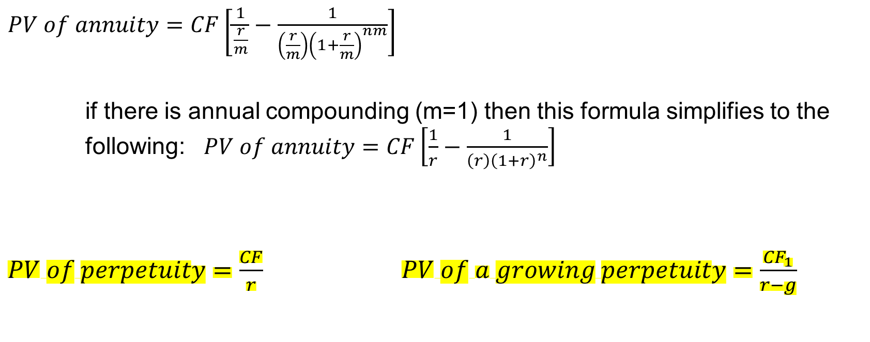
TVM formulas for annuities and perpetuities
$PV of annuity=CF\left[\frac{1}{\frac{r}{m}}−\frac{1}{\left(\frac{r}{m}\right){\left(1+\frac{r}{m}\right)}^{nm}}\right]$
if there is annual compounding (m=1) then this formula simplifies to the following: $PV of annuity=CF\left[\frac{1}{r}−\frac{1}{\left(r\right){\left(1+r\right)}^{n}}\right]$
$PV of perpetuity=\frac{CF}{r}$ $PV of a growing perpetuity=\frac{{CF}_{1}}{r−g}$

Slide 20

Future value of an annuity
In Excel:=FV(rate,nper,pmt) =FV(0.05,40,1000)
Suppose you invest $1,000 a year for the next 40 years at 5%. The first payment will be made in one year. How much will you have in your investment fund at the end of 40 years?
Suggested approach:
  1. Use the PV of an annuity formula to calculate the PV of these CFs.
  2. Then multiply by a 40-year interest factor
  FV = 1000$\left[\frac{1}{r}−\frac{1}{r{\left(1+r\right)}^{40}}\right]∗{\left(1+r\right)}^{40}=\$120,799.77$

Slide 21
Example review questions related to PowerPoint file 4
How are APRs and EARs similar? How are they different?
How do you convert an APR to and EAR?

Slide 22
Two common ways to annualize returns: APRs and EARs
Returns are quoted in a variety of ways. Annual percentage rates (APRs) ignore compounding and effective annual rates (EARs) include compounding.
EARs represent actual growth rates while APRs do not. When a return is an actual growth rate, we call it an “effective” return. EARs are sometimes referred to as APYs.
Important intuition: An account that says pays a 10% APR will not actually grow your deposit by 10% over a year if there is compounding during that year.

Slide 23
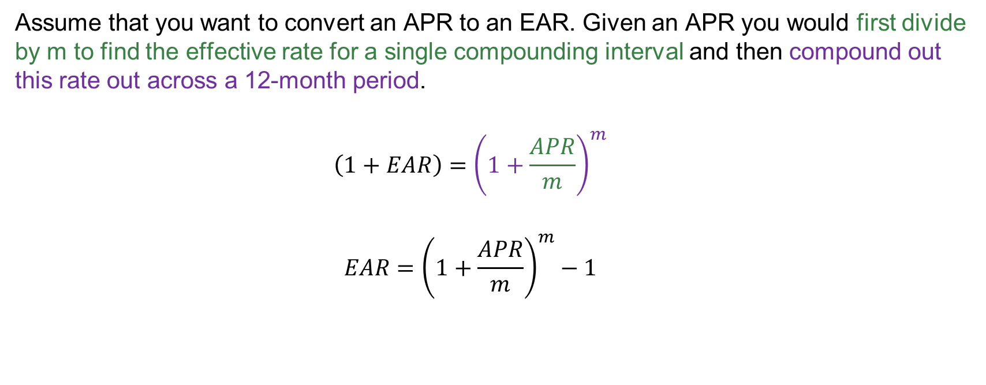
Calculating EARs from APRs
Assume that you want to convert an APR to an EAR. Given an APR you would first divide by m to find the effective rate for a single compounding interval and then compound out this rate out across a 12-month period.
  $$\left(1+EAR\right)={\left(1+\frac{APR}{m}\right)}^{m}$$
  $$EAR={\left(1+\frac{APR}{m}\right)}^{m}−1$$
Notes:
This means that if interest is compounded monthly then the exponent would be 12. If the interest is compounded semi annually the exponent would be 2.

Slide 24
Example review questions related to PowerPoint file 5
Bond price as a DCF equation
Bond terminology: coupon payments, face value, coupon rates, yield to maturity, flat price, accrued interest
Bond ratings

Slide 25
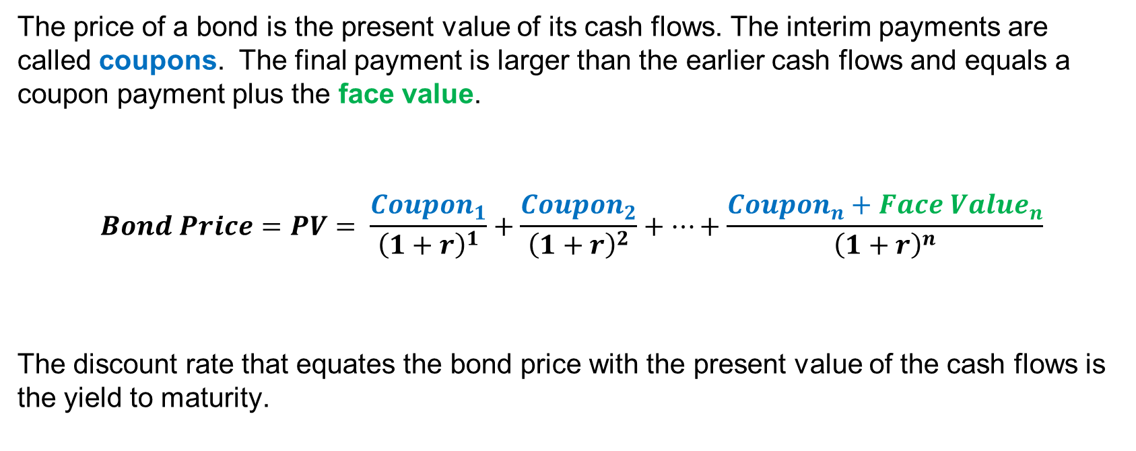
The price of a bond can be modeled as a TVM/DCF problem.
The price of a bond is the present value of its cash flows. The interim payments are called coupons. The final payment is larger than the earlier cash flows and equals a coupon payment plus the face value.
$$Bond Price=PV= \frac{{Coupon}_{1}}{{\left(1+r\right)}^{1}}+\frac{{Coupon}_{2}}{{\left(1+r\right)}^{2}}+…+\frac{{Coupon}_{n}+{Face Value}_{n}}{{\left(1+r\right)}^{n}}$$
The discount rate that equates the bond price with the present value of the cash flows is the yield to maturity.

Slide 26

Coupon Payment Calculation
$$PMT= \frac{Coupon Rate}{m}∗Face Value$$
where “m” represents the number of coupons paid each year.

Slide 27
Table 6.6 from the textbook
Bond Ratings and the Number of U.S. Public Firms with Those Ratings in March 2016 --“Investment grade” bonds
Moody’s | Standard & Poor’s | Number of Public Firms | Description (Moody’s)
Investment Grade Debt
Aaa | AAA | 3* | Judged to be of the best quality. They carry the smallest degree of investment risk and are generally referred to as “gilt edged.”
Aa | AA | 29 | Judged to be of high quality by all standards. Together with the Aaa group, they constitute what are generally known as high-grade bonds.
A | A | 221 | Possess many favorable investment attributes and are considered as upper-medium-grade obligations. Factors giving security to principal and interest are considered adequate at present, but may not remain that way.
Baa | BBB | 515 | Are considered as medium-grade obligations (i.e., they are neither highly protected nor poorly secured).

Slide 28
Table 6.6 from the textbook continued
“speculative”, “high-yield”, “junk” bonds
Moody’s | Standard & Poor’s | Number of Public Firms | Description (Moody’s)
Ba | BB | 363 | Judged to have speculative elements; their future cannot be considered as well assured.
B | B | 255 | Generally lack characteristics of the desirable investment. Assurance of interest and principal payments over any long period may be small.
Caa | CCC | 41 | Are of poor standing. Such issues may be in default or there may be present elements of danger with respect to principal or interest.
Ca | CC | 5 | Are speculative to a high degree. Such issues are often in default or have other marked shortcomings.
C | C, D | 10 | Lowest-rated class of bonds, and issues so rated can be regarded as having extremely poor prospects of ever attaining any real investment standing.
Notes:
In the last year Arby’s acquired Buffalo Wild Wings for ~ 2.4B. They paid for this in part with a CCC+ debt issue for around 495 million.

Slide 29
Example review questions related to PowerPoint files 7, 8, and 9
Common decision tools used in making capital budgeting decisions: NPV, IRR, Payback
Which cash flows go into the calculations? How do you solve for FCFs using accounting numbers?
Which financial statements are useful in thinking about FCFs? Which financial ratios help you understand the financial situation at a firm?

Slide 30
Table 8.5 Summary of Decision Rules NPV
NPV | Blank
Definition | The difference between the present value of an investment’s benefits and the present value of its costs
Rule | Take any investment opportunity where the NPV is positive; turn down any opportunity where it is negative
Advantages | Corresponds directly to the impact of the project on the firm’s value Direct application of the Valuation Principle
Disadvantages | Relies on an accurate estimate of the discount rate Can be time-consuming to compute

Slide 31
Table 8.5 Summary of Decision Rules IRR
IRR | Blank
Definition | The interest rate that sets the net present value of the cash flows equal to zero; the average return of the investment
Rule | Take any investment opportunity where its IRR exceeds the opportunity cost of capital; turn down any opportunity where its IRR is less than the opportunity cost of capital
Advantages | Related to the NPV rule and usually yields the same (correct) decision
Disadvantages | Hard to compute Multiple IRRs lead to ambiguity Cannot be used to choose among projects Can be misleading if inflows come before outflows

Slide 32
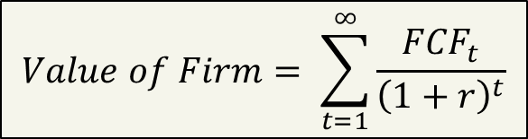
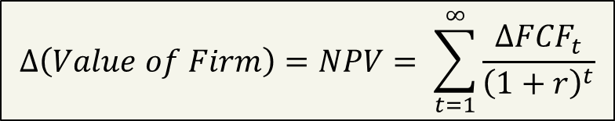
NPV and firm value
Firm value can be thought of as the present value of all future FCFs .
The NPV of a project is…
(1) the change in firm value if the project is taken.
(2) the present value of all cash flows incremental to the project.
$$Value of Firm= \sum_{t=1}^{∞}{\frac{{FCF}_{t}}{{\left(1+r\right)}^{t}}}$$
$$∆\left(Value of Firm\right)=NPV= \sum_{t=1}^{∞}{\frac{{∆FCF}_{t}}{{\left(1+r\right)}^{t}}}$$
Notes:
The upper equation is without the project. The lower equation is with the project.
NPV summarizes in dollars the possible contribution of an investment to firm value –and hence to shareholder’s wealth.

Slide 33
Example net present value profile of an investment
NPV
Possible discount rates
Remember, IRR is the rate at which the present value of the discounted cash flows equals 0. In this example IRR= .1944 (19.44%)
Notes:
Note that the “cost of capital” is not the same as the IRR. In this example the IRR is 19.44%.

Slide 34
IRR
The Internal Rate of Return is the discount rate that implies a zero net present value for a series of cash flows. It is “internal” because it only depends on the cash flows and not outside market rates.
Notes:
Determining the IRR is like solving for the yield to maturity or the return on investment.
The internal rate of return depends only on the characteristics of the cash flows.

Slide 35
Table 8.5 Summary of Decision Rules Payback Period
Payback Period | Blank
Definition | The amount of time it takes to pay back the initial investment
Rule | Accept the project if the payback period is less than a prespecified length of time—usually a few years; otherwise, turn it down
Advantages | Simple to compute Favors liquidity
Disadvantages | No guidance as to correct payback cutoff Ignores cash flows after the cutoff completely Not necessarily consistent with maximizing shareholder wealth

Slide 36
Calculating FCFs
To find FCFs you need to adjust accounting numbers each year to get actual cash flows (FCFs) …
  FCF = EBIT(1-t) + Depreciation & Amortization
  – Change in Net Working Capital – Capital Expenditure

Slide 37
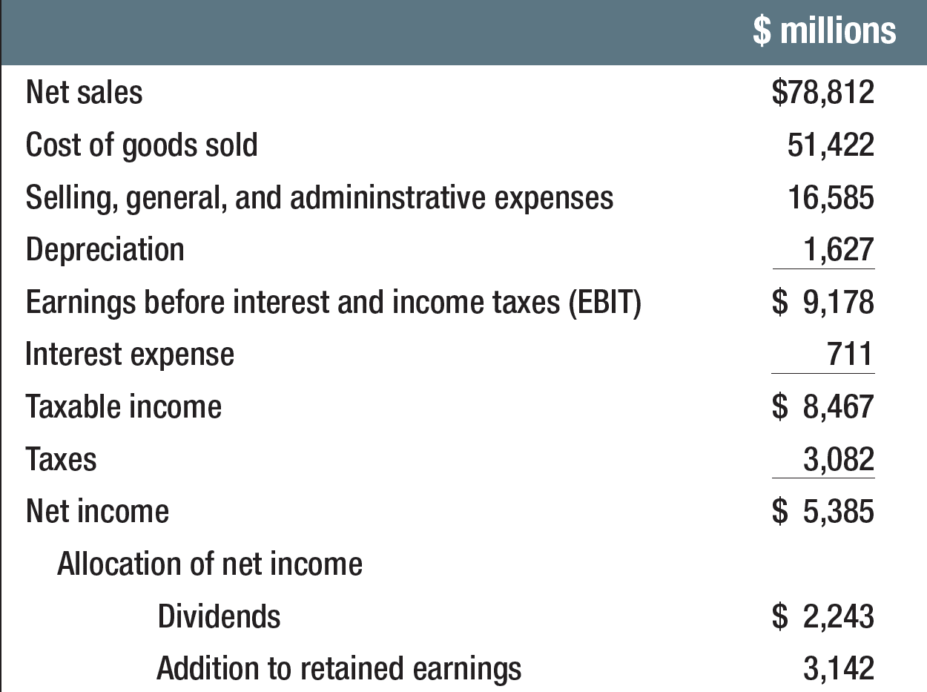
Intuition for FCFs --- Example income statement
Not a cash outflow
Net Income does
not reflect the actual
cash available each
period for several reasons: (1) depreciation was subtracted to get NI but depreciation
is not an actual cash outflow, (2) capital expenditures and investments in WC are
actual cash flows but are not included in the NI calculations

Slide 38
Incremental cash flows
Sunk costs are not incremental to a project – they do not belong in NPV calculations.
Notes:
When identifying incremental cash flows always ask the "with vs. without“ question!
i.e. “With the project the revenues and costs would be … without the project the revenues and costs would be …”

Slide 39
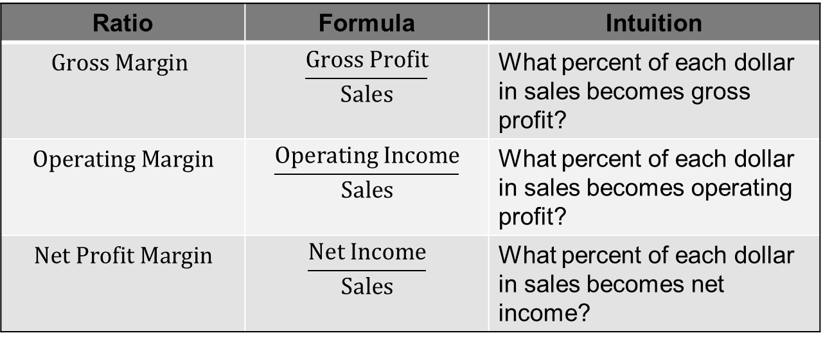
Profitability ratios
Ratio | Formula | Intuition
$Gross Margin$ | $$\frac{Gross Profit}{Sales}$$ | What percent of each dollar in sales becomes gross profit?
$$Operating Margin$$ | $$\frac{Operating Income}{Sales}$$ | What percent of each dollar in sales becomes operating profit?
$$Net Profit Margin$$ | $$\frac{Net Income}{Sales}$$ | What percent of each dollar in sales becomes net income?
Important Intuition: Higher margins mean higher profitability. Looking at the same firm’s margins over time helps you see if the firm is becoming more or less profitable.

Slide 40
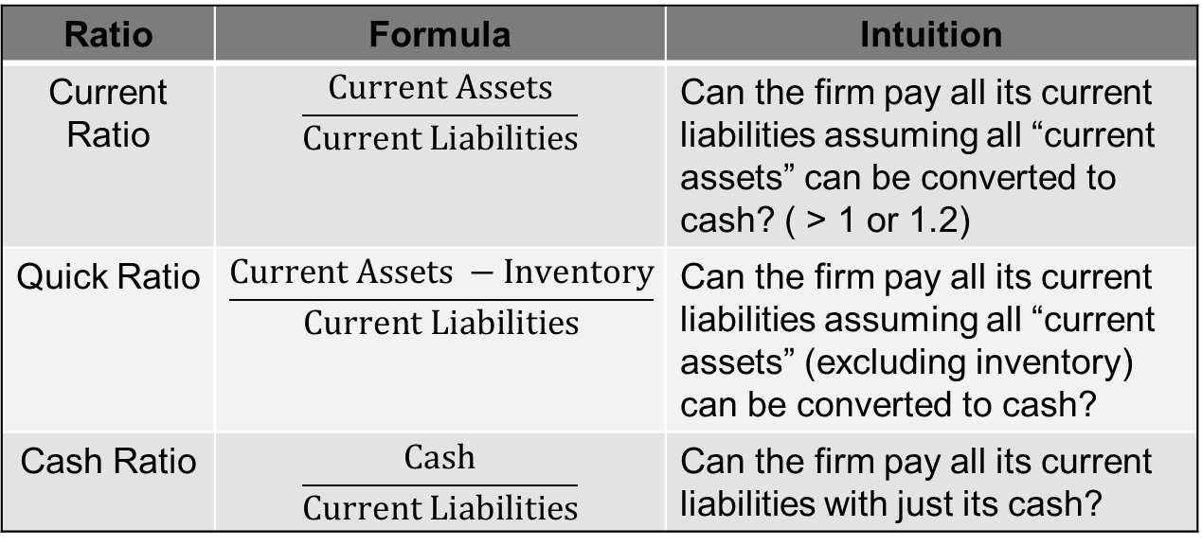
Liquidity ratios
Ratio | Formula | Intuition
Current Ratio | $$\frac{Current Assets}{Current Liabilities}$$ | Can the firm pay all its current liabilities assuming all “current assets” can be converted to cash? ( > 1 or 1.2)
Quick Ratio | $$\frac{Current Assets −Inventory}{Current Liabilities}$$ | Can the firm pay all its current liabilities assuming all “current assets” (excluding inventory) can be converted to cash?
Cash Ratio | $$\frac{Cash}{Current Liabilities}$$ | Can the firm pay all its current liabilities with just its cash?
Important Intuition: Low liquidity ratios can be an indication of possible near-term cash problems. Different types of firms tend to have higher (lower) liquidity ratios.

Slide 41
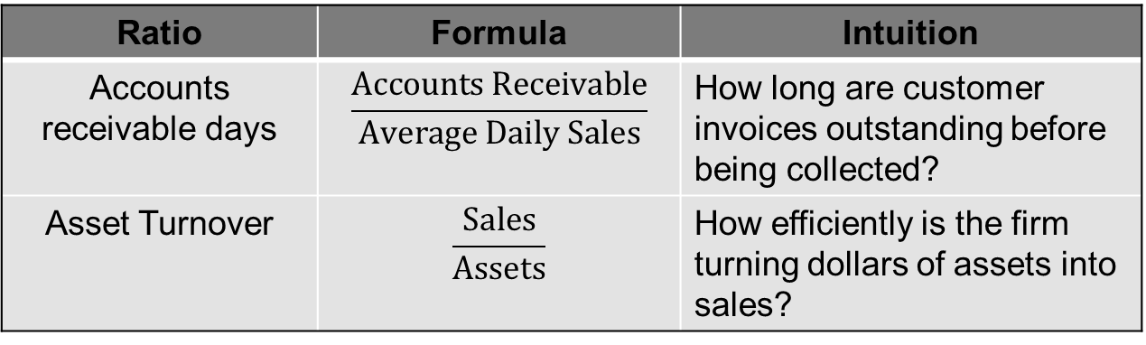
Efficiency and Working Capital Ratios
Ratio | Formula | Intuition
Accounts receivable days | $$\frac{Accounts Receivable}{Average Daily Sales}$$ | How long are customer invoices outstanding before being collected?
Asset Turnover | $$\frac{Sales}{Assets}$$ | How efficiently is the firm turning dollars of assets into sales?
Important Intuition: An accounts receivable days number of 8 would mean that on average the firm took 8 days to collect payment on customer purchases.
An asset turnover ratio of 6 tells you that each dollar of assets was converted into 6 dollars of sale.

Slide 42
Example review questions related to PowerPoint file 10
What is the difference between the primary and secondary markets?
What is an IPO? SEO?
What function do investment banks fulfill when issuing new securities?
What is the purpose of an IPO roadshow? How are IPO valuations done?

Slide 43
IPOs and SEOs (common stock)
New issues of common stock are classified as either
initial public offerings (IPOs)
Seasoned or secondary equity offerings (SEOs)
Notes:
http://www.nasdaq.com/markets/ipos/

Slide 44
Taking your firm public: The IPO valuation
How much is a private firm worth? Interested investors might know annual revenue and earnings numbers but lack a total market valuation.
Underwriters work with the company to come up with a price range.
Estimate the future cash flows and compute the present value (DCF approach)
Use market multiples approach (this is where you look at how the market values other firms in the same industry and apply the same valuation to a private firm.)
Road Show (red herring ➔ prospectus)
Book Building

Slide 45
Thank You

