Slide 1
BUS 641
Financial Markets and Investments
Strategic Asset Allocation, Optimization

Slide 2
Lecture Preview
  Big-Picture Motivation:
    We now have the tools for making strategic asset allocation decisions. In prior lectures we introduced the equations for calculating portfolio returns and standard deviation. We introduced the CAL and illustrated how to create new portfolios by combining risky assets with the risk-free asset in a single portfolio.
    In this lecture we will practice using these approaches with real-world data. In this lecture we will use historical information, Excel, and the above-mentioned formulas to create portfolios with targeted characteristics.
  Discussion Outline:
Introduce several investments that people might be considering investing in this year.
Illustrate how to download historical return information for these investments, how to calculate the average historical returns, standard deviations, and correlations for these assets in Excel.
Illustrate how the “expected returns” used in our portfolio calculations can diverge from historical returns.
Discuss how to create portfolios with targeted risk-return characteristics using the equations introduced this semester. Discuss the limitations with using these mathematical approaches.

Slide 3
For the sake of this discussion assume that you are considering investing in the following assets. You are trying to decide whether to split your money across these assets or whether to put all your money in just one or two of them.
Amazon (ticker: AMZN)
A fund that invests in gold (ticker: GLD)
A fund that invests in 7-10 year Treasury Bonds (ticker: IEF)
Crocs (ticker: CROX)
A fund that mimics the S&P500 index (ticker: SPY)

Slide 4
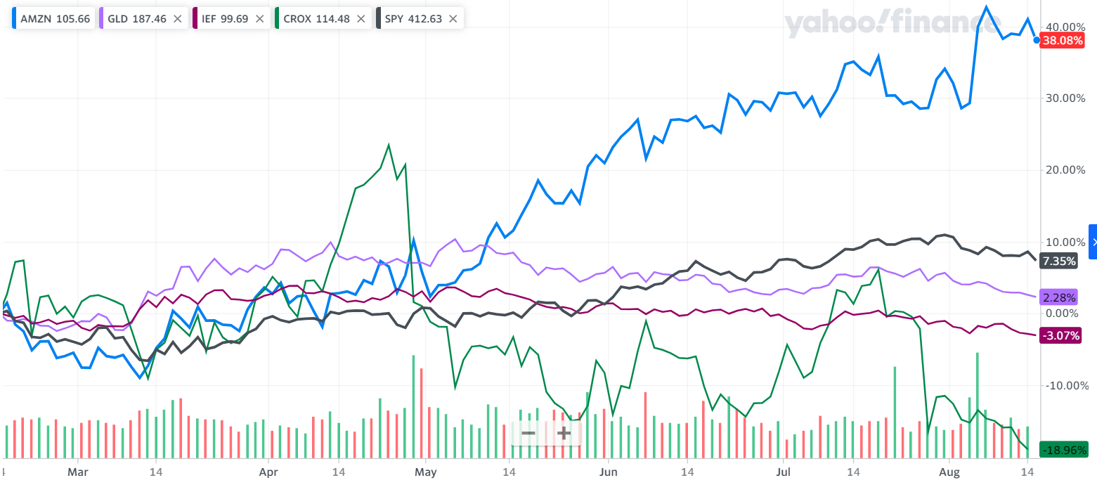
In the last 6 months Amazon performed the best (38%) followed by the SP500 fund (7.35%) and Crocs did the worst (-18.9%). Does this tell us anything about the future?
Notes:
This chart ends in August 2024.

Slide 5
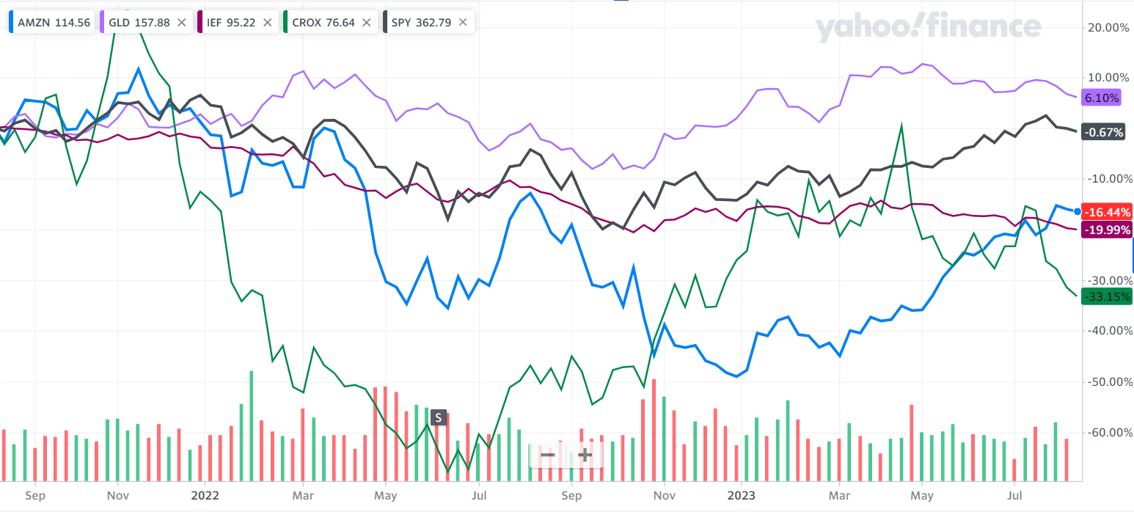
Over the last 2 years the Gold ETF did the best (6.10%) while Crocs, the bond fund, and Amazon lost between 16% and 33% of their value.

Slide 6
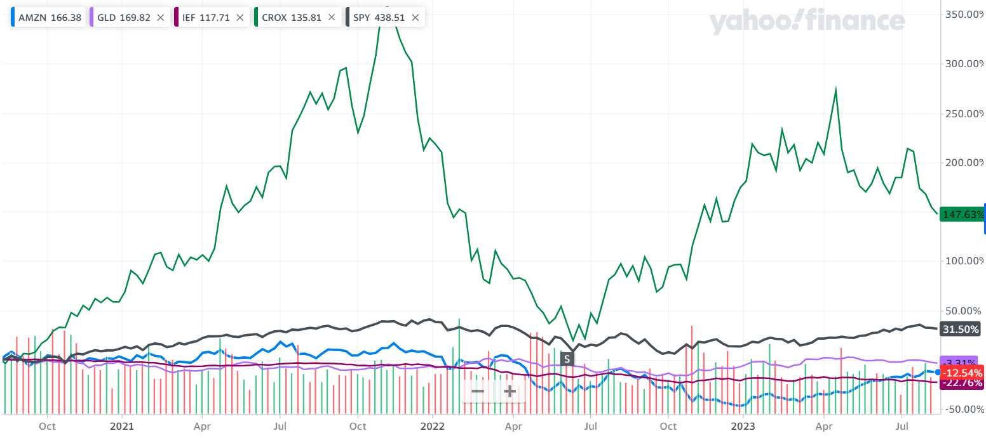
Over the last 3 years Crocs performed the best (147.6%) followed by the SP500 fund (31.5%) and the bond fund did the worst (-22.7%).

Slide 7
3 types of logic we sometimes hear when people talk about investing in a company. Note that these arguments don’t necessarily mean the stock will be a good investment going forward.
The company is doing well compared to its competitors, the company has good products, or the company has shown recent improvements in revenues or profit measures
  ➔ If these statements are understood to mean the stock will make a good investment going forward then the assumption must be that we expect the company will have solid cash flows going forward and that the current price doesn’t already reflect those high expectations.
Recent positive or negative stock performance
  ➔ (positive)The assumption must be that there is momentum in stock prices and that the current price is still less than the price that will occur in the near future.
  (negative) The assumption must be that investors sometimes over react and that the current low stock price is less than the price that will occur in the near future.
The company is large and is relative safe
  ➔ Large companies do tend to experience less volatility over time. This doesn’t tell you whether the company will experience good returns going forward.
Do any of these arguments tell you how to allocate your wealth across assets to achieve targeted outcomes?

Slide 8
What information do we need to use the tools introduced in recent lectures to try to create a portfolio with a target expected return or level of risk?
Expected returns for AMZN, GLD, IEF, CROX, and SPY
  What are the expected returns for these firms? People can form expectations based on detailed firm- and industry-level analysis, historical returns, analyst forecasts, models, etc. For simplicity we will use probability weighted average past returns as our approach to form estimates of expected returns. We have no way of knowing what the actual returns will be going forward.
  Past performance does not necessarily tell us about the future performance.
Standard deviations in returns for AMZN, GLD, IEF, CROX, and SPY
  We can use historical return data to get a sense of the typical standard deviations in these assets. Note that volatility can increase or decrease across time and/or business cycles, but historical volatility is a good starting point.
Correlations between each pair of the assets -- AMZN, GLD, IEF, CROX, and SPY
  We can use historical return data to get a sense of the correlation structure. Correlations can increase and/or decrease over time and/or during crisis, but historical correlations are a good starting point.

Slide 9
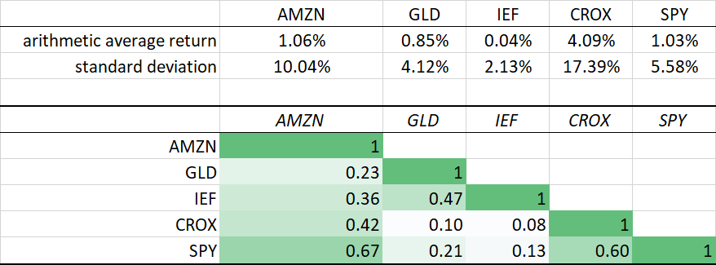
Let’s use monthly data from the last 5 years to learn about these assets.
The embedded spreadsheet (link below) has 2 tabs. The “prices, returns, correlations” tab reports the monthly prices and returns for the last 5 years. This tab also reports the arithmetic average returns, standard deviations, and correlations using monthly data.

Slide 10
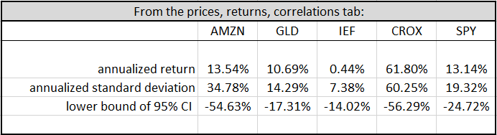
Monthly historical information annualized
Do you think the past average returns and standard deviations for these 5 assets are good estimates for the future expected returns and volatility? Why or why not?
Both CROX and AMZN showed unusual movements around COVID
What do analysts and investment groups say?
Notes:
The lower bound of the 95% confidence interval is the expected return minus 1.96*sigma. In the above table I am using the arithmetic average as the “expected return”.

Slide 11
Over the last 3 years Crocs performed the best (147.6%) followed by the SP500 fund (31.5%) and the bond fund did the worst (-22.7%).

Slide 12
Over the last 2 years the Gold ETF did the best (6.10%) while Crocs, the bond fund, and Amazon lost between 16 and 33% of their value.

Slide 13
Other data sources
JPMorgan’s 2023 Long-Term Capital Market Assumptions predicts a 7.9% return on US large-cap stocks. Invesco’s 2023 Long-Term Capital Market Assumptions predicts a 7.74% return on US large-cap stock.
  Both forecasts suggest the S&P500 expected return should be around 7.7 to 8%.
As of early 2023 multiple analysts posted price targets for AMZN and Crocs suggesting strong price appreciation in the coming year. The analysts are suggesting high expected returns going forward. If the S&P500 is expected to appreciate by 8% then these companies will likely grow more.
The central bank signaled repeatedly in 2023 that they would be raising rates.
  Bond prices move inversely with interest rates. This suggests small expected returns to IEF in the near future.
Notes:
Sources accessed on 8/15/2023
https://am.jpmorgan.com/us/en/asset-management/institutional/insights/portfolio-insights/ltcma/

Slide 14
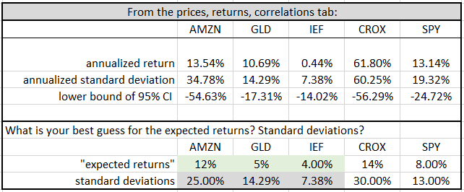
Refining my expected return estimates
Considering this information, I am going to assume the expected returns and standard deviations shown above in the calculations. I’m going to also assume that the historical correlations are good estimates of future correlations.

Slide 15
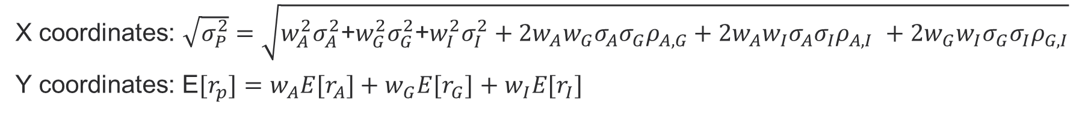
Let’s assume that we want to first consider what kinds of portfolio expected returns and standard deviations we can create using only AMZN (A), GLD (G), and IEF (I).
At this point in the analysis we will take the expected return, standard deviation, and correlation estimates as given. The different portfolios we consider going forward will be created using different investment weights.
The numbers used for the 3 assets’ E[r]’s and σ’s are highlighted on the prior slide.
Each new portfolio can be plotted with an x and y coordinate.
The figure shown on the next slide illustrates 500 hypothetical portfolios that can be created using a random number generator to assign 500 different investment weight scenarios. In each scenario the 3 weights would sum to 1.
X coordinates: $\sqrt{σ_{P}^{2}}=\sqrt{w_{A}^{2}σ_{A}^{2}\text{+}w_{G}^{2}σ_{G}^{2}\text{+}w_{I}^{2}σ_{I}^{2}+2w_{A}w_{G}σ_{A}σ_{G}ρ_{A,G}+2w_{A}w_{I}σ_{A}σ_{I}ρ_{A,I} +2w_{G}w_{I}σ_{G}σ_{I}ρ_{G,I}}$
Y coordinates: E${[r}_{p}]=w_{A}{E[r}_{A}]+w_{G}{E[r}_{G}]$ $+ w_{I}{E[r}_{I}]$

Slide 16
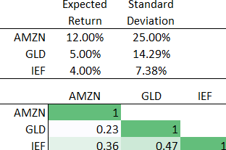
The plot shows 500 hypothetical 3-asset portfolios that can be created with the expected return, standard deviation, and correlation numbers shown below. Expected returns (standard deviations) are shown on the vertical (horizontal) axis.
For comparison assume you are considering a baseline portfolio with 30% in AMZN, 40% in GLD, and 30% in IEF.
Questions: (1) Can you use the same 3 underlying assets to create a portfolio that dominates the baseline example? (2) Why is the S&P 500 to the left of the frontier? (3) How would you identify the optimal risky portfolio on this frontier?
Notes:
1 – Yes – in the figure you can see portfolios just above and to the left of the baseline example.
2 – The S&P 500 is not one of the 3 assets used to create the frontier. It contains 500 underlying assets and hence is more diversified (lower sigma) than any combination of the 3 assets considered here.
3 – You could use calculus or an optimization software to identify the tangency portfolio. A rough way to do it would be to draw a CAL from the risk-free rate tangent to the frontier.

Slide 17
The plot shows 500 hypothetical 3-asset portfolios that can be created with the expected return, standard deviation, and correlation numbers shown below. Expected returns (standard deviations) are shown on the vertical (horizontal) axis.
The 500 random weights help us see the efficient frontier. The efficient frontier traces out the best possible hypothetical portfolios in terms of E[r] and σ that we can create using a set of assets.
If we had used 1000 random weight, instead of 500, some of the interior blank spaces would be filled in with new portfolios but the frontier would not be changed.
Important Intuition: The only way to move the frontier left is to introduce new assets with different E[r], σ, and ρ combinations. Intuitively, more assets allow for new combinations that better diversify risk. The S&P 500 is made up of more assets and hence is to the left of the frontier created using only 3 assets.

Slide 18
Concept checks
What will happen to the frontier if we explore 500 hypothetical portfolio created using all 5 assets instead of just 3 assets?
Which CAL will have a higher Sharpe ratio? The CAL tangent to the 3-asset frontier or the CAL tangent to the 5-asset frontier?
Would the 2 CALs have different y-intercepts?
Would the frontier move to the left if we added a new asset that had the exact E[r], σ, and correlation as one of the assets already included?
How would the x and y coordinate formulas change for the 5-asset portfolios versus the 3-asset portfolios?
Notes:
1— We would expect the 5-asset frontier to be to the left of the 3-asset frontier given the greater diversification that is possible with additional assets.
2 – The CAL tangent to the 5-asset frontier will have a higher Sharpe ratio than the CAL tangent to the 3-asset frontier.
3 – No – all CALs have the same risk-free rate intercept
4 – No – it is not the number of assets alone that moves the frontier left. It is the number of assets with unique E[r], σ, and correlations
5 – Each x – coordinate would still be the E[r] of the portfolio. Each y-coordinate would still be the σ of the portfolio. See next slides to see how the formulas would change.

Slide 19
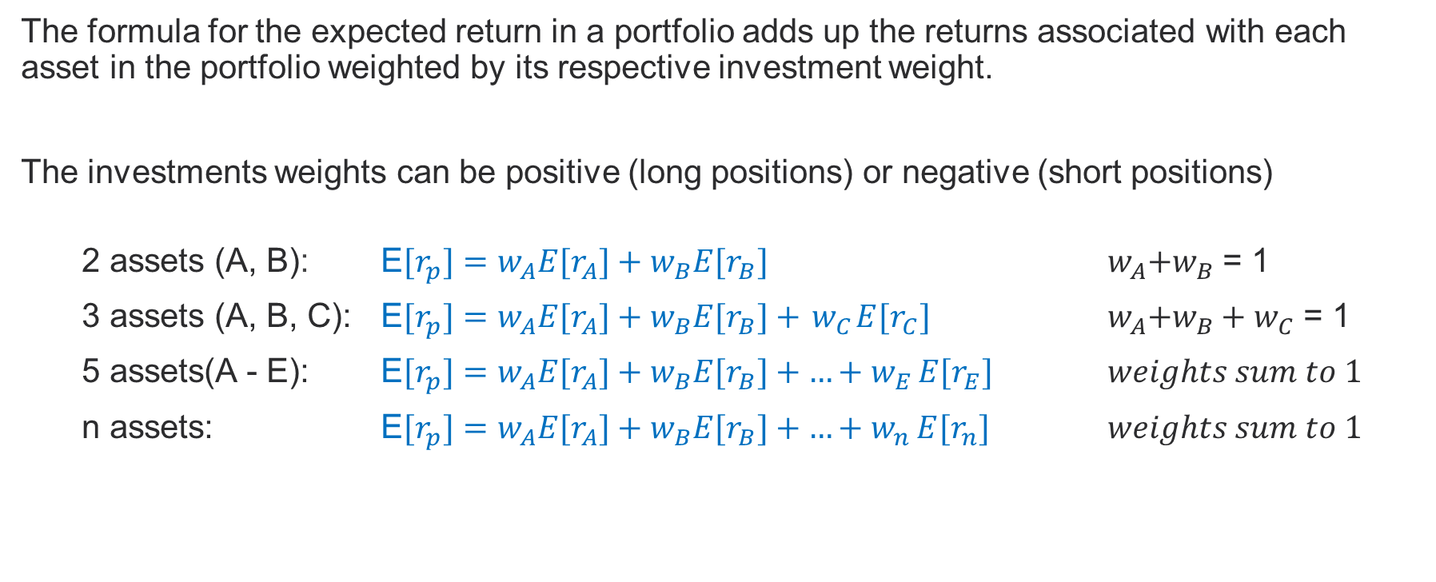
The y-coordinate for each portfolio on the plot would still be that portfolio’s E[r]
The formula for the expected return in a portfolio adds up the returns associated with each asset in the portfolio weighted by its respective investment weight.
The investments weights can be positive (long positions) or negative (short positions)
2 assets (A, B): E${[r}_{p}]=w_{A}{E[r}_{A}]+w_{B}{E[r}_{B}]$ ${ w}_{A}+w_{B}$ = 1
3 assets (A, B, C): E${[r}_{p}]=w_{A}{E[r}_{A}]+w_{B}{E[r}_{B}]+{ w}_{C}{E[r}_{C}]$ ${ w}_{A}+w_{B}+w_{C}$ = 1
5 assets(A - E): E${[r}_{p}]=w_{A}{E[r}_{A}]+w_{B}{E[r}_{B}]+{…+w}_{E}{E[r}_{E}]$ $weights sum to 1$
n assets: E${[r}_{p}]=w_{A}{E[r}_{A}]+w_{B}{E[r}_{B}]+{…+w}_{n}{E[r}_{n}]$ $weights sum to 1$

Slide 20
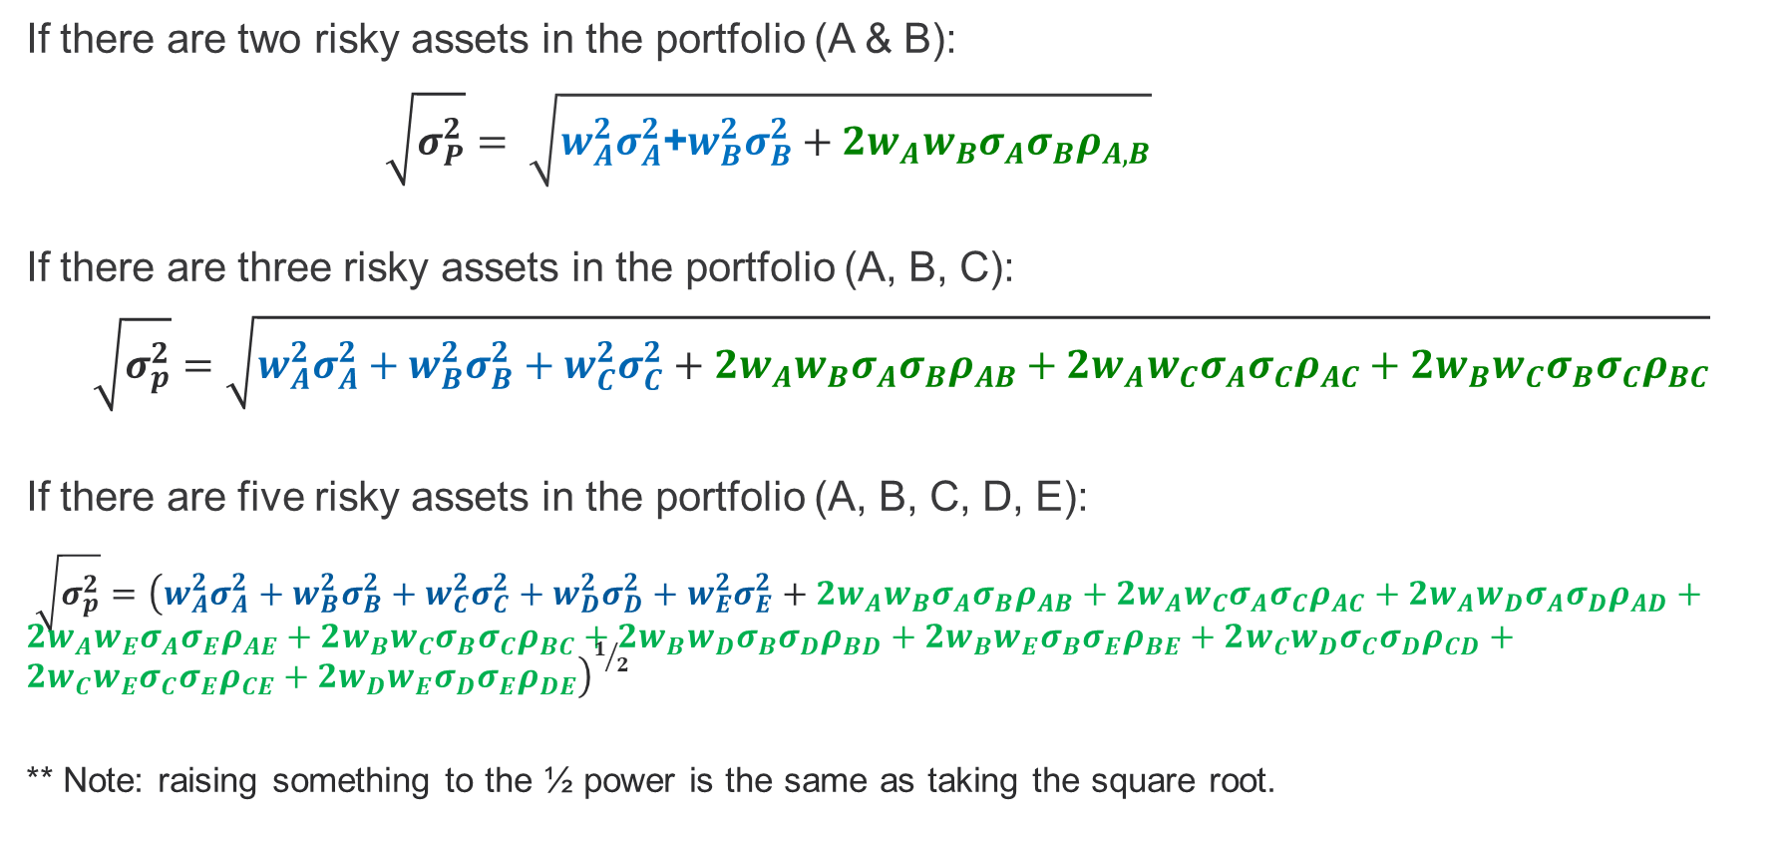
The x-coordinate for each portfolio on the plot would still be that portfolio’s σ
If there are two risky assets in the portfolio (A & B):
$\sqrt{σ_{P}^{2}}= \sqrt{w_{A}^{2}σ_{A}^{2}\text{+}w_{B}^{2}σ_{B}^{2}+2w_{A}w_{B}σ_{A}σ_{B}ρ_{A,B}}$
If there are three risky assets in the portfolio (A, B, C):
$$\sqrt{σ_{p}^{2}}=\sqrt{w_{A}^{2}σ_{A}^{2}+w_{B}^{2}σ_{B}^{2}+w_{C}^{2}σ_{C}^{2}+2w_{A}w_{B}σ_{A}σ_{B}ρ_{AB}+2w_{A}w_{C}σ_{A}σ_{C}ρ_{AC}+2w_{B}w_{C}σ_{B}σ_{C}ρ_{BC}}$$
If there are five risky assets in the portfolio (A, B, C, D, E):
$\sqrt{σ_{p}^{2}}={\left(w_{A}^{2}σ_{A}^{2}+w_{B}^{2}σ_{B}^{2}+w_{C}^{2}σ_{C}^{2}+w_{D}^{2}σ_{D}^{2}+w_{E}^{2}σ_{E}^{2}+2w_{A}w_{B}σ_{A}σ_{B}ρ_{AB}+2w_{A}w_{C}σ_{A}σ_{C}ρ_{AC}+2w_{A}w_{D}σ_{A}σ_{D}ρ_{AD}+2w_{A}w_{E}σ_{A}σ_{E}ρ_{AE}+2w_{B}w_{C}σ_{B}σ_{C}ρ_{BC}+2w_{B}w_{D}σ_{B}σ_{D}ρ_{BD}+2w_{B}w_{E}σ_{B}σ_{E}ρ_{BE}+2w_{C}w_{D}σ_{C}σ_{D}ρ_{CD}+2w_{C}w_{E}σ_{C}σ_{E}ρ_{CE}+2w_{D}w_{E}σ_{D}σ_{E}ρ_{DE}\right)}^{1/2}$
** Note: raising something to the ½ power is the same as taking the square root.
Notes:
The standard deviation is the square root of the variance.
Portfolio risk is a function of each individual security’s risk as well as the covariance between the returns of each security. The notation and formula shown below is shorthand for the same formulas shown in the slide. I won’t have you calculate this using summation signs in this class. I include it here for those that have mathematical backgrounds and wondered what the general formula would be.
$$σ_{p}^{2}=\sum_{i=1}^{n}{w_{i}^{2}σ_{i}^{2}+\sum_{i=1}^{n}{\sum_{\begin{aligned}j=1 \\ i≠j\end{aligned}}^{n}{w_{i}w_{j}σ_{ij}}}}$$
$σ_{i}^{2}=$the variance of returns for security I
$σ_{ij}^{}=$the covariance between asset i and asset
j’s returns
$w_{i}^{}=$portfolio weight in i

Slide 21
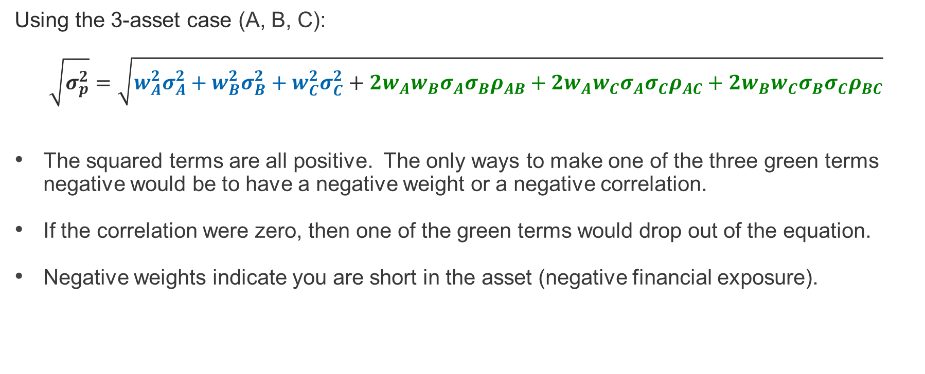
What are some ways that the portfolio volatility can be decreased?
Using the 3-asset case (A, B, C):
$$\sqrt{σ_{p}^{2}}=\sqrt{w_{A}^{2}σ_{A}^{2}+w_{B}^{2}σ_{B}^{2}+w_{C}^{2}σ_{C}^{2}+2w_{A}w_{B}σ_{A}σ_{B}ρ_{AB}+2w_{A}w_{C}σ_{A}σ_{C}ρ_{AC}+2w_{B}w_{C}σ_{B}σ_{C}ρ_{BC}}$$
The squared terms are all positive. The only ways to make one of the three green terms negative would be to have a negative weight or a negative correlation.
If the correlation were zero, then one of the green terms would drop out of the equation.
Negative weights indicate you are short in the asset (negative financial exposure).
Notes:
The standard deviation is the square root of the variance.
Portfolio risk is a function of each individual security’s risk as well as the covariance between the returns of each security. The notation and formula shown below is shorthand for the same formulas shown in the slide. I won’t have you calculate this using summation signs in this class. I include it here for those that have mathematical backgrounds and wondered what the general formula would be.
$$σ_{p}^{2}=\sum_{i=1}^{n}{w_{i}^{2}σ_{i}^{2}+\sum_{i=1}^{n}{\sum_{\begin{aligned}j=1 \\ i≠j\end{aligned}}^{n}{w_{i}w_{j}σ_{ij}}}}$$
$σ_{i}^{2}=$the variance of returns for security I
$σ_{ij}^{}=$the covariance between asset i and asset
j’s returns
$w_{i}^{}=$portfolio weight in i

Slide 22
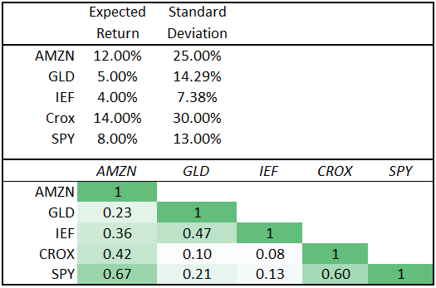
The plot shows 500 hypothetical portfolios that can be created with the following expected return, standard deviation, and correlation numbers shown below. Expected returns (standard deviations) are shown on the vertical (horizontal) axis.
Questions: (1) What would happen to the figure if we were to use 1000 random weight scenarios instead of 500? (2) How could you create a final portfolio with an E[r] of 6%? (3) How would you identify the optimal risky portfolio on the blue frontier?
Notes:
1 – If we had used 1000 random weight, instead of 500, some of the interior blank spaces would be filled in with new portfolios but the general frontier would not be changed. We would not be able to create a portfolio to the left of the blue frontier using only risky assets.
2 – Note to Students – when this lecture was recorded I answered question #2 as though the question was asking how to create a portfolio with a 6% expected return. But if you look at the video carefully the original slide in the background (since changed) was asking about a portfolio with a 6% sigma. If we allow for investment in a risky portfolio then we could create a portfolio with 6% standard deviation by placing some funds in the risk-free asset and some in the tangency portfolio. The slide has been updated to reflect a 6% expected return.
3 – You could use calculus or an optimization software to identify the tangency portfolio. A rough way to do it would be to draw a CAL from the risk-free rate tangent to the frontier.

Slide 23
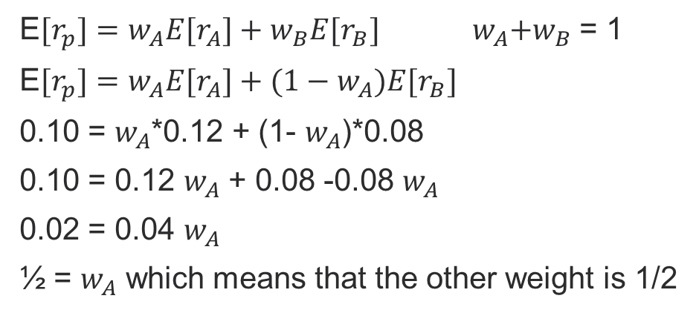
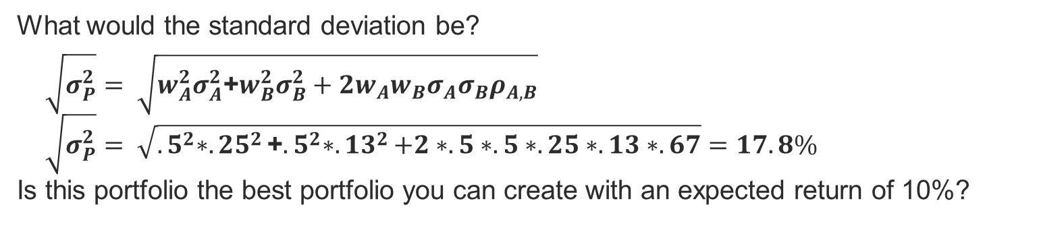
Assume you wanted to create a portfolio with 10% expected return using a combination of AMZN and SPY. What would the investment weights be?
E${[r}_{p}]=w_{A}{E[r}_{A}]+w_{B}{E[r}_{B}]$ ${ w}_{A}+w_{B}$ = 1
E${[r}_{p}]=w_{A}{E[r}_{A}]+(1−w_{A}){E[r}_{B}]$
0.10 = $w_{A}$*0.12 + (1- $w_{A}$)*0.08
0.10 = 0.12 $w_{A}$ + 0.08 -0.08 $w_{A}$
0.02 = 0.04 $w_{A}$
½ = $w_{A}$ which means that the other weight is 1/2
What would the standard deviation be?
$\sqrt{σ_{P}^{2}}= \sqrt{w_{A}^{2}σ_{A}^{2}\text{+}w_{B}^{2}σ_{B}^{2}+2w_{A}w_{B}σ_{A}σ_{B}ρ_{A,B}}$
$\sqrt{σ_{P}^{2}}= \sqrt{{.5}^{2}∗{.25}^{2}\text{+}{.5}^{2}∗{.13}^{2}+2∗.5∗.5∗.25∗.13∗.67}=17.8\%$
Is this portfolio the best portfolio you can create with an expected return of 10%?

Slide 24
Concept Questions
What inputs are needed to use the portfolio equations we’ve been talking about this semester?
Do we know any of these inputs with certainty?
Where do our estimates of expected returns come from?
Where do our estimates of standard deviations come from?
Where do our estimates of correlations come from?
Just because the math tells us a set of investments weights to use to create a hypothetical portfolio, is it always possible to do so? Why not?
Is the past a good predictor of the future?
Notes:
1 – Expected returns, standard deviations, correlations
2 – no
3 – Historical returns, analyst forecasts, investment firm forecasts, risk-return models, opinions, etc.
4 – Mostly historical returns. Sometimes the standard deviations in recent years is not a good predictor of upcoming standard deviations if unique events have occurred in the recent past.
5 – Mostly historical returns. Correlations spike during financial crisis.
6 – No. For example, sometimes the mathematical solution suggests a large negative weight on an asset. But in the real world we many not be able to short or borrow enough or we may not want to .
7 – No but it is often a starting point for our analysis.

Slide 25
For next time…
Review the concepts and terminology introduced in today’s lecture and check the schedule for upcoming assignments.

Slide 26
Review
You should be able to give a 1-2 sentence answer for each of these questions.
What formulas describe the x- and y-coordinates of portfolios on the figures?
If new assets are added to the mix, what happens to the investment frontier?
Could some assets be of interest to portfolio managers because of their unique correlation with other assets even though they might not be of interest as stand-alone investments?
Can you use the equations to solve for the investment weights needed to create a portfolio with a specific expected return?
(If you don’t know a term you can look in the assigned reading from the textbook or on
Investopedia.com)

Slide 27
Thank You

