Slide 1
Equity Valuation
FIN 300

Slide 2
Discussion Topics
Background information related to equity ownership
DCF equity valuation models based on a…
  Dividend discount model
  Free cash flow model
Review problems
Terminal growth assumption in DCF models.
Discuss the intuition in the P/E ratio.

Slide 3
Real versus financial assets
In your accounting class you learned that the value of the left side of the balance sheet equals the value of the right side.
The items listed on the left side generate the current and future cash flows at the firm. The items listed on the right side are claims to those cash flows.
The value of the claims (right side) equals the value generated by the assets (left side).
Balance Sheet
Assets (e.g., property, equipment, etc.) | Debt (e.g., bonds) Equity (e.g., common stock, preferred stock)

Slide 4
How are debt and equity claims similar? How do they differ?
Key Characteristics Differences
Nature of claim on cash flows…………..….…..……….fixed vs residual?
Priority of claim on cash flows…………...........….primary vs secondary?
Maturity…………………………………………….....…...finite vs ongoing?
Managerial control………………………...….…..……………..ownership?
Expected return/risk………………………….…….…….….………….risk?
Important intuition: Debt contracts tend to have fixed claims on cash flows that have higher priority than equity claims. This is why debt tends to be less risky (lower variability in returns) and to have lower average returns across time than equity. Equity contracts lay claim to the upside.

Slide 5
Key ideas related to common stock ownership
Common shares grant ownership claims to all future residual cash flows.
Common shares have no maturity.
Mangers can choose to distribute residual cash flows in the form of dividends or to retain the cash for future use.
Common shares generally grant voting rights. Voting rights have value.
Important intuition: The value of a share today can be modeled as the present value of all future residual cash flows and voting rights. If you assume that “dividends” encompass the future residual cash flows then….
Share price today = PV(all future dividends) + value of voting rights

Slide 6
Firms issue shares to raise capital
Managers often need additional capital to fund new projects. One way to obtain this capital is to issue (i.e., “sell” or “float”) new equity or debt securities in the primary market. This is normally done with the help of investment banks.
The number of shares outstanding changes when the firm issues new shares and when the firm repurchases shares (“share buybacks”)
Important Intuition: Assuming only one class of common shares (and assuming no preferred stock) the market value of equity at the firm is equal to:
MCAP = MVE = # of shares outstanding * share price
Notes:
Examples of large investment banks:
Bank of America
Barclays
BNP Paribas
Citigroup
Credit Suisse
Deutsche Bank
Goldman Sachs
HSBC
Jefferies Group
JPMorgan Chase
Lazard
Morgan Stanley
Normura Holdings
RBC Capital Markets
Societe Generale
TD Securities
UBS
Wells Fargo

Slide 7
Stocks are traded via exchanges
In the US most stocks are traded online on either the NYSE or the Nasdaq during market hours and on ECNs after hours.
Many firms have active daily trading in their shares.
This means that the current traded price reflects the current knowledge/opinions of thousands of traders each day. The market price is “information rich”.
Important Intuition: You can see the “market’s” valuation of shares of stock by looking at the most recent traded prices.
Question: What information does the “market” use to value the shares?
Notes:
Later in the lecture we are going to talk about Caterpillar’s stock price. What types of information would the market use in determining Caterpillar’s stock price?
https://finviz.com/quote.ashx?t=CAT&ty=c&ta=0&p=m
https://s25.q4cdn.com/358376879/files/doc_financials/2020/q4/4Q-2020-Caterpillar-Earnings-Presentation.pdf

Slide 8
What does it mean to own equity?
Public equity represents ownership in a company. Managers have a fiduciary duty to work on behalf of shareholders’ interests.
Common stock typically gives you the ability to vote for directors and gives you claim to future residual cash flows.
The board of directors hires and fires CEOs. The stockholders pick the directors by voting.
Each year firms need to pay certain bills, make payments on the outstanding debt, and pay government taxes before reporting net income. The “residual cash flow” is related to the cash flows each year that remain after making the above-mentioned payments. Dividend payments are made out of this residual cash flow.

Slide 9
Preferred Stock
Preferred stock has no maturity but receives a pre-specified regular dividend.
A share of preferred stock tends to pay a fixed dividend.

Slide 10
What is value?
The price (value) today of any asset is equal to the sum of the present value of all future expected cash flows.
This idea applies to firms, projects, stock, and bonds.
The value of each of these items is equal to the present
value of the cash flows tied to each item discounted back.

Slide 11
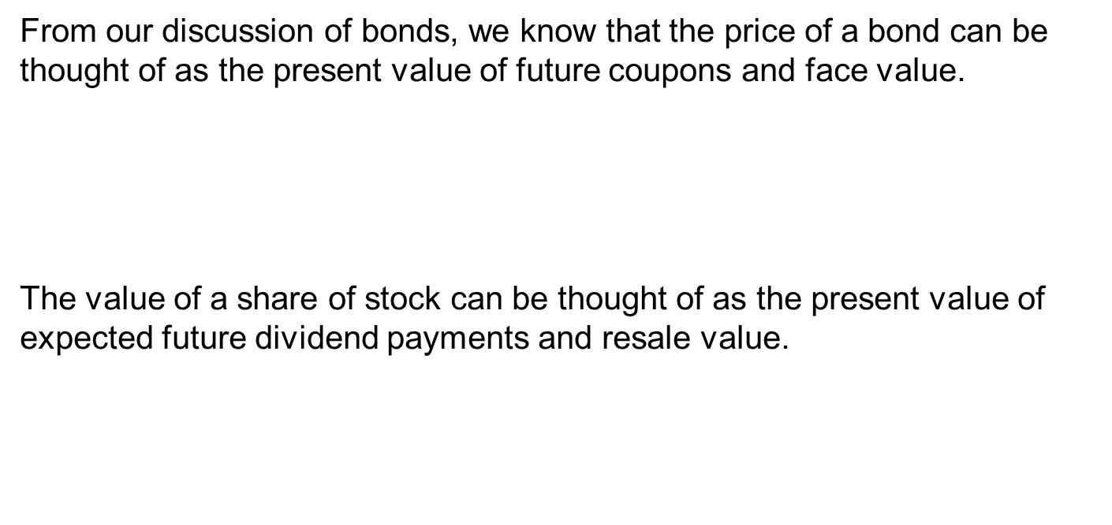
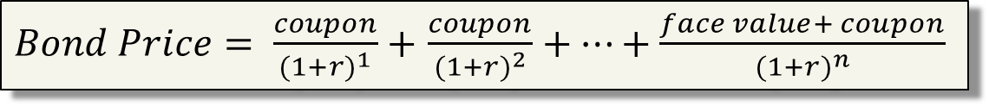
Borrowing intuition from bond valuation …
From our discussion of bonds, we know that the price of a bond can be thought of as the present value of future coupons and face value.
The value of a share of stock can be thought of as the present value of expected future dividend payments and resale value.
$Bond Price= \frac{coupon}{{(1+r)}^{1}}+$ $\frac{coupon}{{(1+r)}^{2}}+…+\frac{face value+ coupon}{{(1+r)}^{n}}$
$Stock Price= \frac{E[div1]}{{(1+r)}^{1}}+$ $\frac{E[div2]}{{(1+r)}^{2}}+…+\frac{E[sale of stock n periods from now]}{{(1+r)}^{n}}$
Notes:
To value common stock we need estimates of
Future dividends (DIVs)
Required return on equity cash flow for the firm in question
If dividends are growing through time we will often make simplifying assumptions about a growth rate (g) that explains dividend growth through time.
The E[Div] notation indicates “expected dividends”. This formula is known as a dividend discount model.

Slide 12
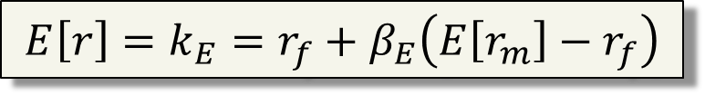

When valuing stock, which discount rate should be used for the cash flows?
Dividends (and the resale value of the stock) will go to the shareholder. The cash flows to equity holders should be discounted at the equity cost of capital ($k_{E} or r_{E})$.
The CAPM can be used to estimate the equity cost of capital if an “equity” beta is used.
$$E\left[r\right]=k_{E}=r_{f}+β_{E}\left(E\left[r_{m}\right]−r_{f}\right)$$

Slide 13
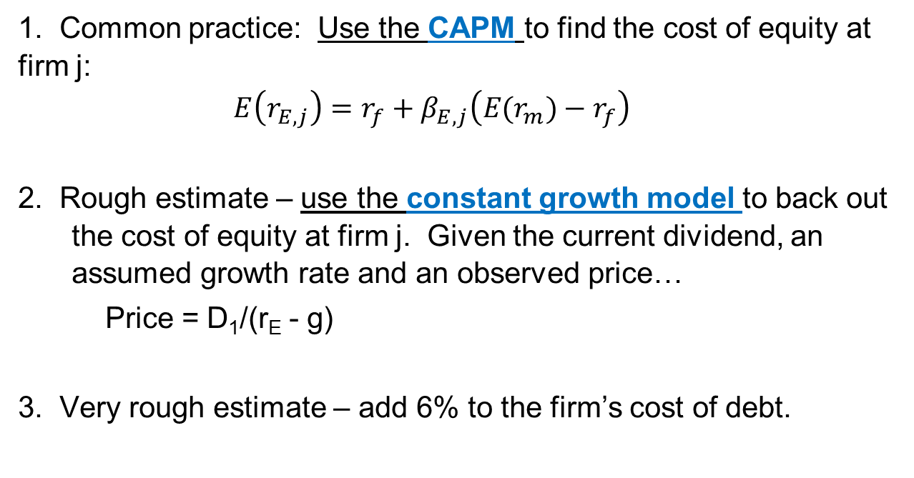
Three ways to calculate r_{E}
1. Common practice: Use the CAPM to find the cost of equity at firm j:
$$E\left(r_{E,j}\right)=r_{f}+β_{E,j}\left(E(r_{m})−r_{f}\right)$$
2. Rough estimate – use the constant growth model to back out the cost of equity at firm j. Given the current dividend, an assumed growth rate and an observed price…
  Price = D₁/(r_{E} - g)
3. Very rough estimate – add 6% to the firm’s cost of debt.
Notes:
Remember that if you are using the CAPM to solve for the cost of equity then the beta should be the equity beta. For a private firm you can use the “bottom up” approach to find the beta if you have to.

Slide 14

$$Share price={Div}_{0}+\frac{{E[Div}_{1}]}{{\left(1+r\right)}^{1}}+\frac{E[{Div}_{2}]}{{\left(1+r\right)}^{2}}+\frac{{E[Div}_{3}]}{{\left(1+r\right)}^{3}}+…$$
This is known as the dividend discount model
Any news that changes the investors’ expectations for future cash flows will affect today’s share price. Remember that dividends are paid from residual cash flows.
The discount rate (r) is related to the firm’s systematic risk. The higher the systematic risk the higher the discount rate. Any news that changes the investors’ views on the systematic risk in the firm will change the share price.
➔ How do you know what the future dividends will be?

Slide 15
Key question for stock valuation:
What will the future dividends be?
We will consider 3 approaches to modeling future dividends:
Constant dividend (no growth)
Constant growth
Two stage (high growth followed by constant growth)
Note that the same growth assumptions (and formulas) used with dividend can be used when modeling “free cash flows”. We will discuss free cash flow modeling later in the lecture.

Slide 16
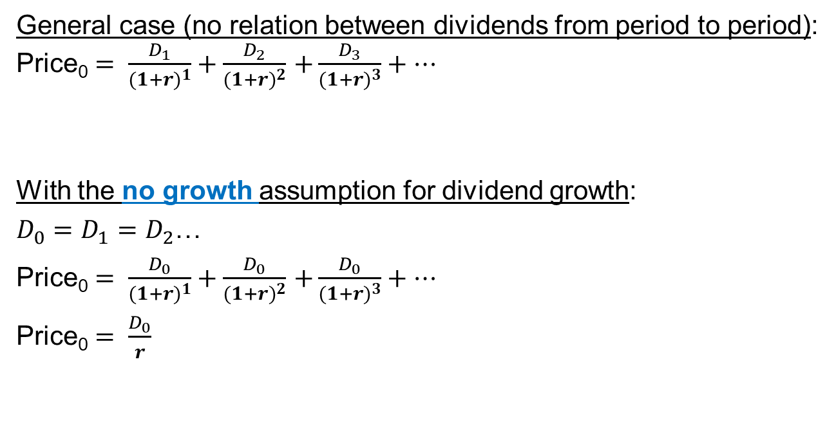
General Approach:
Stock price today = present value of all (expected) future dividends
General case (no relation between dividends from period to period):
Price₀ $= \frac{D_{1}}{{(1+r)}^{1}}+\frac{D_{2}}{{(1+r)}^{2}}$ $+\frac{D_{3}}{{(1+r)}^{3}}+…$
With the no growth assumption for dividend growth:
$D_{0}=D_{1}=D_{2}$…
Price₀ $= \frac{D_{0}}{{(1+r)}^{1}}+\frac{D_{0}}{{(1+r)}^{2}}$ $+\frac{D_{0}}{{(1+r)}^{3}}+…$
Price₀ $= \frac{D_{0}}{r}$
Notes:
Under the no growth assumption the valuation simplifies to a perpetuity.

Slide 17
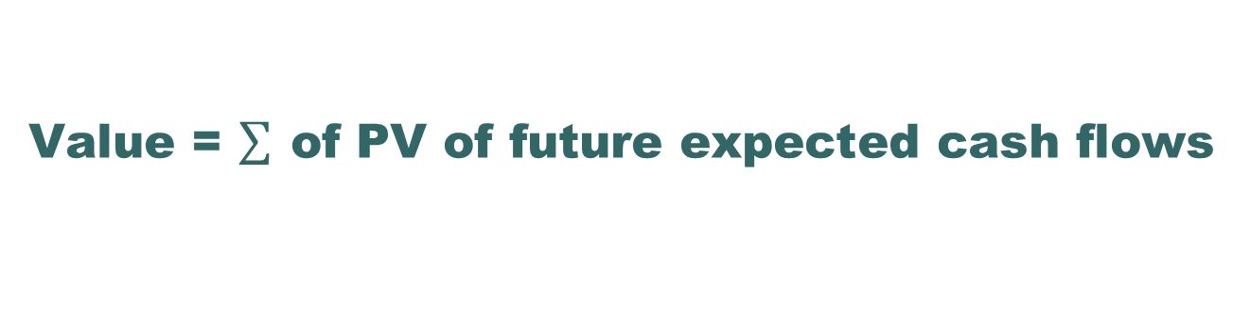
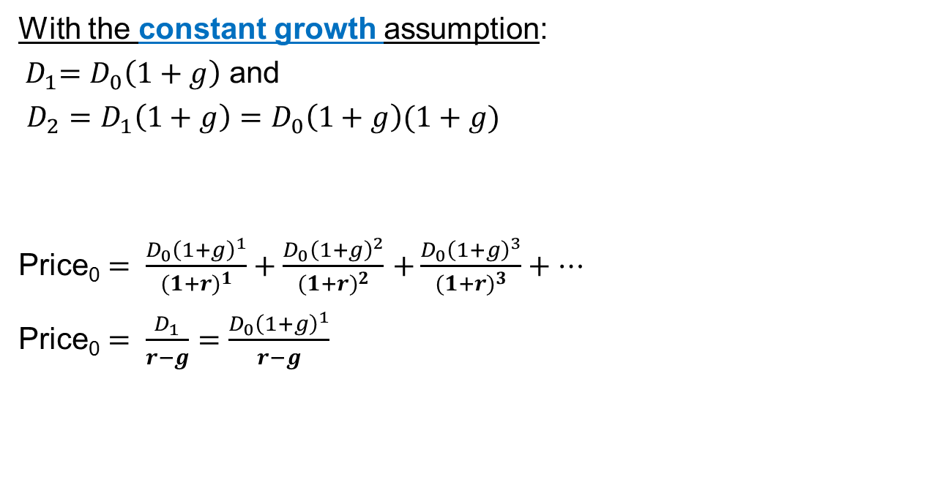
Value = $\sum{ \text{of} \text{PV} \text{of} \text{future} \text{expected} \text{cash} \text{flows}}$
With the constant growth assumption:
${ D}_{1}=D_{0}\left(1+g\right)$ and
$D_{2}=D_{1}\left(1+g\right)=D_{0}\left(1+g\right)(1+g)$
Price₀ $= \frac{D_{0}{\left(1+g\right)}^{1}}{{(1+r)}^{1}}+\frac{D_{0}{\left(1+g\right)}^{2}}{{(1+r)}^{2}}$ $+\frac{D_{0}{\left(1+g\right)}^{3}}{{(1+r)}^{3}}+…$
Price₀ $= \frac{D_{1}}{r−g}=\frac{D_{0}{\left(1+g\right)}^{1}}{r−g}$
Notes:
Under the constant growth assumption the valuation simplifies to the “constant growth dividend model” using the “Gordon growth” formula. Note that the formula is only useful if g<r.

Slide 18
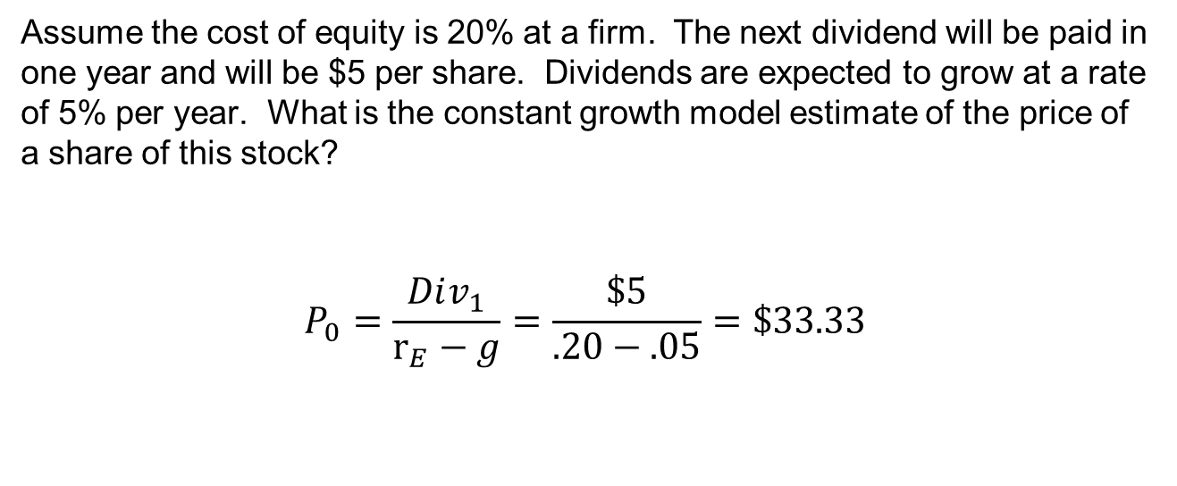
Example 1:
Using the constant-growth dividend discount model
Assume the cost of equity is 20% at a firm. The next dividend will be paid in one year and will be $5 per share. Dividends are expected to grow at a rate of 5% per year. What is the constant growth model estimate of the price of a share of this stock?
$$P_{0}=\frac{Div_{1}}{r_{E}−g}=\frac{\$5}{.20−.05}=\$33.33$$

Slide 19
General comments on the no growth example
This valuation example assumes (a) the next dividend will be received one full period in the future, (b) the dividends will grow at a fixed rate forever, and (c) the discount rate remain the same forever.

Slide 20

Example 2: Caterpillar
Caterpillar website -- http://www.cat.com
Caterpillar dividends -- http://www.caterpillar.com/investors/stock-information/dividend-history
How much would you pay for this cash stream of dividends? How would you decide?

Slide 21
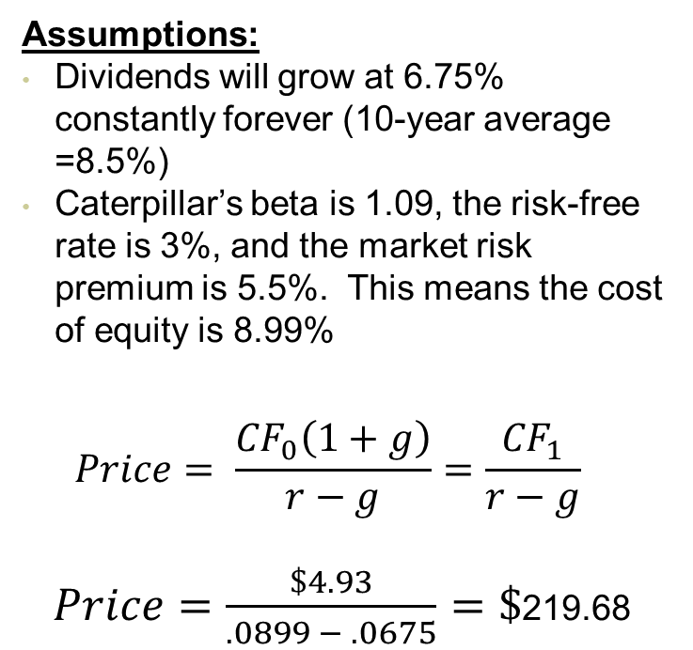
Example valuation using Caterpillar dividends and a constant growth model. Assume today is Jan 1, 2023.
Year | Annual | Dividend
 | Dividend | growth
2022 | 4.62 | 7.94%
2021 | 4.28 | 3.88%
2020 | 4.12 | 8.99%
2019 | 3.78 | 15.24%
2018 | 3.28 | 5.47%
2017 | 3.11 | 0.97%
2016 | 3.08 | 2.33%
2015 | 3.01 | 15.77%
2014 | 2.6 | 12.07%
2013 | 2.32 | 14.85%
2012 | 2.02 | 10.99%
2011 | 1.82 | 4.60%
Assumptions:
Dividends will grow at 6.75% constantly forever (10-year average =8.5%)
Caterpillar’s beta is 1.09, the risk-free rate is 3%, and the market risk premium is 5.5%. This means the cost of equity is 8.99%
$$Price= \frac{{CF}_{0}\left(1+g\right)}{r−g}=\frac{{CF}_{1}}{r−g}$$
$Price=\frac{\$4.93}{.0899 − .0675}=\$$219.68

Slide 22
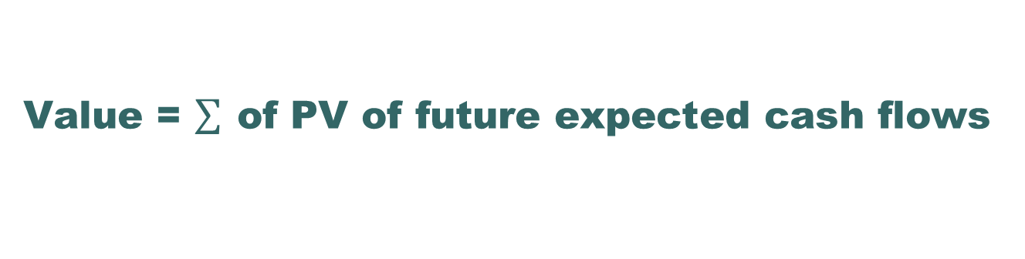

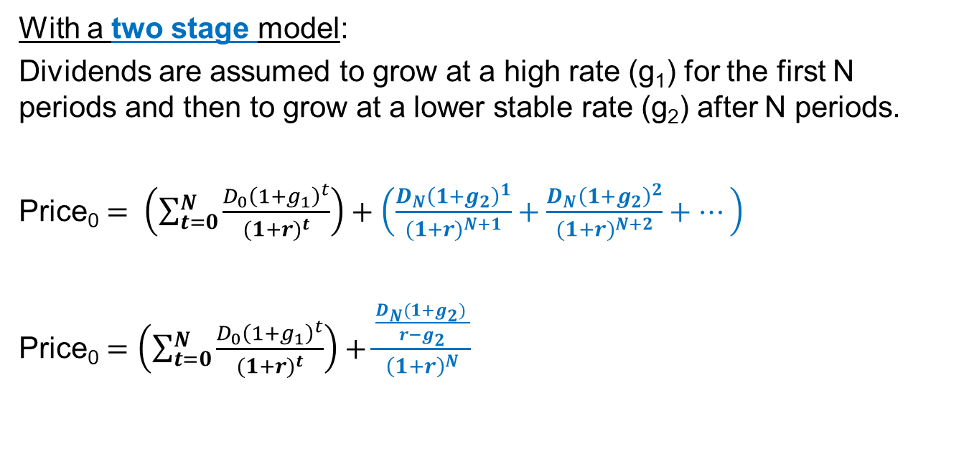
Value = $\sum{ \text{of} \text{PV} \text{of} \text{future} \text{expected} \text{cash} \text{flows}}$
With a two stage model:
Dividends are assumed to grow at a high rate (g₁) for the first N periods and then to grow at a lower stable rate (g₂) after N periods.
Price₀ $= \left(\sum_{t=0}^{N}{\frac{D_{0}{\left(1+g_{1}\right)}^{t}}{{(1+r)}^{t}}}\right)+\left(\frac{D_{N}{\left(1+g_{2}\right)}^{1}}{{(1+r)}^{N+1}}+\frac{D_{N}{\left(1+g_{2}\right)}^{2}}{{(1+r)}^{N+2}}+…\right)$
Price₀ $=\left(\sum_{t=0}^{N}{\frac{D_{0}{\left(1+g_{1}\right)}^{t}}{{(1+r)}^{t}}}\right)+\frac{\frac{D_{N}(1+g_{2}) }{r−g_{2}}}{{\left(1+r\right)}^{N}}$
D_{N} is the “N”^{th} future dividend.
D_{N}*(1+g₂) is the “N+1” dividend.
$\frac{D_{N}(1+g_{2}) }{r−g_{2}}$ is in “year N” dollars.
Notes:
Under the constant growth assumption the valuation simplifies to the “constant growth dividend model” using the “Gordon growth” formula. Note that the formula is only useful if g<r.

Slide 23
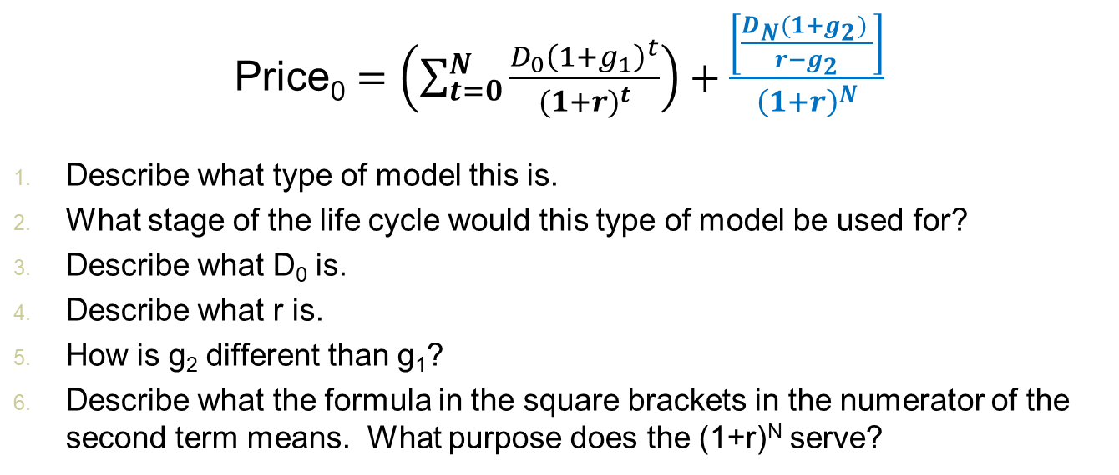
23
Concept check
Price₀ $=\left(\sum_{t=0}^{N}{\frac{D_{0}{\left(1+g_{1}\right)}^{t}}{{(1+r)}^{t}}}\right)+\frac{\left[\frac{D_{N}(1+g_{2}) }{r−g_{2}}\right]}{{\left(1+r\right)}^{N}}$
Describe what type of model this is.
What stage of the life cycle would this type of model be used for?
Describe what D₀ is.
Describe what r is.
How is g₂ different than g₁?
Describe what the formula in the square brackets in the numerator of the second term means. What purpose does the (1+r)^{N} serve?

Slide 24
Concept check answers
Price₀ is the current price in a two-stage dividend model.
This type of model is useful for early-stage companies experiencing explosive growth (g₁) for some time before becoming mature and then experiencing steady growth (g₂).
D₀ would be the current dividend.
r would be the discount rate. For a dividend model this would be the cost of equity. For a FCF model this would be the wacc.
g₂ < g₁ where g₂ is more appropriate for a stable (perpetual) growth rate
The Gordon growth portion of the formula (which is everything in blue except the (1+r)^{N} part) calculates the PV of the cash flows starting in N+1 growing at a constant g₂ rate forever as of year N. The (1+r)^{N} portion of the formula then discounts this quantity to year 0.

Slide 25
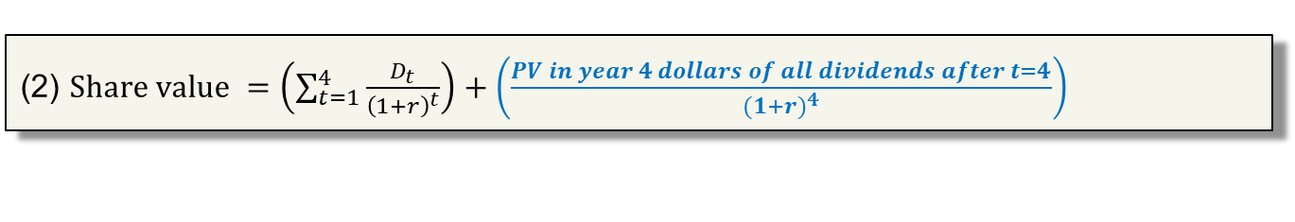
These 3 expressions for the share value are equivalent if the projected future dividends are the same
$Share value=\frac{D_{1}}{{\left(1+r\right)}^{1}}+\frac{D_{2}}{{\left(1+r\right)}^{2}}+\frac{D_{3}}{{\left(1+r\right)}^{3}}+$ $\frac{D_{4}}{{\left(1+r\right)}^{4}}+$ $\frac{D_{5}}{{\left(1+r\right)}^{5}}+\frac{D_{6}}{{\left(1+r\right)}^{6}}+\frac{D_{7}}{{\left(1+r\right)}^{7}}+$…
(2) $Share value =\left(\sum_{t=1}^{4}{\frac{D_{t}}{{\left(1+r\right)}^{t}}}\right)+\left(\frac{PV in year 4 dollars of all dividends after t=4}{{(1+r)}^{4}}\right)$
The numerator in the second part of (2) would be in year 4 dollars if a constant growth formula were used $\left({PV}_{4}=\frac{D_{5}}{r−g}\right)$ to estimate the value of all future dividends.

Slide 26
Concept checks - stock
A share of stock can be thought of as the present value of which types of cash flow?
What is the appropriate discount rate for these cash flows?
How do you calculate this discount rate?
Which type of beta is used to calculate the discount rate?
What types of modeling assumptions do we make for equity cash flows?
Notes:
Present value of cash flows to equity holders. In order for the value to be a single share then the cash flows should be at the share-level. Dividends per share are commonly used.
The appropriate discount rate is the cost of equity.
CAPM is typically used to calculate the cost of equity.
In order for CAPM to be used to calculate the cost of equity it must be the case that the beta used in the CAPM is an equity beta.
In lecture we talked about a general case (no pattern for dividends), a not growth case, a constant growth case, and a two stage model.

Slide 27
Wait! What if there are no dividends?
Some firms don’t pay dividends. They decide instead to “plow back” the earnings into the firm. Reinvestment of earnings allows firms to grow future earnings.
plowback ratio = retention ratio
Notes:
The “plowback ratio” is the percent of earnings retained rather paid out to shareholders. This is also called the retention rate.
What criteria should a manager use to decide whether to reinvest earnings or to distribute them to shareholders?

Slide 28
Dividend discount model vs discounted free cash flow model
In the previous valuation examples, we focused on the dividends and discounted them using the equity cost of capital.
Using a related valuation approach, we could instead value the entire firm (not just the equity) by discounting the cash flows that pertain to both the equity and debt holders using the WACC.
These cash flows are the free cash flows.

Slide 29
Ideas you already know…
Question: What is something worth?
Answer: The ______ is the PV of all cash flows tied to it.
  Bond price = PV(coupons) + PV(face value)
  Share price = PV (cash flows to equity holder)
  Firm value = PV(all future FCFs)
Terminology: PV, coupons, face value, FCFs, share, bond

Slide 30
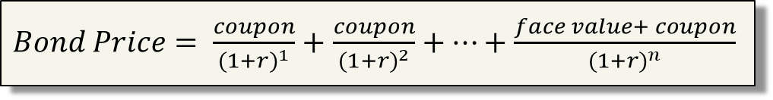
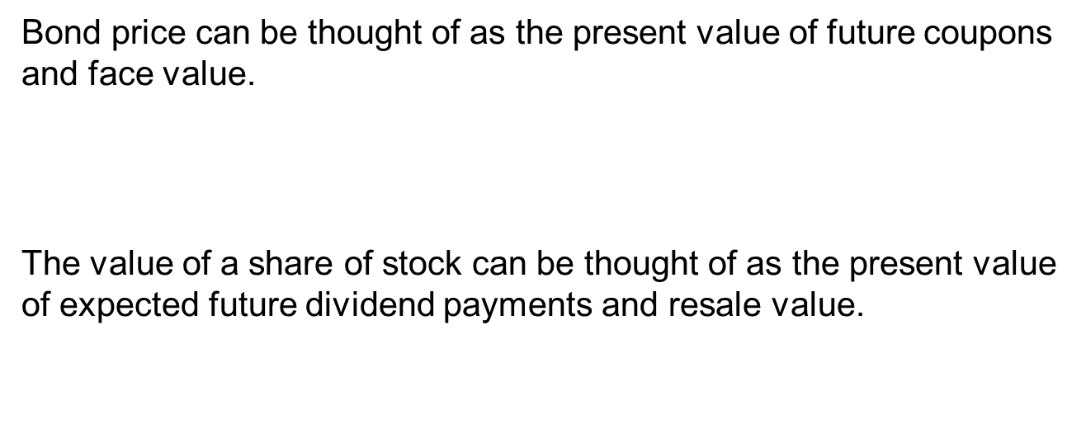
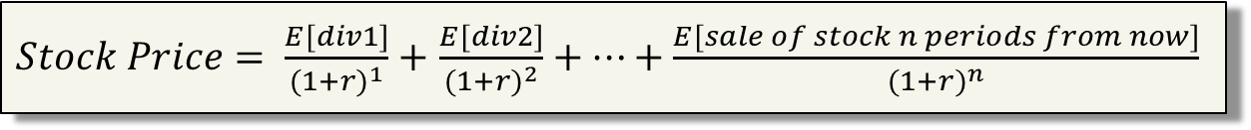
Bond and stock valuation using DCF approaches…
Bond price can be thought of as the present value of future coupons and face value.
The value of a share of stock can be thought of as the present value of expected future dividend payments and resale value.
$Bond Price= \frac{coupon}{{(1+r)}^{1}}+$ $\frac{coupon}{{(1+r)}^{2}}+…+\frac{face value+ coupon}{{(1+r)}^{n}}$
$Stock Price= \frac{E[div1]}{{(1+r)}^{1}}+$ $\frac{E[div2]}{{(1+r)}^{2}}+…+\frac{E[sale of stock n periods from now]}{{(1+r)}^{n}}$

Slide 31

Discounted free cash flow model
$Enterprise value=\frac{{FCF}_{1}}{{\left(1+wacc\right)}^{1}}+\frac{{FCF}_{2}}{{\left(1+wacc\right)}^{2}}+…$
The PV of FCFs is equal to the enterprise value which is a measure of firm value. The words “firm value” are used in different ways. Sometimes “enterprise value” is referred to as “firm value” and sometimes “enterprise value + cash” is referred to as “firm value”.
Note that the PV of future FCFs (equation shown above) does not include the cash already in place. I.e., if a firm has a large amount of excess cash then
Firm value (with cash) = D + E = Enterprise value + cash

Slide 32
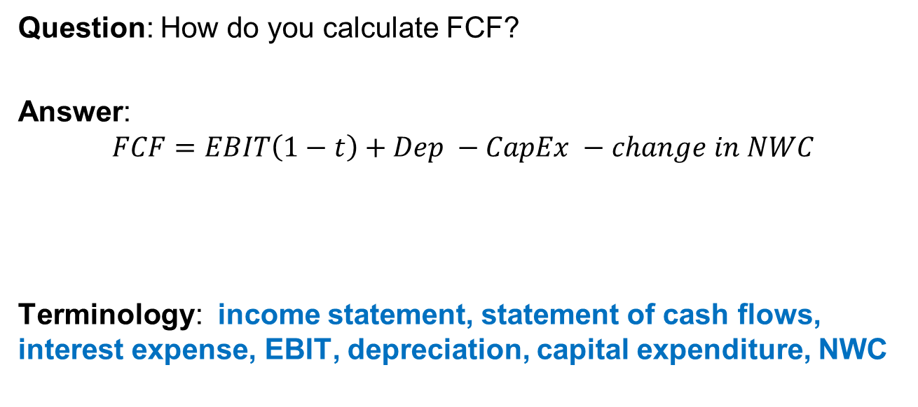
Ideas you already know…
Question: How do you calculate FCF?
Answer:
$$FCF=EBIT\left(1−t\right)+Dep −CapEx −change in NWC$$
Terminology: income statement, statement of cash flows, interest expense, EBIT, depreciation, capital expenditure, NWC
Notes:
As noted on page 25 of your textbook in reference to the EBIT(1-t) part of the formula “Note that interest expense is not deducted before calculating the firm’s tax liability. This is because FCF represents the cash flow available for both creditors (interest plus principal) and owners.” There is a different version of the FCF formula that focuses on FCFs to equity holders.

Slide 33
Review terminology so far for your personal study
(some of these terms are in the assigned reading)
You should be able to give a 1-2 sentence description, or formula, of each of these terms.
common stock preferred stock what is value? 3 ways to solve for r_{E} Limitations of dividend discount model | free cash flows no growth assumption constant growth assumption two-stage growth assumption cost of equity estimation Gordon growth dividend discount model free cash flow model

Slide 34
Review problem #1
Myox Labs suddenly announces that it will pull one of its leading drugs from the market, owing to the potential side effects recently discovered with the drug.
As a result, its future expected free cash flow will be $85 million less each year for the next ten years than was previously expected. Assume that Myox Labs has not debt such that the FCFs pertain only to the equity holders.
Myox has 50 million shares outstanding, no debt, and an equity cost of capital of 8%. If this news came as a complete surprise to investors, what should happen to Myox’s stock price at announcement?

Slide 35
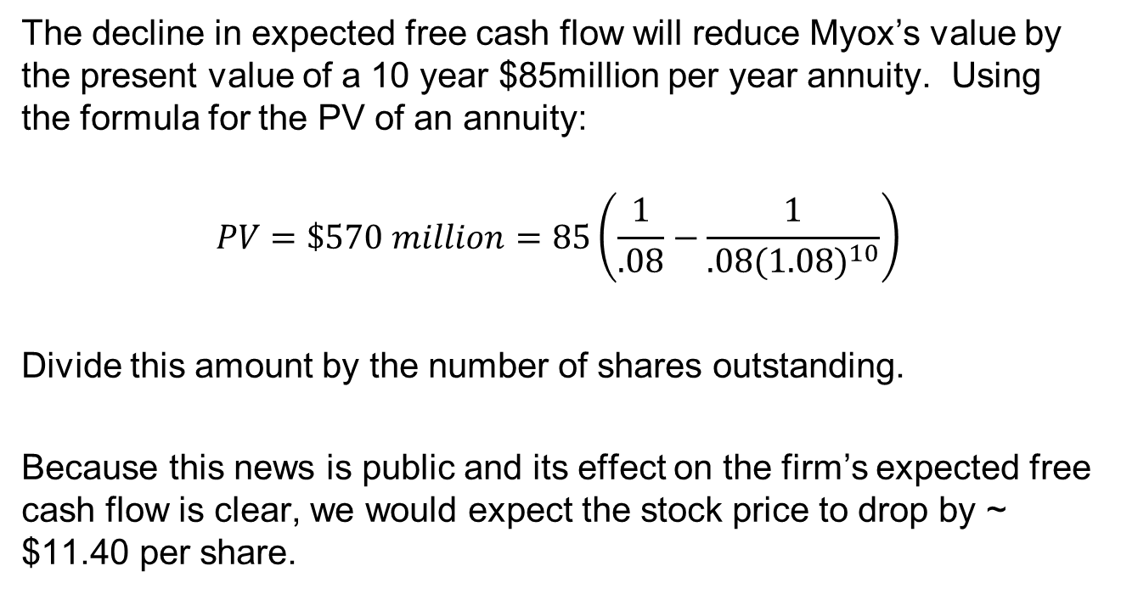
Answer to review problem #1
The decline in expected free cash flow will reduce Myox’s value by the present value of a 10 year $85million per year annuity. Using the formula for the PV of an annuity:
$$PV=\$570 million=85\left(\frac{1}{.08}−\frac{1}{.08{(1.08)}^{10}}\right)$$
Divide this amount by the number of shares outstanding.
Because this news is public and its effect on the firm’s expected free cash flow is clear, we would expect the stock price to drop by ~ $11.40 per share.

Slide 36
Discussion Topics
Background information related to equity ownership
DCF equity valuation models based on a…
  Dividend discount model
  Free cash flow model
Review problems
Terminal growth assumption in DCF models.
Discuss the intuition in the P/E ratio.

Slide 37
Big picture summary of DCF equity valuation
The value of equity (today) is calculated by discounting all expected cash flows to equity at the cost of equity.
The dividend discount model is a specialized case of equity valuation where the value of a stock is calculated as the present value of expected future dividends.
(General Case) $Value of Equity= \sum_{t=1}^{∞}{\frac{{E[Cash Flows to Equityholders}_{t}]}{{\left(1+r_{E}\right)}^{t}}}$
(DDM Case) $Value of Equity=$ $\frac{D_{1}}{{\left(1+r_{E}\right)}^{1}}+\frac{D_{2}}{{\left(1+r_{E}\right)}^{2}}+\frac{D_{3}}{{\left(1+r_{E}\right)}^{3}}$+…
Notes:
The value of equity is the present value of cash flows to the equity investors discounted back at the rate of return that those equity investors need to make to be fairly compensated for that level of risk.
The formulas on this slide assume that the next cash flow will occur 1 period from now.

Slide 38
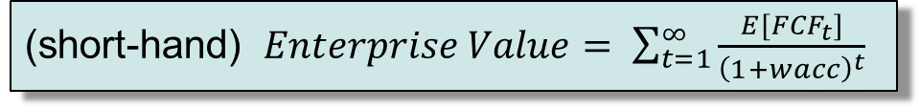
Big picture summary of DCF firm valuation
The value of the firm (today) is calculated by discounting expected cash flows to the firm (the free cash flows) at the weighted average cost of capital.
(short-hand) $Enterprise Value= \sum_{t=1}^{∞}{\frac{{E[FCF}_{t}]}{{\left(1+wacc\right)}^{t}}}$
(long version) $Enterprise Value=$ $\frac{{FCF}_{1}}{{\left(1+wacc\right)}^{1}}+\frac{{FCF}_{2}}{{\left(1+wacc\right)}^{2}}+\frac{{FCF}_{3}}{{\left(1+wacc\right)}^{3}}\text{+…}$
Notes:
The free cash flow model values the firm (and not just the equity).
The formulas on this slide assume that the next cash flow will occur 1 period from now.

Slide 39
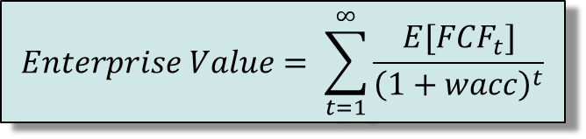
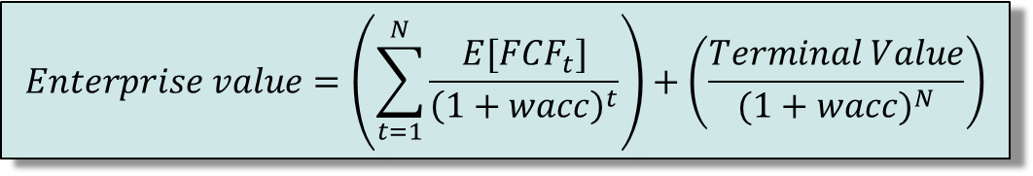
Infinite cash flows in both equity and firm DCF models…
A publicly traded firm has no expected end to the cash flows.
Since we cannot estimate detailed cash flows forever, we estimate cash flows for a “growth period” and then estimate a terminal or horizon value, to capture the value at the end of the period:
becomes
$$Enterprise Value= \sum_{t=1}^{∞}{\frac{{E[FCF}_{t}]}{{\left(1+wacc\right)}^{t}}}$$
“Horizon Value”
or
“Terminal Value”
$$Enterprise value=\left(\sum_{t=1}^{N}{\frac{{E[FCF}_{t}]}{{\left(1+wacc\right)}^{t}}}\right)+\left(\frac{Terminal Value}{{(1+wacc)}^{N}}\right)$$
Notes:
Firms have infinite lives. Since we cannot estimate cash flows forever, we assume a constant growth rate forever as a way of closing off the valuation.
A commonly used variant of this approach is to use a multiple of the terminal year’s earnings. This brings an element of relative valuation into the analysis. In a pure DCF model, the terminal value has to be estimated with a stable growth rate.
The formulas on this slide assume that the next cash flow will occur 1 period from now.

Slide 40
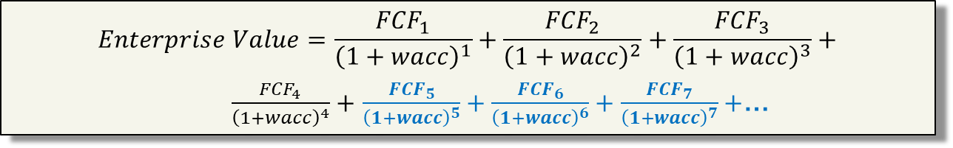
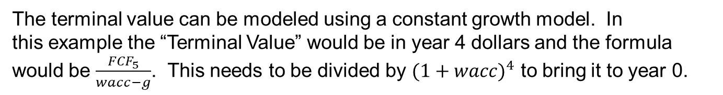
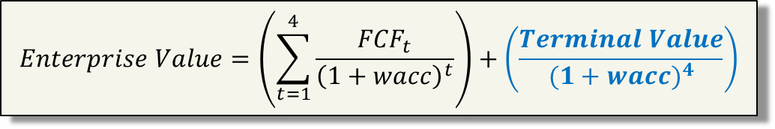
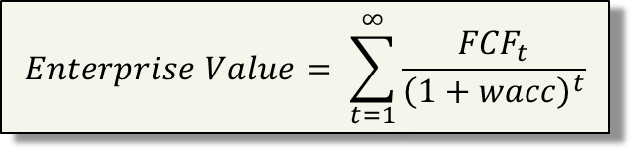
All 3 of these firm value expressions are the same if the projected future FCFs are the same
$$Enterprise Value=\frac{{FCF}_{1}}{{\left(1+wacc\right)}^{1}}+\frac{{FCF}_{2}}{{\left(1+wacc\right)}^{2}}+\frac{{FCF}_{3}}{{\left(1+wacc\right)}^{3}}+$$
$\frac{{FCF}_{4}}{{\left(1+wacc\right)}^{4}}+$ $\frac{{FCF}_{5}}{{\left(1+wacc\right)}^{5}}+\frac{{FCF}_{6}}{{\left(1+wacc\right)}^{6}}+\frac{{FCF}_{7}}{{\left(1+wacc\right)}^{7}}+$…
$$Enterprise Value= \sum_{t=1}^{∞}{\frac{{FCF}_{t}}{{\left(1+wacc\right)}^{t}}}$$
$$Enterprise Value=\left(\sum_{t=1}^{4}{\frac{{FCF}_{t}}{{\left(1+wacc\right)}^{t}}}\right)+\left(\frac{Terminal Value}{{(1+wacc)}^{4}}\right)$$
The terminal value can be modeled using a constant growth model. In
this example the “Terminal Value” would be in year 4 dollars and the formula
would be $\frac{{FCF}_{5}}{wacc−g}$. This needs to be divided by ${(1+wacc)}^{4}$ to bring it to year 0.
Notes:
The formulas on this slide assume that the next cash flow will occur 1 period from now.

Slide 41
Concept check - Firm value
The firm value is the present value of what types of cash flows?
What is the appropriate discount rate for these cash flows?
If a firm has no debt, is the firm value the same as the equity value?
How do you convert an earnings number to a free cash flow number? What is the intuition behind the formula?
Free cash flows extend indefinitely into the future. How do you model an infinite series of cash flows?
How do you choose a growth rate when forecasting cash flows?
What would you need to do to the firm value in order to use it to then calculate the value of a single share of stock?
Notes:
Free cash flows
Wacc
Yes
FCF = EBIT(1-t) + Depreciation & Amortization – Change in Net Working Capital – Capital Expenditure. The intuition for this formula focuses on finding the “free” cash each period. Some of the changes are undoing accounting numbers that do not represent actual cash in/out flows. For example depreciation affects net income but it itself is not a cash flow.
You make a simplifying assumption. For example you could assume no growth (perpetuity formula), constant growth (Gordon growth formula).
You look at recent years’ growth rates at the firm. You look at growth in the industry. You choose a growth rate informed by both the firm’s and industry’s recent historical growth rate. But you have to mindful that a perpetual growth rate can’t be too high even if recent growth has been high.
Subtract off market value of debt and then divide by shares outstanding

Slide 42
Discussion Topics
Background information related to equity ownership
DCF equity valuation models based on a…
  Dividend discount model
  Free cash flow model
Review problems
Terminal growth assumption in DCF models.
Discuss the intuition in the P/E ratio.

Slide 43
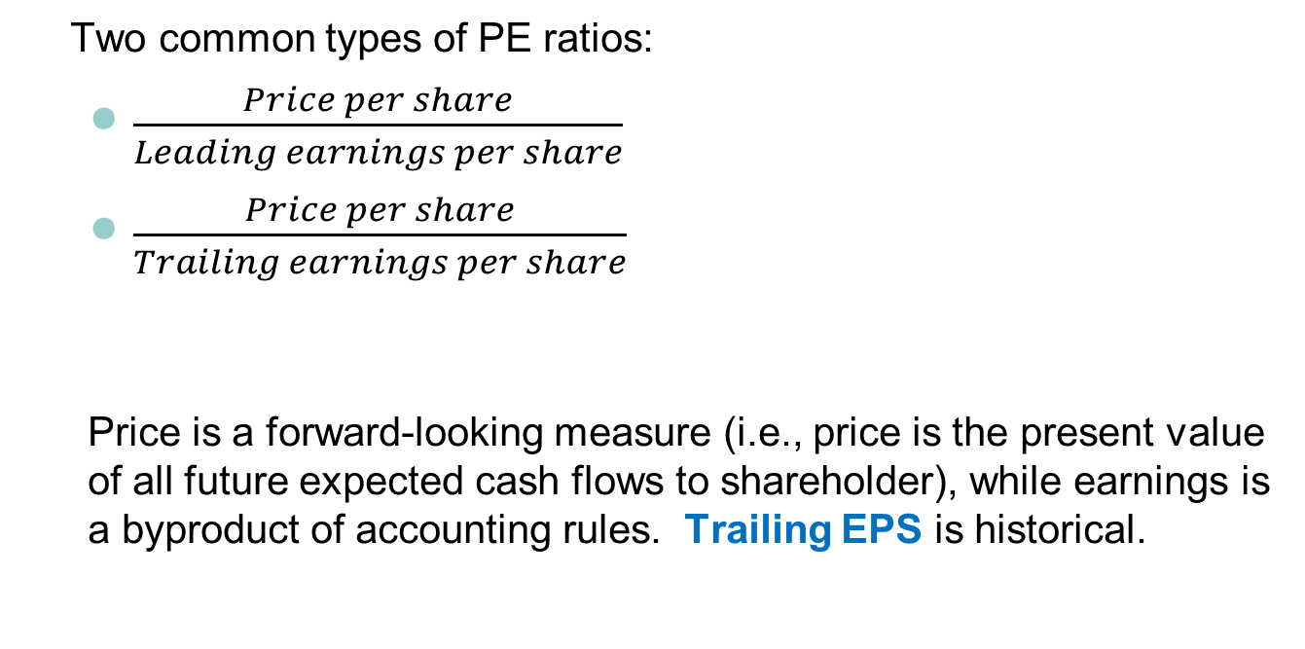
P/E ratio
Two common types of PE ratios:
  $\frac{Price per share}{Leading earnings per share}$
  $\frac{Price per share}{Trailing earnings per share}$
  Price is a forward-looking measure (i.e., price is the present value of all future expected cash flows to shareholder), while earnings is a byproduct of accounting rules. Trailing EPS is historical.
Notes:
Earnings are sensitive to business cycles and earnings management.

Slide 44
What does the P/E ratio mean?
A high P/E ratio is generally interpreted as suggesting that the market expects relatively high growth in the firm’s future earnings.
Notes:
Whether or not a firm’s P/E ratio is “high” depends on a comparison of that firm’s P/E ratio with both its historical P/E ratio and the P/E ratios of firms in its industry.

Slide 45
If a high P/E ratio implies expected high growth, what are the underlying implications for the firm?
Why do dividends and earnings grow through time?
If firms have a plowback ratio greater than 0 (i.e., b>0 on next couple slides), then some portion of each period’s earnings are being reinvested and not distributed as dividends. Plowback is required in order to have earnings growth.
Notes:
The plowback ratio is also known as the earning retention ratio.

Slide 46
Additional review terminology for your personal study
(some of these terms are in the assigned reading)
You should be able to give a 1-2 sentence description, or formula, of each of these terms.
How do you write a DCF formula using dividends? How do you write a DCF formula using FCFs? How are these formulas similar? Different? What is a terminal value? | What assumptions go into DCF models? What assumptions go into relative valuation? How do you calculate firm value using comparables?

