Slide 1
Review of FIN 300 topics (part 2)
FIN 300 – Principles of Finance
Lecture 26
Professor Schonlau

Slide 2
Discussion Topics
We will spend the time in class today going through key takeaways from the lectures that covered the topics in PowerPoint files 11 - 15.
We won’t have time to go into detail about everything, but our class discussion is intended to help you remember some of the key points from the second half of the semester.
As discussed in class, the final exam will cover key topics from earlier in the semester in addition to the topics covered since midterm 2.

Slide 3
Example review questions related to PowerPoint file 11
How is total risk measured in finance? How is systematic risk measured?
What happens to the total risk of a portfolio as you increase the number of assets together in the portfolio?
What is the difference between “market” and “firm specific” risk? What are some synonyms for “market” risk? What are some synonyms for “firm specific” risk?
According to the CAPM, what type of risk is “compensated”? What is the CAPM equation? What are the inputs?
How do you estimate a beta?
Can you draw and interpret the SML and SCL figures?

Slide 4
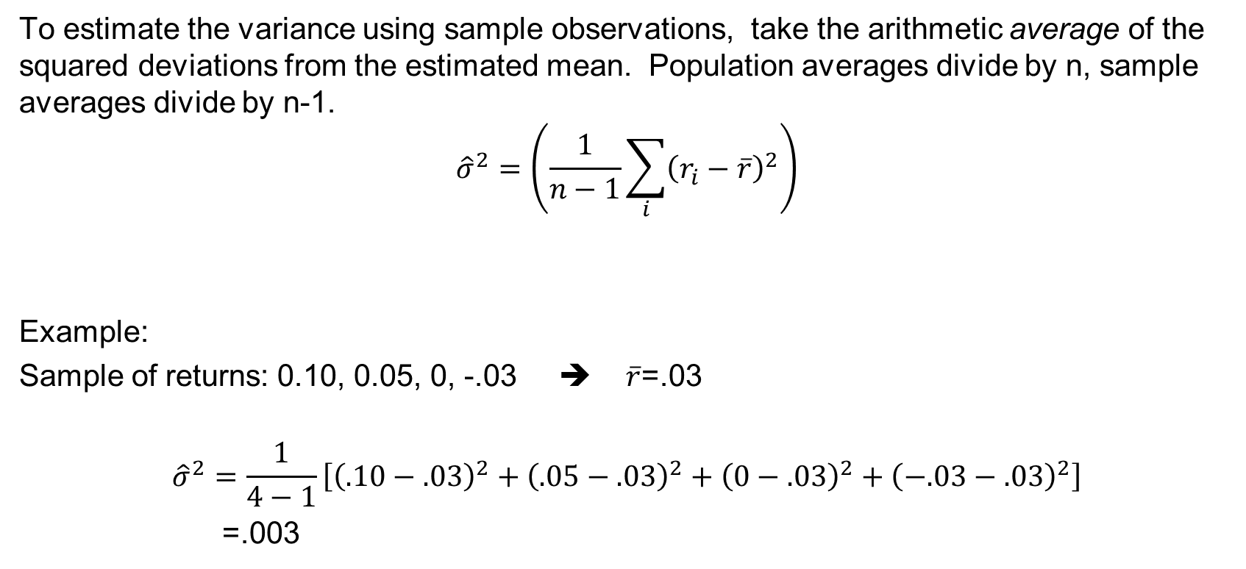
Variance and standard deviation are measures of total risk
To estimate the variance using sample observations, take the arithmetic average of the squared deviations from the estimated mean. Population averages divide by n, sample averages divide by n-1.
$${\hat{σ}}^{2}=\left(\frac{1}{n−1}\sum_{i}{{\left(r_{i}−\overline{r}\right)}^{2}}\right)$$
Example:
Sample of returns: 0.10, 0.05, 0, -.03 ➔ $\overline{r}$=.03
$${\hat{σ}}^{2}=\frac{1}{4−1}\left[{\left(.10−.03\right)}^{2}+{\left(.05−.03\right)}^{2}+{\left(0−.03\right)}^{2}+{\left(−.03−.03\right)}^{2}\right]$$
=.003

Slide 5
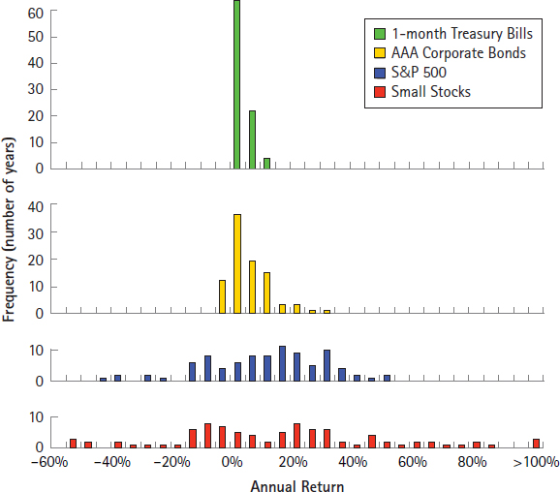
The distribution of annual returns (1926-2015) for…
Treasury Bills
Corporate Bonds
U.S. Large Stocks (S&P 500)
Small Stocks
Notes:
Notice the greater dispersion of historical outcomes with the riskier assets. This figure came from Fundamentals of Corporate Finance chapter 11.

Slide 6
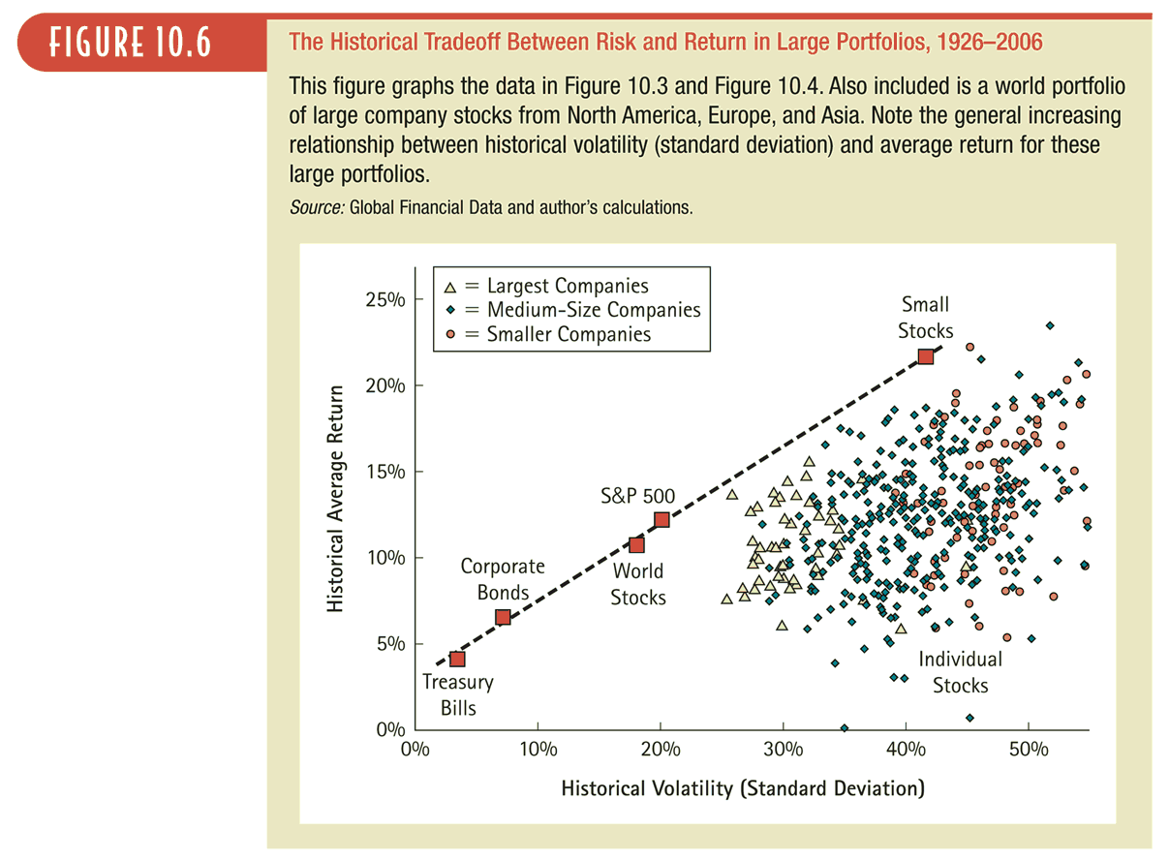
6
Notes:
This figure is from Fundamentals of Corporate Finance by Berk, DeMarzo, and Harford

Slide 7
Effect of diversification on firm specific risk in portfolio.
σ
Firm or
Diversifiable or
Unique or
Idiosyncratic
Risk
Market or non-diversifiable Risk
1 2 3 . . . Number of firms in portfolio
Notes:
The effects of diversification :
Firm specific risk can be reduced, if not eliminated in a portfolio. Market risk cannot.
Diversifying and holding a larger portfolio eliminates firm specific risk for at least two reasons-
(1) Each investment is a much smaller percentage of the portfolio, muting the effect (positive or negative) on the overall portfolio.
(2) Firm specific actions can be either positive or negative. In a large portfolio, it is argued, these effects will average out to zero. (For every firm, where something bad happens, there will be some other firm, where something good happens.)

Slide 8
CAPM
This portion of the formula
calculates the risk premium to be added to the risk-free rate
Model: E[r_{i}] = r_{f} + β_{i}*(E(r_{M})-r_{f})
Intuition: The expected return on asset i is higher than the return on the risk-free asset by the risk premium.
The beta measures the amount of systematic risk in asset i. The market risk premium is a fair return for each unit of systematic risk.

Slide 9

To estimate an equity beta from a regression you need two columns of historical return data as shown below. You can also view the data in a scatterplot as shown on the next slide.
The top 5 rows of data are copied from the example excel file below. In the file there are more data points.
Dependent variable
Explanatory variable

Slide 10
The beta measures the slope of the trend line. What does the R-squared mean?

Slide 11
Security Market Line (SML) and Alphas
CAPM: E(r_{i}) = r_{f} + β_{i} * (E(r_{m}) - r_{f})
If stock i provided a 20% return in a given year and was expected (given its B_{i} and the other CAPM inputs) to only provide 18%, then the alpha is shown as the vertical difference between the SML and the actual return (*).
The alpha is a measure of over and under performance.
E(R)
*
18%
R_{f}
Beta

Slide 12
Example review questions related to PowerPoint file 13
What are some of the key differences between owning debt versus equity?
What are 3 ways to solve for the cost of equity?
Share price can be modeled using a DCF approach with TVM formulas. What are 3 approaches for modeling infinite series of cash flows?
How do these models change if we focus on FCFs instead of dividends?
The terminal value is usually modeled as a perpetuity or as a growing perpetuity.
How do you use a multiple to do a relative valuation?

Slide 13
How are debt and equity claims similar? How do they differ?
Key Characteristics Differences
Nature of claim on cash flows…………..….…..……….fixed vs residual?
Priority of claim on cash flows…………...........….primary vs secondary?
Maturity…………………………………………….....…...finite vs ongoing?
Managerial control………………………...….…..……………..ownership?
Expected return/risk………………………….…….…….….………….risk?
Important intuition: Debt contracts tend to have fixed claims on cash flows that have higher priority than equity claims. This is why debt tends to be less risky (lower variability in returns) and to have lower average returns across time than equity. Equity contracts lay claim to the upside and represent ownership in the firm.

Slide 14
Key ideas related to common stock ownership
Common shares grant ownership claims to all future residual cash flows.
Common shares have no maturity.
Mangers can choose to distribute residual cash flows in the form of dividends or to retain the cash for future use.
Common shares generally grant voting rights. Voting rights have value.
Important intuition: The value of a share today can be modeled as the present value of all future residual cash flows and voting rights. If you assume that “dividends” encompass the future residual cash flows then….
Share price today = PV(all future dividends) + value of voting rights

Slide 15
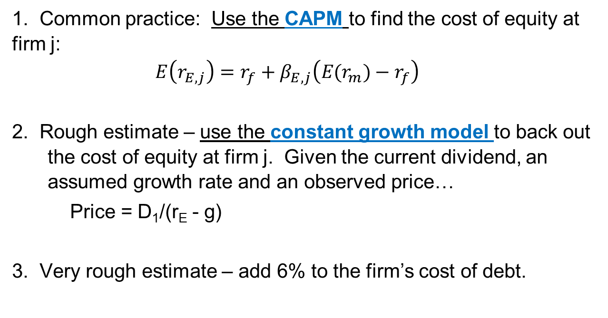
Three ways to calculate r_{E}
1. Common practice: Use the CAPM to find the cost of equity at firm j:
$$E\left(r_{E,j}\right)=r_{f}+β_{E,j}\left(E(r_{m})−r_{f}\right)$$
2. Rough estimate – use the constant growth model to back out the cost of equity at firm j. Given the current dividend, an assumed growth rate and an observed price…
  Price = D₁/(r_{E} - g)
3. Very rough estimate – add 6% to the firm’s cost of debt.
Notes:
Remember that if you are using the CAPM to solve for the cost of equity then the beta should be the equity beta. For a private firm you can use the “bottom up” approach to find the beta if you have to.

Slide 16
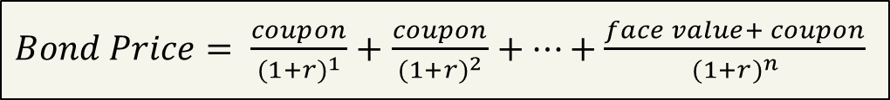
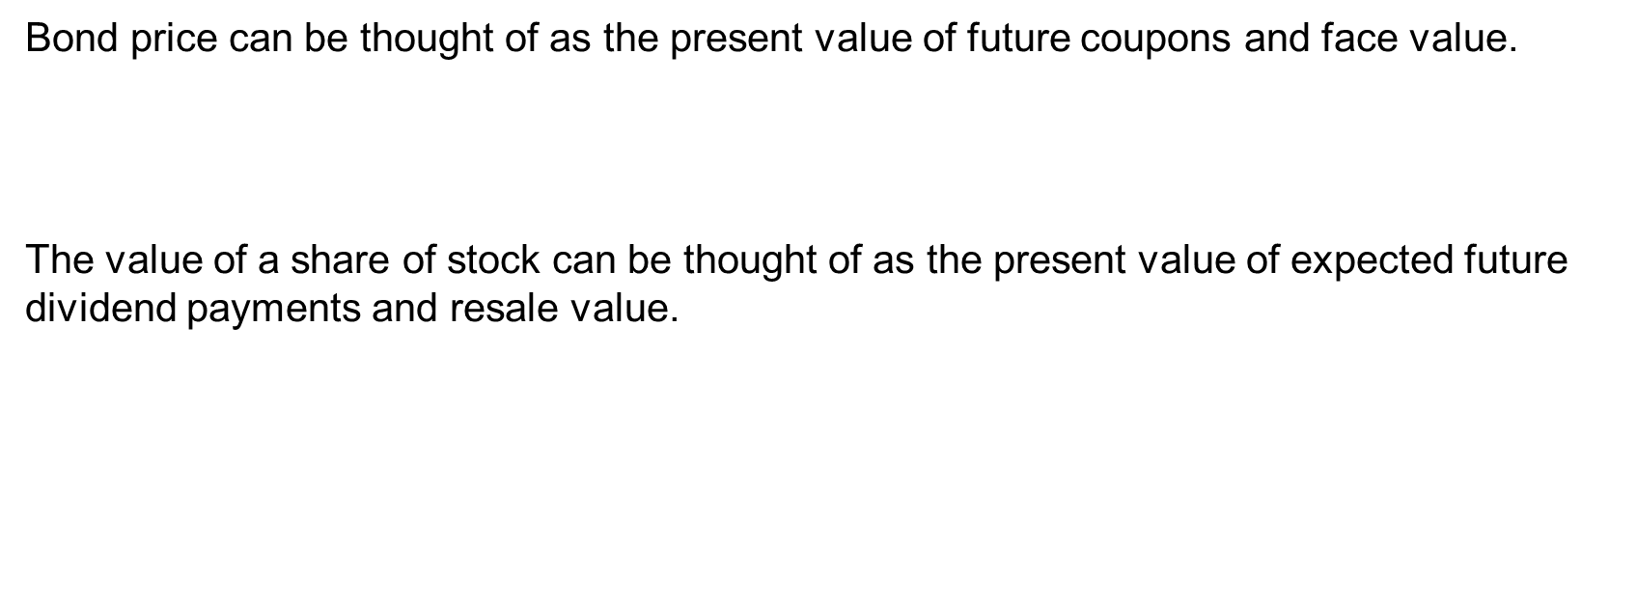
Bond and stock valuation using DCF approaches…
Bond price can be thought of as the present value of future coupons and face value.
The value of a share of stock can be thought of as the present value of expected future dividend payments and resale value.
$Bond Price= \frac{coupon}{{(1+r)}^{1}}+$ $\frac{coupon}{{(1+r)}^{2}}+…+\frac{face value+ coupon}{{(1+r)}^{n}}$
$Stock Price= \frac{E[div1]}{{(1+r)}^{1}}+$ $\frac{E[div2]}{{(1+r)}^{2}}+…+\frac{E[sale of stock n periods from now]}{{(1+r)}^{n}}$

Slide 17
Key question for stock valuation:
What will the future dividends be?
We will consider 3 approaches to modeling future dividends:
Constant dividend (no growth)
Constant growth
Two stage (high growth followed by constant growth)
Note that the same growth assumptions (and formulas) used with dividend can be used when modeling “free cash flows”. We will discuss free cash flow modeling later in the lecture.

Slide 18

No-growth approach
With the no growth assumption for dividend growth:
$D_{0}=D_{1}=D_{2}$…
Price₀ $= \frac{D_{0}}{{(1+r)}^{1}}+\frac{D_{0}}{{(1+r)}^{2}}$ $+\frac{D_{0}}{{(1+r)}^{3}}+…$
Price₀ $= \frac{D_{0}}{r}$
Notes:
Under the no growth assumption the valuation simplifies to a perpetuity.

Slide 19

Constant growth approach
With the constant growth assumption:
${ D}_{1}=D_{0}\left(1+g\right)$ and
$D_{2}=D_{1}\left(1+g\right)=D_{0}\left(1+g\right)(1+g)$
Price₀ $= \frac{D_{0}{\left(1+g\right)}^{1}}{{(1+r)}^{1}}+\frac{D_{0}{\left(1+g\right)}^{2}}{{(1+r)}^{2}}$ $+\frac{D_{0}{\left(1+g\right)}^{3}}{{(1+r)}^{3}}+…$
Price₀ $= \frac{D_{1}}{r−g}=\frac{D_{0}{\left(1+g\right)}^{1}}{r−g}$
Notes:
Under the constant growth assumption the valuation simplifies to the “constant growth dividend model” using the “Gordon growth” formula. Note that the formula is only useful if g<r.

Slide 20
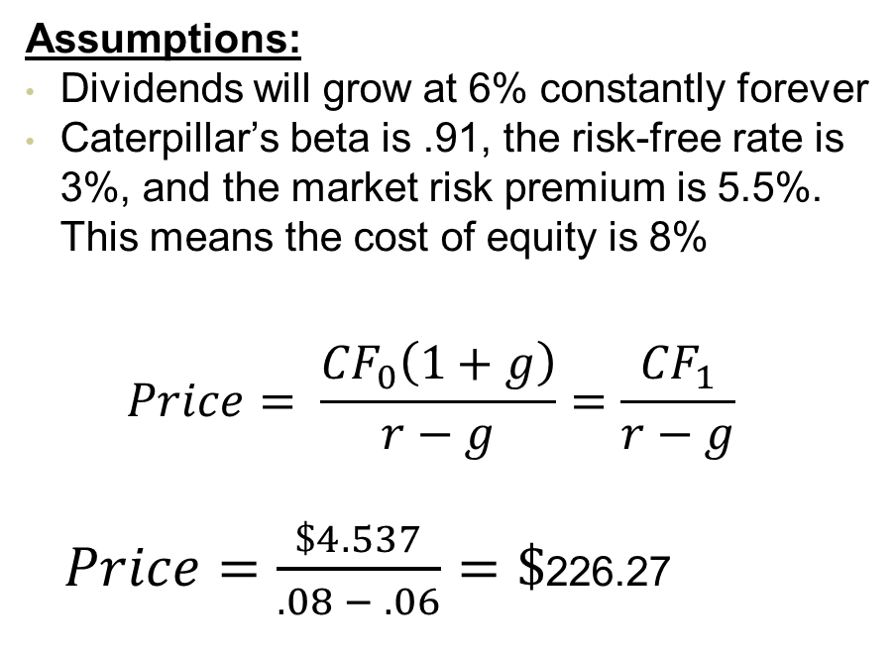
Example valuation using Caterpillar dividends and a constant growth model. Assume today is Jan 1, 2022.
Year | Annual | Dividend
 | Dividend | growth
2021 | 4.28 | 3.88%
2020 | 4.12 | 8.99%
2019 | 3.78 | 15.24%
2018 | 3.28 | 5.47%
2017 | 3.11 | 0.97%
2016 | 3.08 | 2.33%
2015 | 3.01 | 15.77%
2014 | 2.6 | 12.07%
2013 | 2.32 | 14.85%
2012 | 2.02 | 10.99%
2011 | 1.82 | 4.60%
2010 | 1.74 | 3.57%
Assumptions:
Dividends will grow at 6% constantly forever
Caterpillar’s beta is .91, the risk-free rate is 3%, and the market risk premium is 5.5%. This means the cost of equity is 8%
$$Price= \frac{{CF}_{0}\left(1+g\right)}{r−g}=\frac{{CF}_{1}}{r−g}$$
$Price=\frac{\$4.537}{.08 − .06}=\$$226.27

Slide 21
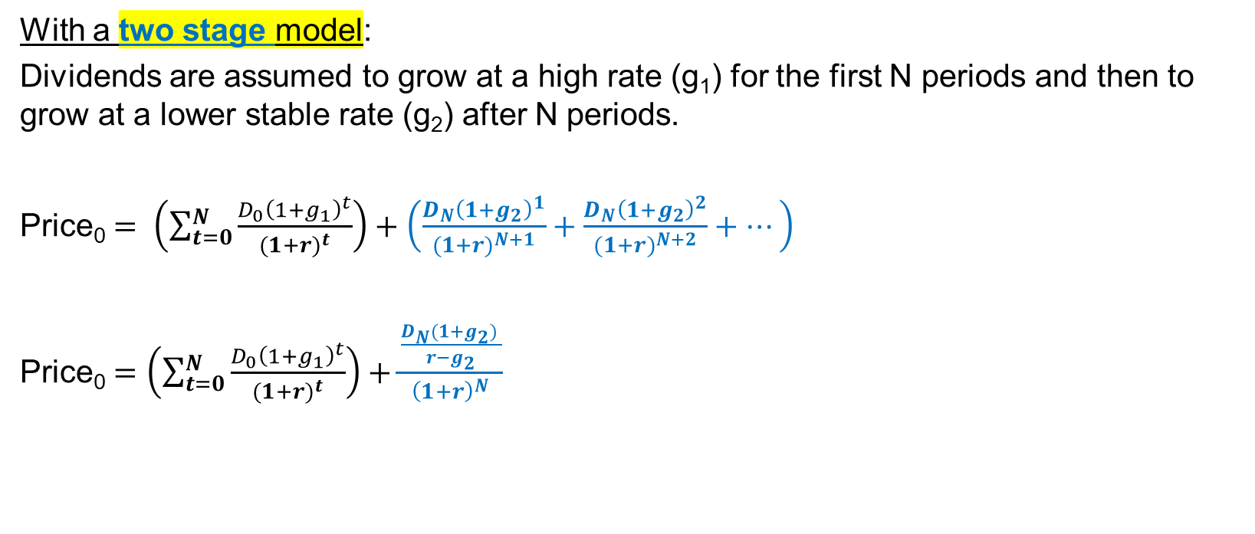

Two-stage approach (terminal value is in second stage)
With a two stage model:
Dividends are assumed to grow at a high rate (g₁) for the first N periods and then to grow at a lower stable rate (g₂) after N periods.
Price₀ $= \left(\sum_{t=0}^{N}{\frac{D_{0}{\left(1+g_{1}\right)}^{t}}{{(1+r)}^{t}}}\right)+\left(\frac{D_{N}{\left(1+g_{2}\right)}^{1}}{{(1+r)}^{N+1}}+\frac{D_{N}{\left(1+g_{2}\right)}^{2}}{{(1+r)}^{N+2}}+…\right)$
Price₀ $=\left(\sum_{t=0}^{N}{\frac{D_{0}{\left(1+g_{1}\right)}^{t}}{{(1+r)}^{t}}}\right)+\frac{\frac{D_{N}(1+g_{2}) }{r−g_{2}}}{{\left(1+r\right)}^{N}}$
D_{N} is the “N”^{th} future dividend.
D_{N}*(1+g₂) is the “N+1” dividend.
$\frac{D_{N}(1+g_{2}) }{r−g_{2}}$ is in “year N” dollars.
Notes:
Under the constant growth assumption the valuation simplifies to the “constant growth dividend model” using the “Gordon growth” formula. Note that the formula is only useful if g<r.

Slide 22
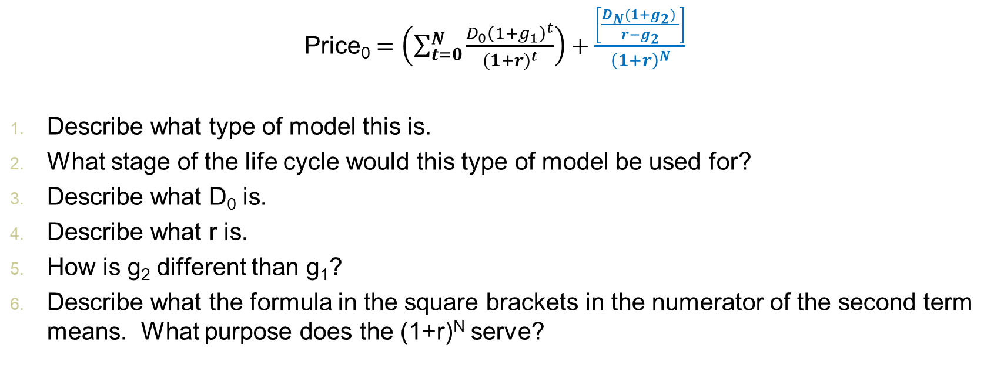
Concept check
Price₀ $=\left(\sum_{t=0}^{N}{\frac{D_{0}{\left(1+g_{1}\right)}^{t}}{{(1+r)}^{t}}}\right)+\frac{\left[\frac{D_{N}(1+g_{2}) }{r−g_{2}}\right]}{{\left(1+r\right)}^{N}}$
Describe what type of model this is.
What stage of the life cycle would this type of model be used for?
Describe what D₀ is.
Describe what r is.
How is g₂ different than g₁?
Describe what the formula in the square brackets in the numerator of the second term means. What purpose does the (1+r)^{N} serve?

Slide 23
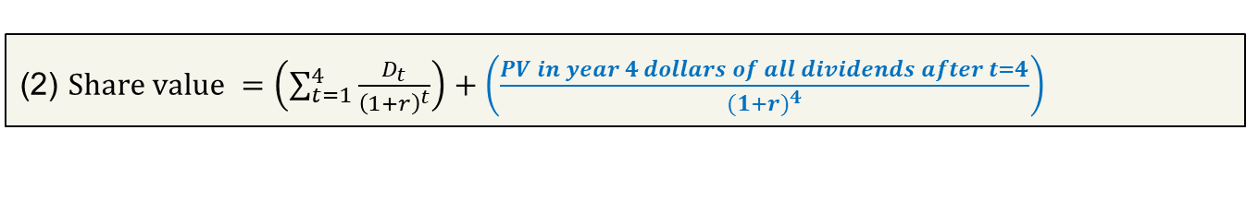
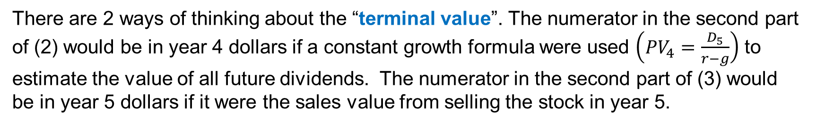

Three ways to write the same thing
$Share value=\frac{D_{1}}{{\left(1+r\right)}^{1}}+\frac{D_{2}}{{\left(1+r\right)}^{2}}+\frac{D_{3}}{{\left(1+r\right)}^{3}}+$ $\frac{D_{4}}{{\left(1+r\right)}^{4}}+$ $\frac{D_{5}}{{\left(1+r\right)}^{5}}+\frac{D_{6}}{{\left(1+r\right)}^{6}}+\frac{D_{7}}{{\left(1+r\right)}^{7}}+$…
(2) $Share value =\left(\sum_{t=1}^{4}{\frac{D_{t}}{{\left(1+r\right)}^{t}}}\right)+\left(\frac{PV in year 4 dollars of all dividends after t=4}{{(1+r)}^{4}}\right)$
(3) $Share value =\left(\sum_{t=1}^{4}{\frac{D_{t}}{{\left(1+r\right)}^{t}}}\right)+\left(\frac{PV in year 5 dollars of all dividends after t=4}{{(1+r)}^{5}}\right)$
There are 2 ways of thinking about the “terminal value”. The numerator in the second part of (2) would be in year 4 dollars if a constant growth formula were used $\left({PV}_{4}=\frac{D_{5}}{r−g}\right)$ to estimate the value of all future dividends. The numerator in the second part of (3) would be in year 5 dollars if it were the sales value from selling the stock in year 5.

Slide 24
Dividend discount model vs discounted free cash flow model
In the previous valuation examples, we focused on the dividends and discounted them using the equity cost of capital.
Using a related valuation approach, we could instead value the entire firm (not just the equity) by discounting the cash flows that pertain to both the equity and debt holders using the WACC.
These cash flows are the free cash flows.

Slide 25
Discounted free cash flow model
$Enterprise value=\frac{{FCF}_{1}}{{\left(1+wacc\right)}^{1}}+\frac{{FCF}_{2}}{{\left(1+wacc\right)}^{2}}+…$
The PV of FCFs is equal to the enterprise value which is a measure of firm value. The words “firm value” are used in different ways. Sometimes “enterprise value” is referred to as “firm value” and sometimes “enterprise value + cash” is referred to as “firm value”.
Note that the PV of future FCFs (equation shown above) does not include the cash already in place. I.e., if a firm has a large amount of excess cash then
Firm value (with cash) = D + E = Enterprise value + cash

Slide 26
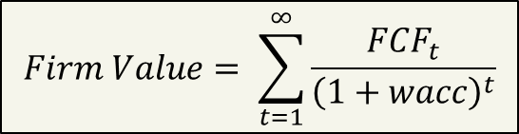
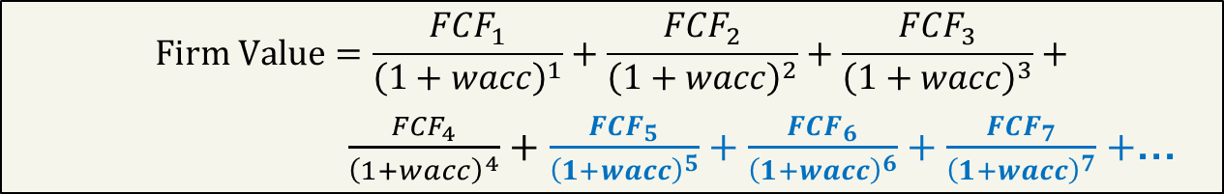
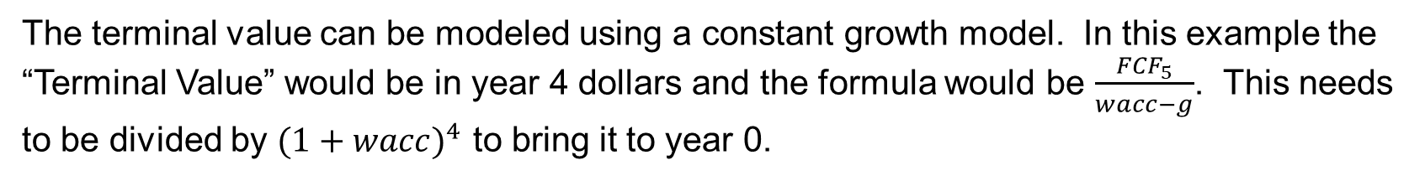
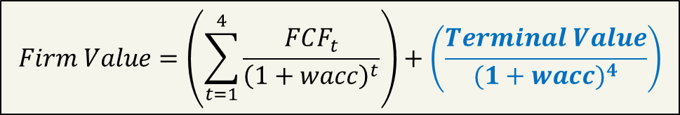
All 3 of these firm value expressions are the same if the projected future FCFs are the same
$$Firm Value=\frac{{FCF}_{1}}{{\left(1+wacc\right)}^{1}}+\frac{{FCF}_{2}}{{\left(1+wacc\right)}^{2}}+\frac{{FCF}_{3}}{{\left(1+wacc\right)}^{3}}+$$
$\frac{{FCF}_{4}}{{\left(1+wacc\right)}^{4}}+$ $\frac{{FCF}_{5}}{{\left(1+wacc\right)}^{5}}+\frac{{FCF}_{6}}{{\left(1+wacc\right)}^{6}}+\frac{{FCF}_{7}}{{\left(1+wacc\right)}^{7}}+$…
$$Firm Value= \sum_{t=1}^{∞}{\frac{{FCF}_{t}}{{\left(1+wacc\right)}^{t}}}$$
$$Firm Value=\left(\sum_{t=1}^{4}{\frac{{FCF}_{t}}{{\left(1+wacc\right)}^{t}}}\right)+\left(\frac{Terminal Value}{{(1+wacc)}^{4}}\right)$$
The terminal value can be modeled using a constant growth model. In this example the “Terminal Value” would be in year 4 dollars and the formula would be $\frac{{FCF}_{5}}{wacc−g}$. This needs to be divided by ${(1+wacc)}^{4}$ to bring it to year 0.

Slide 27
Concept check - Firm value
The firm value is the present value of what types of cash flows?
What is the appropriate discount rate for these cash flows?
If a firm has no debt, is the firm value the same as the equity value?
How do you convert an earnings number to a free cash flow number? What is the intuition behind the formula?
Free cash flows extend indefinitely into the future. How do you model an infinite series of cash flows?
How do you choose a growth rate when forecasting cash flows?
What would you need to do to the firm value in order to use it to then calculate the value of a single share of stock?
Notes:
Free cash flows
Wacc
Yes
FCF = EBIT(1-t) + Depreciation & Amortization – Change in Net Working Capital – Capital Expenditure. The intuition for this formula focuses on finding the “free” cash each period. Some of the changes are undoing accounting numbers that do not represent actual cash in/out flows. For example depreciation affects net income but it itself is not a cash flow.
You make a simplifying assumption. For example you could assume no growth (perpetuity formula), constant growth (Gordon growth formula).
You look at recent years’ growth rates at the firm. You look at growth in the industry. You choose a growth rate informed by both the firm’s and industry’s recent historical growth rate. But you have to mindful that a perpetual growth rate can’t be too high even if recent growth has been high.
Subtract off market value of debt and then divide by shares outstanding

Slide 28
Relative valuation
In relative valuation, the value of an asset is derived from the pricing of “comparable” assets, standardized using a common variable such as earnings, cash flows, book value or revenues.
Examples include --
  • Price/Earnings (P/E) ratios and variants (EBIT multiples, EBITDA multiples, Cash Flow multiples)
  • Price/Book (P/BV) ratios and variants (Tobin's Q)
  • Price/Sales ratios
Notes:
In relative valuation, we assume that markets make mistakes on individual investments, but that they are right, on average, in how they price a sector or the market. (In discounted cash flow valuation, we assume that markets make mistakes over time.)

Slide 29
Example of relative valuation
Summary information from the previous table
Average P/E ratio for software firms: 28.41 “benchmark PE”
Average PEG ratio for software firms: 1.4 “benchmark PEG”
Assume a software company Z had earnings of $977,300 and
expected growth in earnings of 27.03%. What is Z’s value of equity?
Using the P/E ratio: $977,300 * 28.41 = $27.765 million
  Using the PEG ratio: = $977,300 * 27.03 * 1.40 = $ 37.056 million
Logic: $firm value=firm^{′}s earnings ∗ \frac{benchmark price}{benchmark earnings}$
Logic:$firm value=firm^{′}s earnings ∗growth∗ \frac{benchmark price}{benchmark earnings ∗growth}$
Notes:
As discussed earlier the PEG ratio is the PE ratio divided by growth. This is the same as P/(E*G)

Slide 30
Example review questions related to PowerPoint file 14
What is the WACC formula? What are the inputs?
What effect does debt have on taxes? On firm value? On probability of default?
What kinds of characteristics would make debt more valuable for one firm compared to another?
What does M&M say about capital structure?
How much is the tax shield worth? Under what conditions is the value of the tax shield estimated as t*D?

Slide 31

The weighted average cost of capital
The WACC summarizes the after-tax cost of capital to the firm from all sources of financing. Assuming no preferred stock, the weights are the % of equity and debt in the capital structure.
$$WACC= r_{E}\left(\frac{E}{D+E}\right)+r_{D}\left(1−t\right)\left(\frac{D}{D+E}\right)$$

Slide 32
WACC inputs
r_{E} : Cost of equity (CAPM, constant growth, or ~6% + cost of debt)
r_{D} : Cost debt (YTM on straight debt, tables that relate cost of debt to ratings or synthetic ratings)
E: market value of equity
D: market value of debt (often approximated using book value of debt)
t : corporate tax rate

Slide 33
As debt increases in the capital structure…
Tax payments decrease
Initially firm value goes up (because of saved taxes), but eventually firm value decreases (because of the negative valuation effects of financial distress)
The probability of default goes up
The return on equity is leveraged (both bad and good outcomes are more extreme)

Slide 34
Debt tends to work better at firms….
That have relatively more tangible assets, are more profitable, and tend to have relatively less variability in earnings.

Slide 35
M&M
Miller and Modigliani showed that under certain assumptions the capital structure was not important for firm value. These assumptions are described collectively in the lecture as “perfect capital markets”.
These assumptions are violated in the real world and show why/how debt matters for firm value.
  Taxes
  Transaction/Information Costs
  Investment Policy

Slide 36
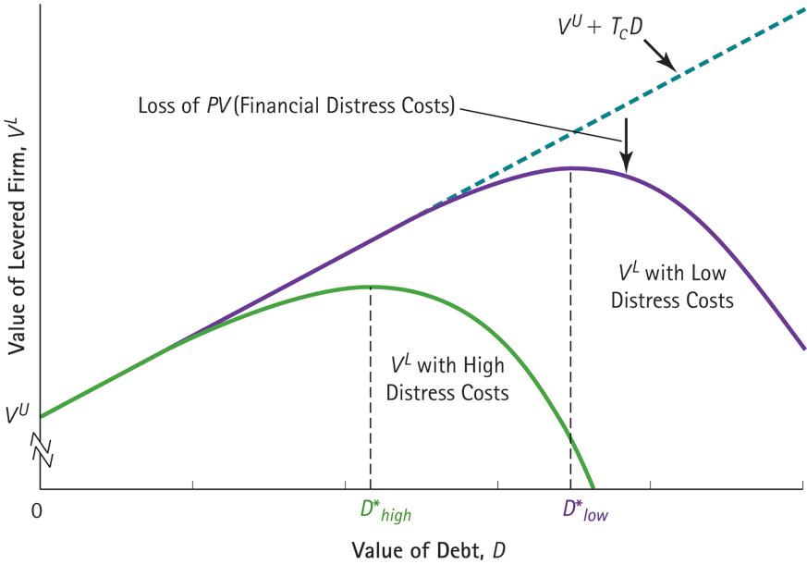
Figure 16.8: Optimal Leverage with Taxes and Financial Distress Costs

Slide 37
Concept check
V_{L} = V_{U} + t * D - PV(Financial distress)
What is V_{L}?
How is V_{L} related to V_{U}?
What does t*D represent?
How might you get a sense of how much the PV of financial distress costs equals?

Slide 38
Example from the lecture
The interest tax shield each year is calculated at the tax rate times interest expense. The overall value of the tax shield would be the present value of all the annual savings.
($ million) | 2014 | 2015 | 2016 | 2017
Interest expense | 20 | 25 | 25 | 30
Interest tax shield (35% × interest expense) | 7 | 8.75 | 8.75 | 10.5

Slide 39
Why (when?) is the debt tax shield = t*D?
Assumptions:
Interest expense this year = r_{D}* D
Tax savings this year = t * r_{D}* D
These savings occur every year (in perpetuity)
r_{D} measures the riskiness of the annual tax shield
If all of these assumptions hold then the PV of the annual tax shield = (t * r_{D}* D) ÷ r_{D} = t * D

Slide 40
Example review questions related to PowerPoint file 15
What information is incorporated into stock prices?
If prices are “efficient”, then what information can we use to predict future price changes?
Even if prices are generally “efficient”…

Slide 41
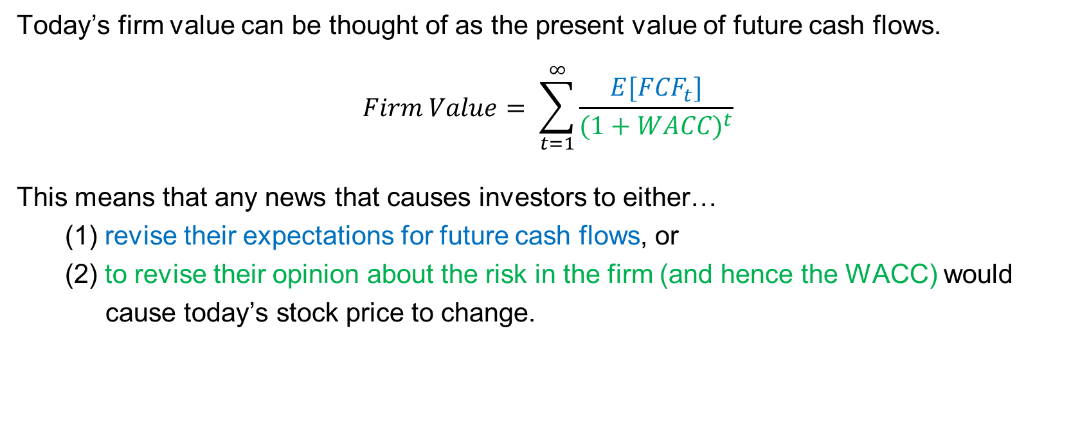
Any information that changes expect future cash flows or investors’ views on risk will change the stock price.
Today’s firm value can be thought of as the present value of future cash flows.
$$Firm Value= \sum_{t=1}^{∞}{\frac{E[{FCF}_{t}]}{{(1+WACC)}^{t}}}$$
This means that any news that causes investors to either…
(1) revise their expectations for future cash flows, or
(2) to revise their opinion about the risk in the firm (and hence the WACC) would
cause today’s stock price to change.

Slide 42
If prices already incorporate all this information, can we predict future returns? If so, what information would we use to do it?
Efficient market hypothesis: Security prices are “efficient” in that they already reflect information.
Important Intuition: This means it is difficult to predict future returns using current information because the current information is already, to some extent, reflected in the current price.

Slide 43
Information sets related to 3 forms of market efficiency (strong, semi-strong, and weak-form efficiency)
All info: private and public
All public info
Past trading
info

Slide 44
Examples of non-efficiency –
“limits to attention”?
Repeated news announcements
Friday announcements
High news days
Market reaction to wrong company (investors mistakenly trade in the wrong stock around a negative event at another firm)
  Herballife in Jan 2013
  Twitter vs Tweeter Oct 2014
  Graco Inc vs Graco Children’s Product Inc
  Nest Labs vs NEST
  Castle Convertible Fund (ticker CVF) drops 32% in 1 day due to Financial Times article about Czech Value Fund abbreviated CVF being investigated for fraud. (See discussion in Journal of Finance “Massively Confused Investors”.)
Other anomalies
  Time of day matters (see next slide)
Notes:
There is empirical evidence that markets react to the same news being announced in different outlets. Friday earnings announcements have smaller immediate market reactions but larger drifts. Earnings announcements that occur on days with many other earnings announcements tend to have smaller immediate market reactions but larger drifts.
Herballife
Jan 28, 2013 – Financial Times article
Herbalife hit as regulator spooks investors
By Dan McCrum in New York
Shares in Herbalife dropped as much as 11 per cent in volatile trading on Monday as regulators said they were taking action against an illegal pyramid scheme that in fact involved a different company.
The move caused jitters among investors in the nutritional supplement company which is under attack from Bill Ackman, the short seller.
Mr Ackman has called Herbalife a pyramid scheme, and made a $1bn bet against the value of its shares. He has also urged regulators to investigate the business model of the direct seller of sports drinks and vitamin pills.
Shares in Herbalife began falling during the morning when investors learnt the Federal Trade Commission was to hold a news conference later in the day to reveal action against a pyramid scheme which at that stage it did not name. They rebounded when it emerged that the commission was targeting Fortune High Tech Marketing, a Kentucky direct seller which is unconnected with Herbalife. Later shares began to fall again.
The FTC said that Fortune High Tech was a pyramid scheme with 100,000 members, 99 per cent of whom did not make money.
Investors have been involved in a fierce debate over Herbalife’s future and the willingness of regulators to examine its business model.
Twitter vs Tweeter
https://abcnews.go.com/Business/tweeter-stock-symbol-changed-prevent-confusion-twitter/story?id=20516990
https://www.theatlantic.com/business/archive/2014/01/investors-buy-worthless-stock-after-confusing-it-successful-company/357081/

Slide 45
Thank You –
I hope you have enjoyed FIN 300.

