Slide 1
BUS 641
Financial Markets and Investments
Review Questions related to:
Portfolio Theory, Diversification, Efficient Frontier

Slide 2
Lecture Preview
  Big-Picture Motivation:
    The previous lecture focused on how diversification affects a portfolio’s expected return and standard deviation. In that lecture we talked about…
    combining risky assets to form new portfolios that trace out the efficient frontier, and
    forming portfolios along the CAL tangent to the frontier.
    These ideas are very important but are not ideas you have likely seen in other classes. In this lecture I plan to use the equations, plots, and terminology from before in a series of review problems to help ensure you understand the material.
  Discussion Outline:
Go through a series of example problems focusing on the equations, plots, ideas, and terminology related to diversification and portfolio construction.

Slide 3
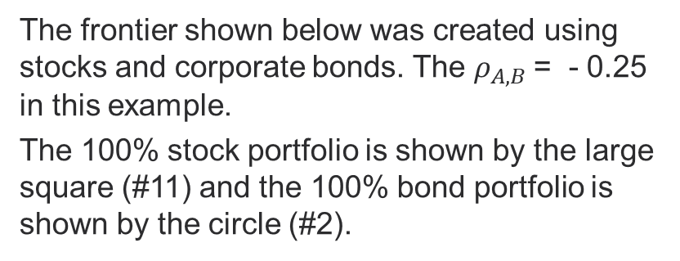
Review Questions (1-8)
The frontier shown below was created using stocks and corporate bonds. The $ρ_{A,B}$= - 0.25 in this example.
The 100% stock portfolio is shown by the large square (#11) and the 100% bond portfolio is shown by the circle (#2).
The plot on this slide shows the investment opportunity set. Assume the risk-free rate is 5%.
What is measured on the x-axis?
What is measured on the y-axis?
Why plot possible portfolios in these 2 dimensions?
Where is the minimum-variance portfolio on the plot?
Where is the efficient frontier?
What does the correlation of -0.25 mean? How does it appear on the chart?
What would the E[r] and σ be (approximately) for the tangency portfolio?
Does the tangency portfolio have a higher/lower Sharpe ratio than the 100% stock portfolio?
Notes:
1 – The x-axis measures the standard deviation (σ) in the portfolio. Standard deviation is a measure of total risk. Zero standard deviation means the portfolio returns have no uncertainty.
2 – The y-axis measures the expected return (E[r]) in the portfolio. Even a risk-free asset typically provides some return.
3 – We make 2 assumptions about investor preferences: (1) All else equal we prefer higher return, (2) All else equal we prefer lower risk. If investors are assumed to care about these 2 dimensions (risk and return) then it makes sense to plot the possible portfolios in these dimensions. All else equal we would want to be as high up and to the left as possible in the plot (i.e. higher return and lower risk), but only certain x,y coordinates (sigma-return coordinates) are possible because we can only create portfolios from existing underlying assets. This point is important because we just “create” a portfolio anywhere on the plot.
4 – The minimum-variance portfolio is on the curve but it is the left-most portfolio on the curve.
5 – The entire curve shows the “investment opportunity set” (i.e., we can create portfolios with the risk-return characteristics of portfolios anywhere along the curve). But given the 2 preferences mentioned above, we would have no interest in creating portfolios along the lower portion of the curve because each of these lower portfolios would be “dominated” by portfolios along the upper portion of the curve. It is for this reason that the upper portion of the curve starting at the minimum variance portfolio and moving up and to the right is known as the “efficient frontier”.
6 – Correlation values range between negative 1 and positive 1. A negative correlation indicates that 2 return series tend to move in oppositive directions over time. A positive correlation indicates that 2 return series tend to move in the same direction over time. A correlation of zero means that the return movements in 2 series move independent of each other over time. A correlation of -.25 suggests that the stock returns and bond returns tend to move in opposite directions over time but that this trend is noisy and not always consistent over time. The curve in the frontier reflects the fact that the 2 assets’ returns are not perfectly correlated.
7 – There is a mathematical approach to solving for the exact tangency portfolio. This question does not ask you to use an exact approach. Using an approximate approach would include a CAL from the risk-free rate (5% in this example) that is drawn tangent to the frontier (see next slide for an illustration). The tangency portfolio appears to have x, y coordinates of (.075 sigma, .08 expected return).
8 – The CAL to the tangency portfolio would have a higher slope (Sharpe ratio = slope of CAL) than the slopes of either of the CALs drawn through either portfolio 11 or portfolio 2.

Slide 4
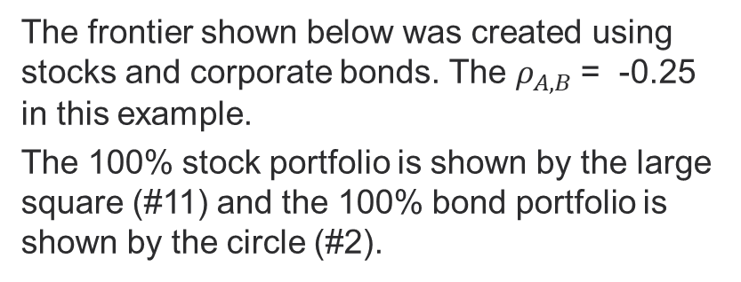
Review Questions (1-8)
The frontier shown below was created using stocks and corporate bonds. The $ρ_{A,B}$= -0.25 in this example.
The 100% stock portfolio is shown by the large square (#11) and the 100% bond portfolio is shown by the circle (#2).
The plot on this slide shows the investment opportunity set. Assume the risk-free rate is 5%.
What is measured on the x-axis?
What is measured on the y-axis?
Why plot possible portfolios in these 2 dimensions?
Where is the minimum-variance portfolio on the plot?
Where is the efficient frontier?
What does the correlation of -0.25 mean? How does it appear on the chart?
What would the E[r] and σ be (approximately) for the tangency portfolio?
Does the tangency portfolio have a higher/lower Sharpe ratio than the 100% stock portfolio?
Notes:
1 – The x-axis measures the standard deviation (σ) in the portfolio. Standard deviation is a measure of total risk. Zero standard deviation means the portfolio returns have no uncertainty.
2 – The y-axis measures the expected return (E[r]) in the portfolio. Even a risk-free asset typically provides some return.
3 – We make 2 assumptions about investor preferences: (1) All else equal we prefer higher return, (2) All else equal we prefer lower risk. If investors are assumed to care about these 2 dimensions (risk and return) then it makes sense to plot the possible portfolios in these dimensions. All else equal we would want to be as high up and to the left as possible in the plot (i.e. higher return and lower risk), but only certain x,y coordinates (sigma-return coordinates) are possible because we can only create portfolios from existing underlying assets. This point is important because we just “create” a portfolio anywhere on the plot.
4 – The minimum-variance portfolio is on the curve but it is the left-most portfolio on the curve.
5 – The entire curve shows the “investment opportunity set” (i.e., we can create portfolios with the risk-return characteristics of portfolios anywhere along the curve). But given the 2 preferences mentioned above, we would have no interest in creating portfolios along the lower portion of the curve because each of these lower portfolios would be “dominated” by portfolios along the upper portion of the curve. It is for this reason that the upper portion of the curve starting at the minimum variance portfolio and moving up and to the right is known as the “efficient frontier”.
6 – Correlation values range between negative 1 and positive 1. A negative correlation indicates that 2 return series tend to move in oppositive directions over time. A positive correlation indicates that 2 return series tend to move in the same direction over time. A correlation of zero means that the return movements in 2 series move independent of each other over time. A correlation of -.25 suggests that the stock returns and bond returns tend to move in opposite directions over time but that this trend is noisy and not always consistent over time. The curve in the frontier reflects the fact that the 2 assets’ returns are not perfectly correlated.
7 – There is a mathematical approach to solving for the exact tangency portfolio. This question does not ask you to use an exact approach. Using an approximate approach would include a CAL from the risk-free rate (5% in this example) that is drawn tangent to the frontier (see next slide for an illustration). The tangency portfolio appears to have x, y coordinates of (.075 sigma, .08 expected return).
8 – The CAL to the tangency portfolio would have a higher slope (Sharpe ratio = slope of CAL) than the slopes of either of the CALs drawn through either portfolio 11 or portfolio 2.

Slide 5
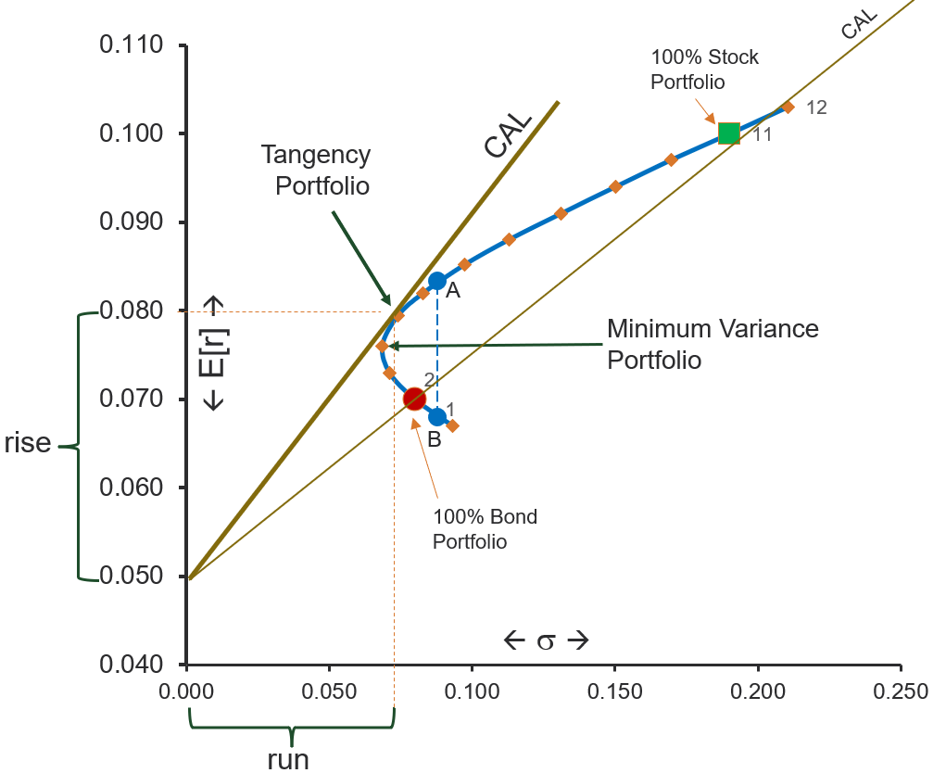
Terminology used in review questions (1-8)
CAL
100% Stock
Portfolio
Investment opportunity set
Frontier
Efficient frontier
Minimum variance portfolio
Risk-free rate
Sigma, standard deviation, σ
Expected return, E[r]
Stocks
Bonds
CAL
Intercept
Sharpe ratio for CAL tangent to frontier = slope = rise / run
= (0.08 - 0.05) / (0.075 – 0)
Dominating portfolios (e.g. A dominates B)
Tangency
Correlation
Tangency
Portfolio
A
← E[r] →
rise
B
100% Bond
Portfolio
← σ →
run

Slide 6
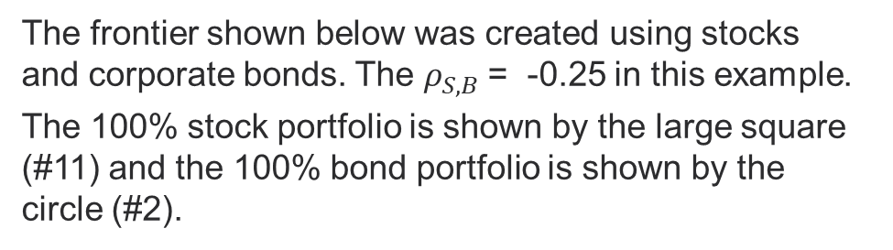
The frontier shown below was created using stocks and corporate bonds. The $ρ_{S,B}$= -0.25 in this example.
The 100% stock portfolio is shown by the large square (#11) and the 100% bond portfolio is shown by the circle (#2).
Review questions (9-11)
Assume:
  E[r₁₁] = 10% (stocks)
  E[r₂] = 7% (corporate bonds)
  r_{f} = 5%
  You have $10,000 to invest.
  Assume the tangency portfolio has E[r_{T}] = 8%.
  3 possible underlying assets to invest in: stocks, corporate bonds, risk-free asset
  Questions:
  Which underlying assets are needed to create portfolio #8?
  Which underlying assets are needed to create the tangency portfolio?
  Why is the tangency portfolio sometimes described as the optimal risky portfolio?
#8
Tangency Portfolio
Notes:
9 – The curve traces out all the possible risky portfolio that can be created by combining the stocks and bonds into a portfolio. The risk-free asset is not used to create any portfolio on the curve. Portfolio #8 could be created by placing some of the $10,000 in stocks and some in bonds. This means the investment weights for stocks and bonds would both be positive and less than 1.
10 – The tangency portfolio is still on the curve. This means that only risky assets are needed to create it. In this case this means stocks and bonds. Students sometimes get confused because the CAL tangent to the frontier is anchored at the risk-free rate but the tangency portfolio is created by combining only risky assets (stocks and bonds here) and not the risk-free asset. The tangency portfolio is the only portfolio on the CAL tangent to the curve that has 0 investment weight in the risk-free asset. The investment weights for stocks and bonds would both be positive and less than 1 when creating the tangency portfolio.
11– You could draw any number of CALs from the risk-free rate to any risky portfolio on the curve. Each CAL would have a different slope (Sharpe Ratio). The Sharpe ratio for the CAL shown in the picture that is tangent to the curve has the highest slope. This means that the “reward-to-risk” ratio is highest for the tangency portfolio compared to all other risky portfolios.

Slide 7

The frontier shown below was created using stocks and corporate bonds. The $ρ_{S,B}$= -0.25 in this example.
The 100% stock portfolio is shown by the large square (#11) and the 100% bond portfolio is shown by the circle (#2).
Review questions (12)
Assume:
  E[r₁₁] = 10% (stocks)
  E[r₂] = 7% (corporate bonds)
  r_{f} = 5%
  You have $10,000 to invest.
  Assume the tangency portfolio has E[r_{T}] = 8%.
  3 possible underlying assets to invest in: stocks, corporate bonds, risk-free asset
  Questions:
  How much money would you need to invest in which assets to create the tangency portfolio?
#8
Tangency Portfolio

Slide 8
The frontier shown below was created using stocks and corporate bonds. The $ρ_{S,B}$= -0.25 in this example.
The 100% stock portfolio is shown by the large square (#11) and the 100% bond portfolio is shown by the circle (#2).
Review question (12) answer
Assume:
  E[r_{S}] = 10%
  E[r_{B}] = 7%
  You have $10,000 to invest.
  Assume the tangency portfolio has E[r_{T}] = 8%.
  Explanation of answer:
  We know the E[r_{T}] = 8% and that the tangency portfolio is created by combining stocks and risky bonds. With this information we can write the equation where the underlying assets in the tangency portfolio are bonds and stocks:
  E[r_{T}] = w_{S}*E[r_{S}] + w_{B}*E[r_{B}] = w_{S}*E[r_{S}] + (1-w_{S}) *E[r_{B}]
  0.08 = w_{S}*.10 + (1-w_{S}) *0.07
  0.08 = 0.10w_{S} + 0.07 - 0.07w_{S} = 0.03w_{S} + 0.07
  0.01 = 0.03w_{S}
  ➔ 1/3 = w_{S} 2/3 = w_{B}
  This means you would invest $3,333.33 in stocks and the rest in bonds to create the tangency portfolio.
#8
Tangency Portfolio
Notes:
The Sharpe ratio which is also known as the “reward-to-risk” ratio is highest for the tangency portfolio compared to all other risky portfolios.

Slide 9

The frontier shown below was created using stocks and corporate bonds. The $ρ_{S,B}$= -0.25 in this example.
The 100% stock portfolio is shown by the large square (#11) and the 100% bond portfolio is shown by the circle (#2).
Review questions (13 - 15)
Assume:
  E[r₁₁] = 10% (stocks)
  E[r₂] = 7% (corporate bonds)
  r_{f} = 5%
  You have $10,000 to invest.
  Assume the tangency portfolio has E[r_{T}] = 8%.
  3 possible underlying assets to invest in: stocks, corporate bonds, risk-free asset
  Questions:
  Which underlying assets are needed to create portfolio #13?
  Which underlying assets are needed to create portfolio #14?
  Which underlying assets are needed to create portfolio #15?
Portfolio #15
#8
Tangency Portfolio
Portfolio #13
Portfolio #14
Notes:
13 – All portfolios on the CAL tangent to the frontier can be created by combining 2 assets: (1) the tangency portfolio and (2) the risk-free asset. Note that this statement treats the tangency portfolio as its own risky asset but as discussed earlier it is itself a combination of other risky assets. If portfolio #13 is located half-way along the CAL between the tangency and the risk-free rate then portfolio #13 would be created with w_{T} = .5 and w_{rf} = .5 meaning that half our money would be invested in the risk-free asset and half in the tangency portfolio.
14 – Portfolio #14 has zero standard deviation meaning it is risk-free. We would need to invest 100% of our money in the risk-free asset to create Portfolio #14. To create portfolio #14 w_{T} = 0 and w_{rf} = 1
15 – Portfolio #15 is on the CAL so it is created by combining 2 assets: (1) the tangency portfolio and (2) the risk-free asset. Because Portfolio #15 is above and to the right of the tangency portfolio we would need to overweight our investment in the tangency portfolio (meaning w_{T}>1 and w_{rf} < 0 ). The only way to do this is to borrow money at the risk free rate (w_{rf} < 0 ) and then to invest both our own money and the borrowed funds in the tangency portfolio (w_{T}>1 )

Slide 10

The frontier shown below was created using stocks and corporate bonds. The $ρ_{S,B}$= -0.25 in this example.
The 100% stock portfolio is shown by the large square (#11) and the 100% bond portfolio is shown by the circle (#2).
Review question (16)
Assume:
  E[r₁₁] = 10% (stocks)
  E[r₂] = 7% (corporate bonds)
  r_{f} = 5%
  You have $10,000 to invest.
  Assume the tangency portfolio has E[r_{T}] = 8%.
  3 possible underlying assets to invest in: stocks, corporate bonds, risk-free asset
  Questions:
  What investment weights are needed to create Portfolio #15 with E[r₁₅] = 10%?
Portfolio #15
#8
Tangency Portfolio

Slide 11

The frontier shown below was created using stocks and corporate bonds. The $ρ_{S,B}$= -0.25 in this example.
The 100% stock portfolio is shown by the large square (#11) and the 100% bond portfolio is shown by the circle (#2).
Review question (16) answer
Assume:
  E[r_{T}] = 8%
  r_{f} = 5%
  You have $10,000 to invest.
  E[r₁₅] = 10%
  Explanation of answer:
  We know the E[r₁₅] = 10% and that this portfolio is created by investing in the tangency portfolio and the risk-free asset. With this information we can write the equation:
  E[r₁₅] = w_{T}* E[r_{T}] + w_{rf}* r_{f} = w_{T}* E[r_{T}] + (1- w_{T}) * r_{f}
  0.10 = w_{T} *0.08 + (1- w_{T}) *0.05
  0.10 = 0.08w_{T} + 0.05 - 0.05w_{T} = 0.03w_{T} + 0.05
  0.05 = 0.03w_{T}
  ➔ 5/3 = w_{T} -2/3 = w_{rf}
  This means you would invest (5/3)*$10,000 in the tangency portfolio. You would need to borrow (2/3)*$10,000 with a 5% interest rate.
Portfolio #15
#8
Tangency Portfolio

Slide 12
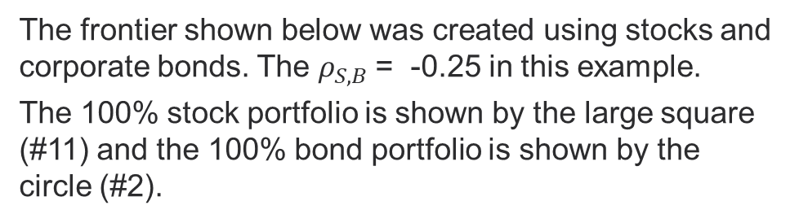
The frontier shown below was created using stocks and corporate bonds. The $ρ_{S,B}$= -0.25 in this example.
The 100% stock portfolio is shown by the large square (#11) and the 100% bond portfolio is shown by the circle (#2).
Review question (17)
Assume:
  E[r₁₁] = 10% (stocks)
  E[r₂] = 7% (corporate bonds)
  r_{f} = 5%
  You have $10,000 to invest.
  Assume the tangency portfolio has E[r_{T}] = 8%.
  3 possible underlying assets to invest in: stocks, corporate bonds, risk-free asset
  Questions:
  If you couldn’t borrow money, but you wanted to create a portfolio with E[r] = 10%, how would you best do this?
Portfolio #15
#8
Tangency Portfolio
Notes:
17 – If you can’t borrow then this means you can’t create any portfolio on the CAL above and to the right of the tangency portfolio. This means that the best portfolio with an expected return of 10% would be #11. You would need to place 100% of your money in stocks to create this portfolio assuming your goal was to have a portfolio with a 10% expected return. W_{S} = 100% W_{B} = 0.

Slide 13
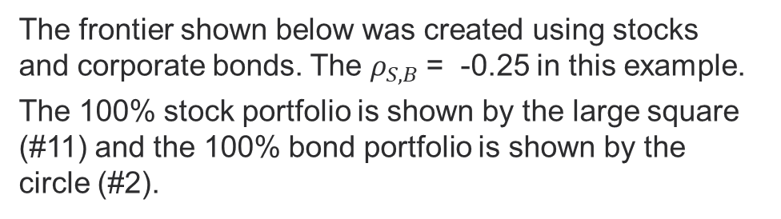
The frontier shown below was created using stocks and corporate bonds. The $ρ_{S,B}$= -0.25 in this example.
The 100% stock portfolio is shown by the large square (#11) and the 100% bond portfolio is shown by the circle (#2).
Review question (18)
Assume:
  E[r₁₁] = 10% (stocks)
  E[r₂] = 7% (corporate bonds)
  r_{f} = 5%
  You have $10,000 to invest.
  Assume the tangency portfolio has E[r_{T}] = 8%.
  3 possible underlying assets to invest in: stocks, corporate bonds, risk-free asset
  Questions:
  Assume you can borrow and lend. Which portfolios dominate #8 on the figure?
#8
Tangency Portfolio
Notes:
18 – When thinking about investments we assume that investors prefer higher returns and lower risk. One portfolio “dominates” another if it is at least as good in one of these dimensions and better in the other. This is shown on the next slide.

Slide 14
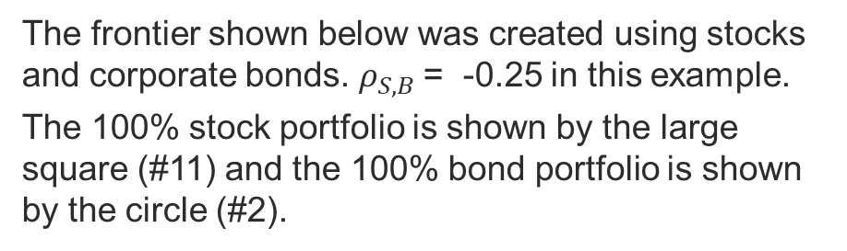
The frontier shown below was created using stocks and corporate bonds. $ρ_{S,B}$= -0.25 in this example.
The 100% stock portfolio is shown by the large square (#11) and the 100% bond portfolio is shown by the circle (#2).
Review question (18) answer
Assume:
  E[r₁₁] = 10% (stocks)
  E[r₂] = 7% (corporate bonds)
  r_{f} = 5%
  You have $10,000 to invest.
  Assume the tangency portfolio has E[r_{T}] = 8%.
  3 possible underlying assets to invest in: stocks, corporate bonds, risk-free asset
  Explanation:
  When thinking about investments we assume that investors prefer higher returns and lower risk. One portfolio “dominates” another if it is at least as good in one of these dimensions and better in the other. Any portfolio along the red segment would dominate #8.
#8
Tangency Portfolio
Notes:
18 – When thinking about investments we assume that investors prefer higher returns and lower risk. One portfolio “dominates” another if it is at least as good in one of these dimensions and better in the other. This is shown on the next slide.

Slide 15
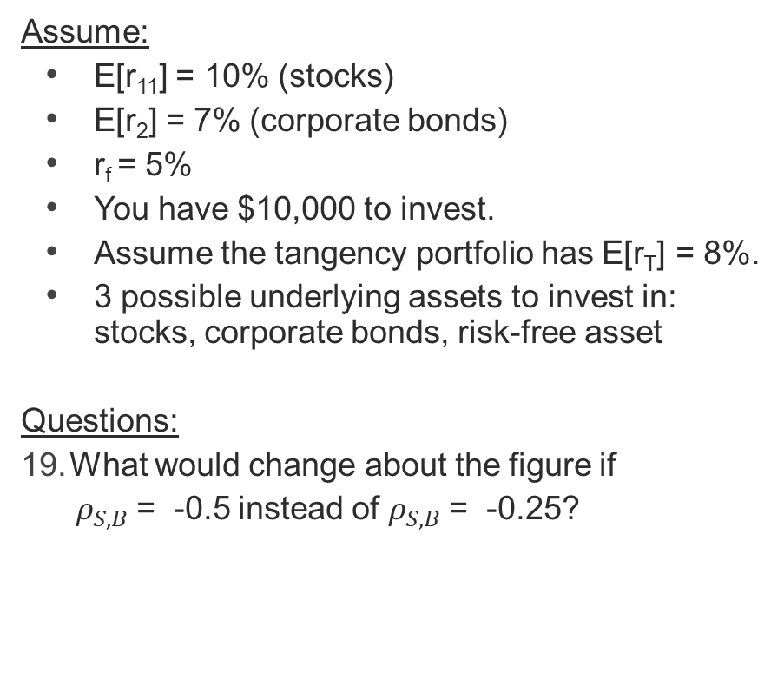

The frontier shown below was created using stocks and corporate bonds. The $ρ_{S,B}$= -0.25 in this example.
The 100% stock portfolio is shown by the large square (#11) and the 100% bond portfolio is shown by the circle (#2).
Review question (19)
Assume:
  E[r₁₁] = 10% (stocks)
  E[r₂] = 7% (corporate bonds)
  r_{f} = 5%
  You have $10,000 to invest.
  Assume the tangency portfolio has E[r_{T}] = 8%.
  3 possible underlying assets to invest in: stocks, corporate bonds, risk-free asset
  Questions:
  What would change about the figure if
  $ρ_{S,B}$= -0.5 instead of $ρ_{S,B}$= -0.25?
#8
Tangency Portfolio
Notes:
19 – The new curve would bulge left more than in the current figure. The CAL tangent to new frontier would have a higher Sharpe ratio than the current CAL. This means that investors would get more reward for each unit of risk.

Slide 16
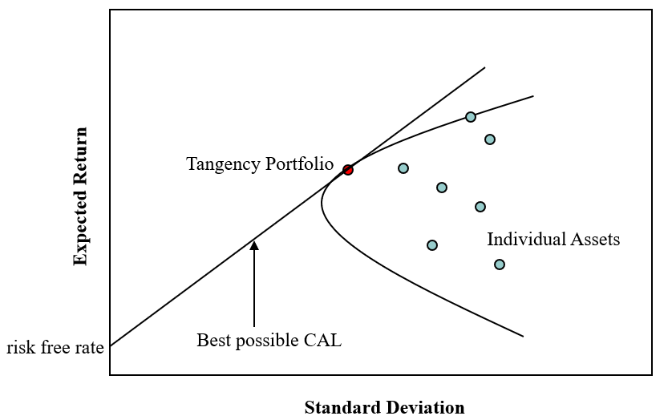
Multiple risky assets
In the earlier review questions we assumed only 2 risky assets (stocks and corporate bonds). What would change if there were many risky assets?
The efficient frontier would still have the same shape as with only 2 risky assets.
The intuition is the same as with the 2 risky asset case meaning that we can trace out the frontier
by combining the various risky assets together
using different investment weights.
It is still the case that all portfolios along the
curve are created by combining only risky assets.
It is still the case that the tangency portfolio is the
optimal risky portfolio.
It is still the case that everyone would create a
final portfolio somewhere on the CAL tangent to
the frontier.
Unlike the 2-risky asset case, we could create
portfolios within the interior of the curve. But
these interior portfolios are not interesting because
they would be dominated by efficient frontier portfolios.

Slide 17
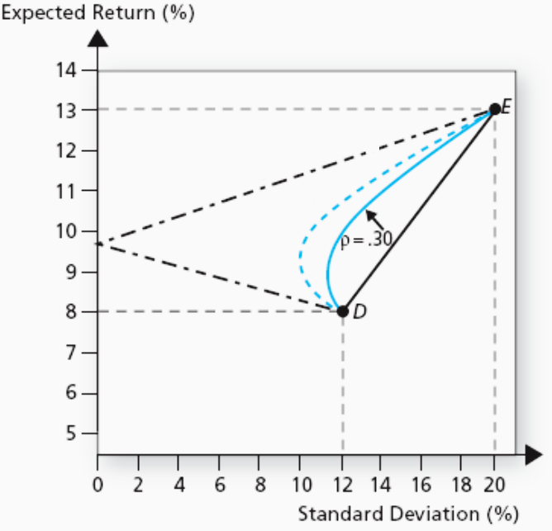

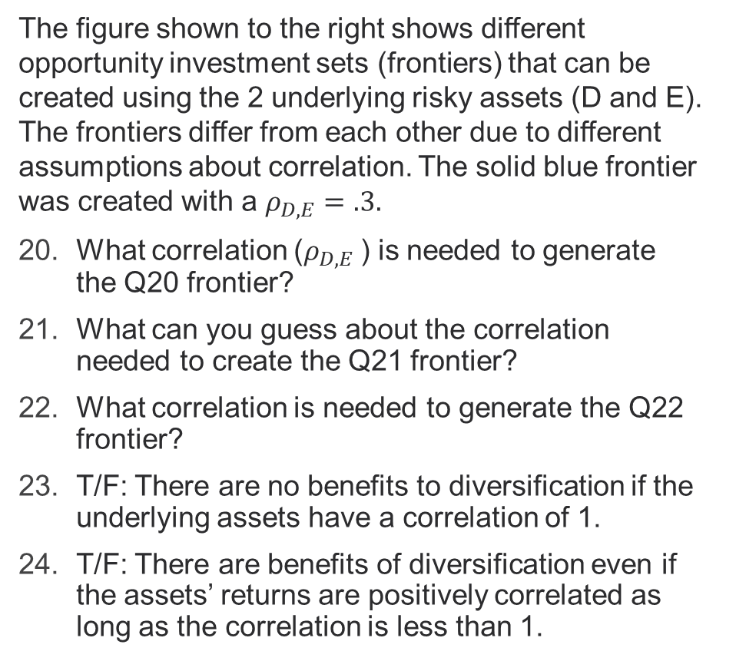


Review Questions (20 - 24)
The figure shown to the right shows different opportunity investment sets (frontiers) that can be created using the 2 underlying risky assets (D and E). The frontiers differ from each other due to different assumptions about correlation. The solid blue frontier was created with a $ρ_{D,E}=.3.$
What correlation ($ρ_{D,E}$) is needed to generate the Q20 frontier?
What can you guess about the correlation needed to create the Q21 frontier?
What correlation is needed to generate the Q22 frontier?
T/F: There are no benefits to diversification if the underlying assets have a correlation of 1.
T/F: There are benefits of diversification even if the assets’ returns are positively correlated as long as the correlation is less than 1.
(Q20) $ρ_{D,E}=?$
(Q21) $ρ_{D,E}=?$
(Q22) $ρ_{D,E}=?$
Notes:
This is a figure from your textbook.
20 – $ρ_{D,E}=−1$ is needed to generate the “<“ frontier.
21 – $ρ_{D,E}$ must be less than .30 to generate the Q21 frontier. We know the correlation must be less than .30 because the Q21 frontier is to the left of the $ρ_{D,E}=.30$ frontier. It is unclear from the picture itself whether this means that $ρ_{D,E}$ would be small and positive or small and negative (or zero).
22 – $ρ_{D,E}=1$ is needed to generate the “/” frontier.
23 – True. The “benefits of diversification” are related to the curvature of the frontier. If the frontier is a straight line then there are no benefits of diversification.
24 – True. There are benefits of diversification for any correlation that is less than 1 and larger than -1. Sometimes students get confused and think that only negative correlation helps. This is not true. There is some “canceling out” of return movements as long as there is not perfect correlation. This means that even a correlation of 0 provides some benefits of diversification.

Slide 18
Summary of approach for optimal asset allocation in the case of many risky assets:
(1) Identify the most efficient risk-return possibilities. This amounts to tracing out the efficient frontier using a mathematical approach.
(2) Identify the tangency portfolio on the efficient frontier where the CAL from the risk-free rate is tangent to the efficient frontier.
(3) Choose the proportion of your wealth to place in the optimal risky portfolio (the tangency portfolio) and in the risk-free asset.
Important intuition: Steps 1 and 2 above are a mathematical exercise. Personal risk preferences don’t affect steps 1 and 2 but they do affect step 3.
This is the separation property discussed in Section 7.4 of the textbook.

Slide 19
For next time…
Review the concepts and terminology in the review questions discussed in today’s lecture and check the schedule for upcoming assignments.

Slide 20
Thank You

