Slide 1
Market efficiency, information in stock prices
FIN 300

Slide 2
Discussion Topics
What information is incorporated in stock prices?
Can we predict return movements? Introduce the random walk nature of stock price changes and discuss market efficiency.
Briefly discuss several “market anomalies”, “bubbles and intrinsic values”, and stock analysts and fund managers in the context of efficient markets.

Slide 3
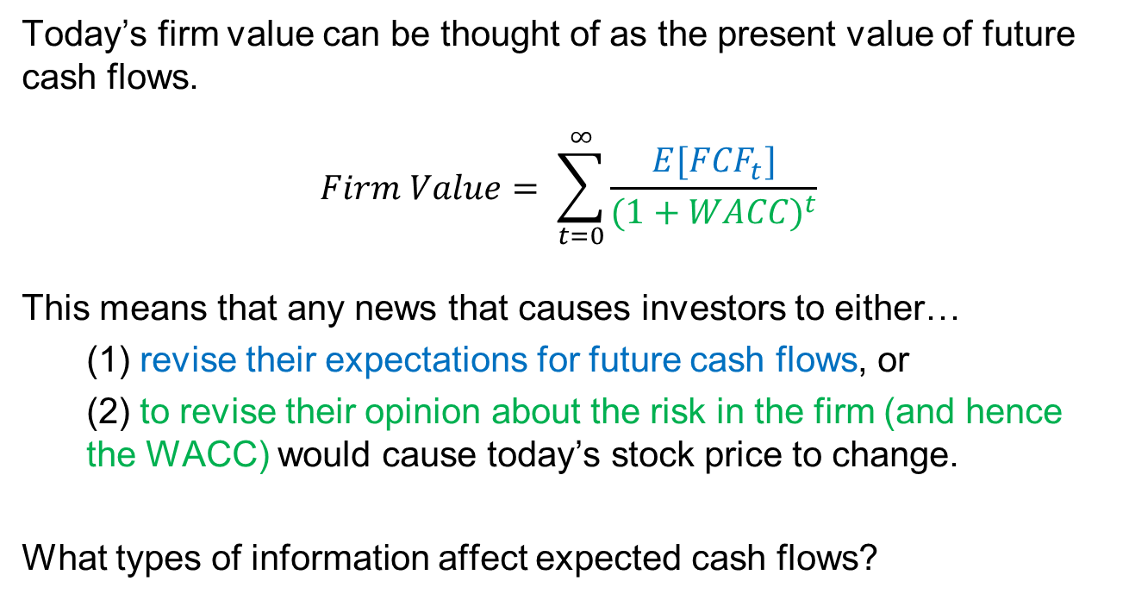
Recall from earlier lectures…
Today’s firm value can be thought of as the present value of future cash flows.
$$Firm Value= \sum_{t=0}^{∞}{\frac{E[{FCF}_{t}]}{{(1+WACC)}^{t}}}$$
This means that any news that causes investors to either…
(1) revise their expectations for future cash flows, or
(2) to revise their opinion about the risk in the firm (and hence the WACC) would cause today’s stock price to change.
What types of information affect expected cash flows?

Slide 4
Recall from earlier lectures…
What types of information affect expected cash flows? ➔Management changes
March 14, 2005: Autozone announces a long-time employee of the firm will be the next CEO. The stock drops more than 12% (S&P500 up .5%).
Aug 20, 2012: Best Buy announces that Hubert Joly, an outsider, is the new CEO. The stock price drops more than 8% (S&P500 up .19%).
July 25th, 2012: Symentec announces a new CEO. The stock price rises 13% (S&P500 down .04%).

Slide 5
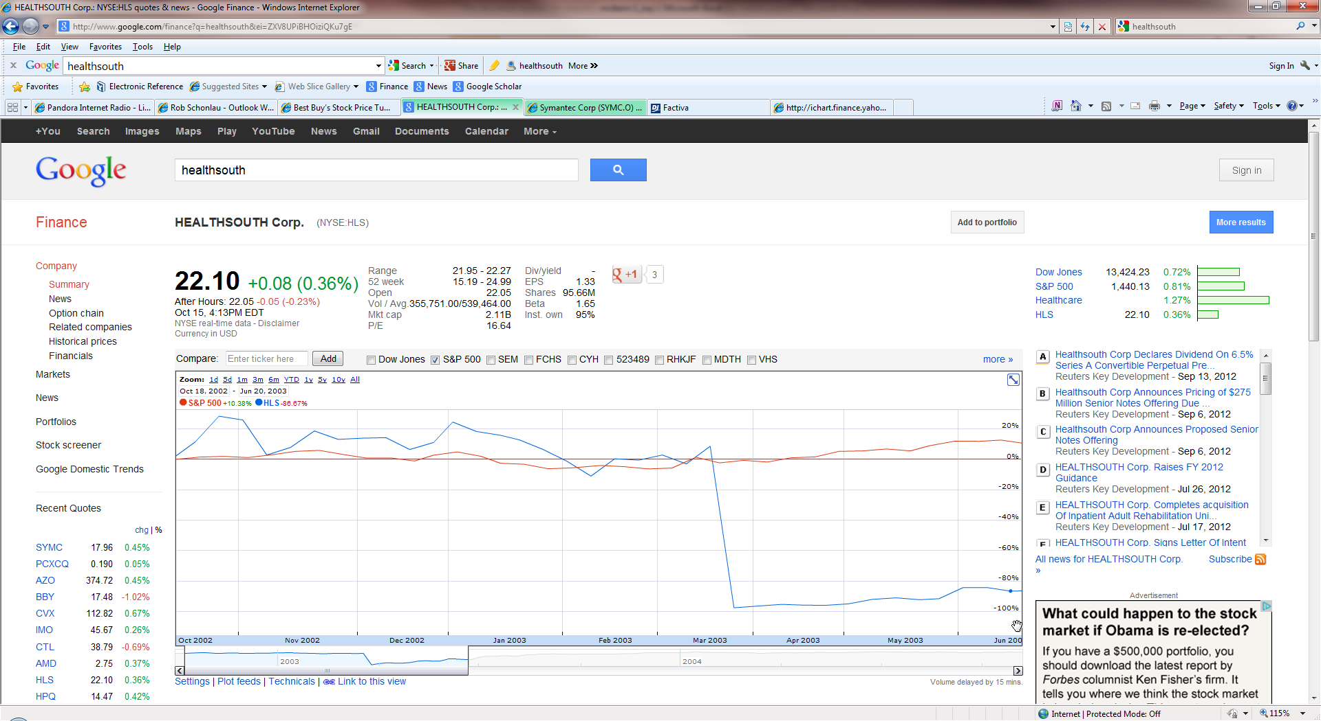
Recall from earlier lectures…
What types of news affects prices?
➔fraud
March 2003: $1.3 billion fraud announced at Healthsouth. The stock price drops from around $20 to 40 cents.

Slide 6
Recall from earlier lectures…
What types of news affects prices?
➔M&A
Jan 27, 2011: Verizon announced its intent to acquire Terremark for $19.00 per share. Terremark’s share price jumps from $14.05 to $18.92 per share.
  Two questions…
On the same day that Terremark went from $14.05 a share to 18.92 a share, Savvis’ (a competitor of Terremark) share price jumped from $26.57 to $30.26. Why?
Notes:
Both Terremark and Savvis provide IT and cloud services.
CenturyLink bought Savvis for $3.7 billion dollars in July of 2011
Two questions:
Why did Terremark’s price jump at the time of the announcement a month before the anticipated acquisition?
Why $18.92?

Slide 7
Cumulative returns around M&A announcement

Slide 8
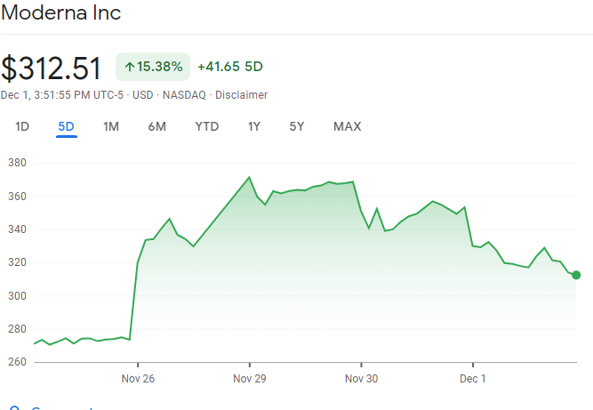
The FDA authorized Moderna’s COVID-19 booster for all adults on Nov 26. Moderna’s MCAP increased around $24B on that day.
Notes:
This figure shows how Moderna's stock price jumped when the FDA authorized Moderna's COVID 19 booster for all adults. It jumped on this day because investors expectations of future cash flows increased when they heard the announcement.

Slide 9
Recall from earlier lectures…
What types of news affects prices?
Today’s price already incorporates the market’s current expectations about likely CEO actions, mergers, earnings, fraud, future products, future sales, the impact of regulatory approvals etc…

Slide 10
If prices already incorporate all this information, can we predict future returns? If so, what information would we use to do it?
Efficient market hypothesis: Security prices are “efficient” in that they already reflect information.
Questions:
Which information is already in the price? Public? Private?
How quickly does information affect the price?
Important Intuition: This means it is difficult to predict future returns using current information because the current information is already, to some extent, reflected in the current price.

Slide 11
Why does it matter whether security prices reflect information?
Implications for business and corporate finance managers (feedback for managers)
Implications for the value in active management, security analysis, and other investments (value added?)
Implications for personal investing based on events.

Slide 12
Random walk and the EMH
Changes in stock prices are often described as a “random walk with drift”. In other words, stock price changes are random and not predictable.
Seemingly randomly evolving stock prices are the consequence of intelligent investors competing from moment-to-moment to discover and invest using new information.
Based on history, the expected change tends to be positive, but the day-to-day change varies randomly around the trend.
For an explanation of what a “random walk” is in this context watch the 90 second introductory video at: https://www.investopedia.com/terms/r/randomwalktheory.asp

Slide 13
“Random walk” with positive trend
Security
Prices
Time
Notes:
This figure shows an example of what a "random walk" with positive trend might look like. The point here is that this looks very similar to what we often see in the stock market.

Slide 14
Market efficiency
If markets are efficient then tomorrow’s price change is independent of what happened to today’s prices. In other words stock prices follow a “random walk”.
To see this, consider a simple bet where you start with $100 and each time you flip the coin…
  if heads you win 5%,
  if tails you lose 4%
After 2 flips what are your possible winnings?
  HH - (100)(1.05)(1.05) = $110.25
  HT – (100)(1.05)(.96) = $100.80
  TH – (100)(.96)(1.05) = $100.80
  TT - (100)(.96)(.96) = $92.16
Notes:
Why would future price changes be “random”? If the information flow is random then price changes will be random.

Slide 15
Comparison of coin flip game versus actual stock market movements.
Which of the above lines is from the coin flip? From the market?

Slide 16
Why would future price changes be “random”?
If (1) prices change from moment to moment to reflect new information, and (2) new information becomes available in unpredictable ways over time, then price changes will appear to be random over time even though price levels are meaningful .

Slide 17
EMH and competition
Why do prices react to news (new information)?
Once information becomes available, market participants analyze it looking for profit opportunities.
Competition assures prices reflect information ← this is the mechanism that leads to efficient prices.
How long does it take for the market to analyze and trade on new information?
Notes:
Research suggests that it takes just a few minutes for new information to be priced.

Slide 18
How does the idea of efficient markets relate to…?
Fundamental analysis
Technical analysis
Information signals (i.e. insider transactions, share repurchases, earnings surprises, etc.)
“Common sense” strategies for identifying firms that are undervalued in some way. For example: relative to peers, 52-week lows, P/E ratios, dividends, size, etc.
People like Warren Buffet

Slide 19
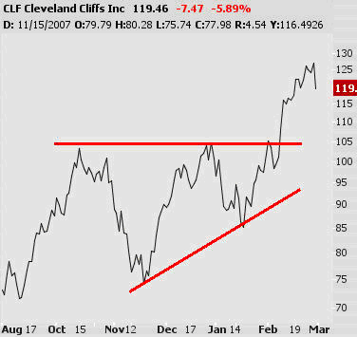
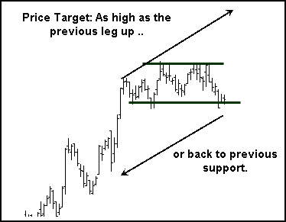
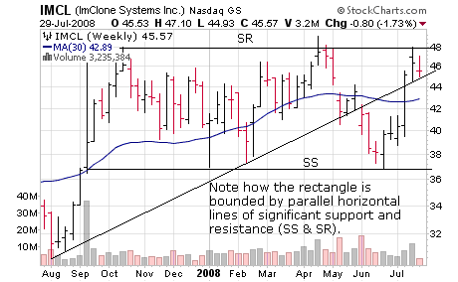
Example technical analysis charts from investopedia.com

Slide 20
Different types of information
When we say, “markets are efficient”, which information is already in the price?
    Past information?
    Past and current public information?
    Private information?
To facilitate the discussion, we will talk about 3 forms of market efficiency.

Slide 21
“Weak form” efficiency
Weak form market efficiency: all information from the history of past prices and trading is currently incorporated into today’s price.

Slide 22
“Semi-strong” form efficiency
Semi-strong form market efficiency: all publicly available information is incorporated into today’s prices.
Evidence for semi-strong form efficiency has mostly come from studies of the stock market’s reaction to various announcements:
  Announcements of dividend changes
  Earnings
  Mergers and acquisition activity

Slide 23
“Strong form” efficiency
(note that no-one thinks markets are strong form efficient)
Strong form market efficiency: all information is incorporated into today’s prices.
  (Evidence Against) Investors with inside information (like politicians) appear to earn abnormally good returns.

Slide 24
Summary of efficiency discussion
The stock market is not completely strong form efficient. This conclusion follows because we can see prices change when announcements are made.
I personally would describe the market as generally being almost semi-strong efficient but with occasional obvious (at least in hindsight) examples of misvaluation.
Notes:
The fact that prices change with announcements show that the private information was not completely priced before the announcement.

Slide 25
Related: Politicians and market efficiency
Why do senators’ portfolios significantly outperform the average investors’ portfolio?
( “Abnormal Returns from the Common Stock Investments of the US Senate” by Ziobrowski, Cheng, Boyd, and Ziobrowski in JFQA).
Also see “Lawmakers’ committee assignments and industry investment overlap” (2010 Washingtonpost)
Notes:
http://www.washingtonpost.com/politics/lawmakers-committee-assignments-and-industry-investments-overlap/2012/01/28/gIQAUn8YYQ_story.html
http://www.washingtonpost.com/wp-srv/special/politics/congressional_holdings/
https://www.theguardian.com/us-news/2019/sep/19/us-senators-investments-conflict-of-interest
Is it surprising that the market is not strong form efficient?
Why can insider traders make money?

Slide 26
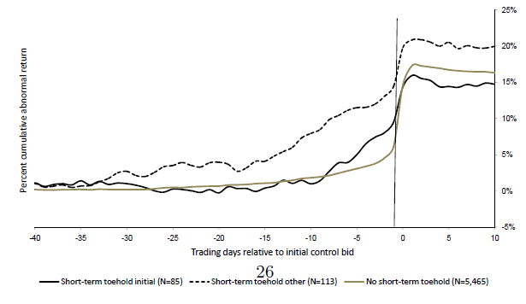
Related: Price increases of target firms’ stock prices before the acquisition announcement…
This chart is from “Markup pricing revisited” by Betton, Eckbo, and Thorburn
based 5,656 mergers from 1980-2002

Slide 27
Examples of non-efficiency –
“limits to attention”?
Repeated news announcements
Friday announcements
High news days
Market reaction to wrong company (investors mistakenly trade in the wrong stock around a negative event at another firm)
  Herballife in Jan 2013
  Twitter vs Tweeter Oct 2014
  Graco Inc vs Graco Children’s Product Inc
  Nest Labs vs NEST
  Castle Convertible Fund (ticker CVF) drops 32% in 1 day due to Financial Times article about Czech Value Fund abbreviated CVF being investigated for fraud. (See discussion in Journal of Finance “Massively Confused Investors”.)
Other anomalies
  Time of day matters (see next slide)
Notes:
There is empirical evidence that markets react to the same news being announced in different outlets. Friday earnings announcements have smaller immediate market reactions but larger drifts. Earnings announcements that occur on days with many other earnings announcements tend to have smaller immediate market reactions but larger drifts.
Herballife
Jan 28, 2013 – Financial Times article
Herbalife hit as regulator spooks investors
By Dan McCrum in New York
Shares in Herbalife dropped as much as 11 per cent in volatile trading on Monday as regulators said they were taking action against an illegal pyramid scheme that in fact involved a different company.
The move caused jitters among investors in the nutritional supplement company which is under attack from Bill Ackman, the short seller.
Mr Ackman has called Herbalife a pyramid scheme, and made a $1bn bet against the value of its shares. He has also urged regulators to investigate the business model of the direct seller of sports drinks and vitamin pills.
Shares in Herbalife began falling during the morning when investors learnt the Federal Trade Commission was to hold a news conference later in the day to reveal action against a pyramid scheme which at that stage it did not name. They rebounded when it emerged that the commission was targeting Fortune High Tech Marketing, a Kentucky direct seller which is unconnected with Herbalife. Later shares began to fall again.
The FTC said that Fortune High Tech was a pyramid scheme with 100,000 members, 99 per cent of whom did not make money.
Investors have been involved in a fierce debate over Herbalife’s future and the willingness of regulators to examine its business model.
Twitter vs Tweeter
https://abcnews.go.com/Business/tweeter-stock-symbol-changed-prevent-confusion-twitter/story?id=20516990
https://www.theatlantic.com/business/archive/2014/01/investors-buy-worthless-stock-after-confusing-it-successful-company/357081/

Slide 28
Are markets efficient?
Yes to some extent but changing companies, markets, technology, and asymmetrical information allow analysts and portfolio managers to add value.
Markets are not so efficient that there are not valuable opportunities for some lucky/sophisticated investors. Active traders would argue that markets are not efficient.
Notes:
Joke: Two financial economists were walking down the street and see a $20 bill. One stoops to pick it up but the other says “Don’t bother. If the bill were real someone else would have already picked it up.”

Slide 29
Review terminology for your personal study
(some of these terms are in the assigned reading)
You should be able to give a 1-2 sentence description, or formula, of each of these terms.
Efficient market hypothesis Insider information Weak form Semi strong form Strong form | Fundamental analysis Technical analysis Random walk

